Slide 1
Develop a novel research idea
Consider feasibility: preliminary work
Contact your department or college URA
Identify a funding agency
Review agency guidelines
cl
Prepare budget
Submit for narrative review
(recommended)
Develop proposal narratives
Respond to compliance requirements
Design checklists & timelines
The Pre-Award Proposal Path
Complete proposal form set
Collect supporting documents
Assemble complete application package
Prepare USF Internal Form
Submit to Sponsored Research
Notes:
University of South Florida, Office of Research & Scholarship, College of Arts & Sciences, 08-06-23

Slide 2
1
2
3
4
5
6
Develop a Novel/Original
Research Idea
4. Answer important questions that
demonstrate the impact of your
research
2. Fill a gap in research or take
scholarship in a new direction
5. Show feasibility of idea/research
plan and PI/team expertise
3. Align idea(s) with the funding
agency’s needs
6. Integrate broader contexts
Notes:
University of South Florida, Office of Research & Scholarship, College of Arts & Sciences, 08-06-23

Slide 3
Consider Feasibility: Preliminary Work
What pilot/preliminary data supports your proposed project?
What credibility/relevant experience/expertise do you and your team bring to the project?
In your proposal, address your project’s proof-of-concept and those preliminary steps that demonstrate your relevant experience and the feasibility of your proposed research.
Feasibility
What type of infrastructure (facility resources) supports your project?
How does your previous research, publications, teaching, conference presentations, etc. support your credibility and research?
Notes:
University of South Florida, Office of Research & Scholarship, College of Arts & Sciences, 08-06-23

Slide 4
Contact your Department or College URA
Your Unit Research Administrator (URA) can assist you with many of the pre-award processes:
Helping to review the RFP Guidelines
Configuring the project budget
01
02
01
Initiating the internal form
Checking for and completing compliance forms
03
04
02
03
Assembling the application package and reviewing the completed package
Submitting the completed application package to the designated Sponsored Research Administrator(SRA)
04
05
06
05
06
Notes:
University of South Florida, Office of Research & Scholarship, College of Arts & Sciences, 08-06-23

Slide 5
Identify a Funding Agency
While your impactful research should drive your grant initiatives, identifying an appropriate funding source and determining your eligibility is critical to finding a good fit.
Review the Funding Search Tools to identify available funding sources. (click on image to go to funding site)
Notes:
University of South Florida, Office of Research & Scholarship, College of Arts & Sciences, 08-06-23

Slide 6
1. PI and institution eligibility
2. Project deadlines
1
2
3. Project’s fit with agency’s
goals/objectives and timelines
4. Proposal format and structure
(e.g., page limits, margins, font type and
size, etc.)
3
4
5. Supporting materials required
6. Budget limitations and requirements
5
6
Review Agency Guidelines
Once a funding agency is identified, the guidelines should be reviewed carefully.
Notes:
University of South Florida, Office of Research & Scholarship, College of Arts & Sciences, 08-06-23

Slide 7
`
Design Checklists & Timelines
What proposal pieces will you need to provide?
What letters of support will you need?
Who will be engaged as partners, collaborators, subcontractors?
What does your preliminary budget look like?
What funding registration and/or internal forms need to be completed?
What will you require in terms of data management, post-doc mentoring, digital data research, and intellectual property plans?
How complete is your CV and Biosketch?
Notes:
University of South Florida, Office of Research & Scholarship, College of Arts & Sciences, 08-06-23

Slide 8
Respond to Compliance Documents
Researchers must complete the USF Internal Form and Interest Application as well as any funding agency registration.
Researchers must also fully disclose any financial interests that would reasonable appear to directly affect the sponsored project by completing the USF Financial Relationship Disclosure Form (Conflict of Interest).
USF Internal Form
USF Conflict of Interest Form
In your proposal, address your project’s proof-of-concept and those preliminary steps that demonstrate your relevant experience and the feasibility of your proposed research. Specific compliance forms & applications to applicable boards/committees are required if the proposal involves any of the following:
Human subjects, live animals as subjects; Recombinant DNA/RNA; Infectious agents, biological toxins, human blood or body fluids; Narcotics/controlled substances; Radioactive materials, hazardous materials; Scuba activities.
Forms & Applications
Research Integrity & Compliance Programs
See the below research integrity & compliance programs for more information: Biosafety, Office of Export Controls, Institutional Review Board (IRB), Scientific Diving Program, Radiation Safety Office.
Notes:
University of South Florida, Office of Research & Scholarship, College of Arts & Sciences, 08-06-23

Slide 9
Develop Proposal Narrative
Typical Sections in the proposal narrative include the following:
Project Summary
Project Description
Project Personnel
Budget justification
Notes:
University of South Florida, Office of Research & Scholarship, College of Arts & Sciences, 08-06-23

Slide 10
Receive a Proposal Narrative Review
Dr. Dianne Donnelly
ddonnelly@usf.edu
READABILITY: Suggestions for optimizing readability & guiding reviewers
CLARITY: Recommendations for ways to improve clarity and concision and to add visual concrete language
EMPHASIS: Suggestions on ways to guide reviewers & highlight important information
COHESION: Suggestions for presenting a well-structured, visually-inviting, & forward-moving proposal
CONNECTIONS: Guidance on ways to make stronger connections to project aims throughout the proposal
SUBSTANCE: Comments that point to areas that could use more evidence and/or details
CONFIDENCE: Direction on strategies for presenting a more active, confident, engaging proposal
GUIDELINES: Input on how to better align proposal with agency’s mission and follow guidelines
Notes:
University of South Florida, Office of Research & Scholarship, College of Arts & Sciences, 08-06-23

Slide 11
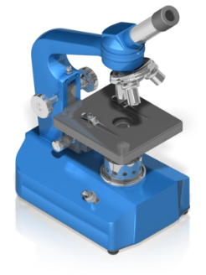
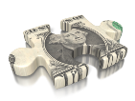
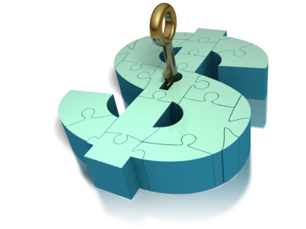
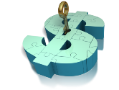
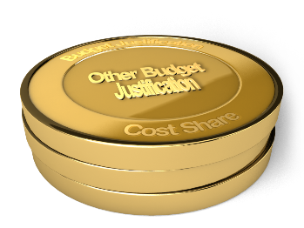
Salaries & Wages
Fringe Benefits
Equipment
Travel
PREPARE BUDGET
Participant Support
Subcontracts
Other Budget Justification
Other
Direct
Costs
Indirect
Costs
Questions?
Notes:
University of South Florida, Office of Research & Scholarship, College of Arts & Sciences, 08-06-23

Slide 12
Slide#1 – do not delete this text
Complete Proposal Form Set
Complete all documents associated with the proposal forms package (i.e., SF424)
Notes:
University of South Florida, Office of Research & Scholarship, College of Arts & Sciences, 08-06-23

Slide 13
Institutional
information
Subcontract
information
Letters of
collaboration
Collect Supporting Documents
References
Bio-sketches
for all senior
personnel
Description of
facilities
Current &
pending support
Notes:
University of South Florida, Office of Research & Scholarship, College of Arts & Sciences, 08-06-23

Slide 14
Final Proposal Steps
Additional proposal steps include the following:
Assemble complete application package
Prepare the USF Internal Form
Submit to Sponsored Research
Perform final checks on the proposal to be sure that all necessary components and documents that support the proposal form set are included in the application package.
Prior to submission, the PI must submit a USF internal form. This form is part of the approval process at the department, college, and university level.
Once the proposal is finalized and approved by all administrators, the PI submits the proposal to the assigned Sponsored Research Administrator (SRA), who is authorized to submit the proposal to the funding agency. The PI receives confirmation once the proposal is submitted.
Notes:
University of South Florida, Office of Research & Scholarship, College of Arts & Sciences, 08-06-23

