Slide 1
USF Biennial Regional Impact Report
Vol. 2
July 1, 2023

Slide 2
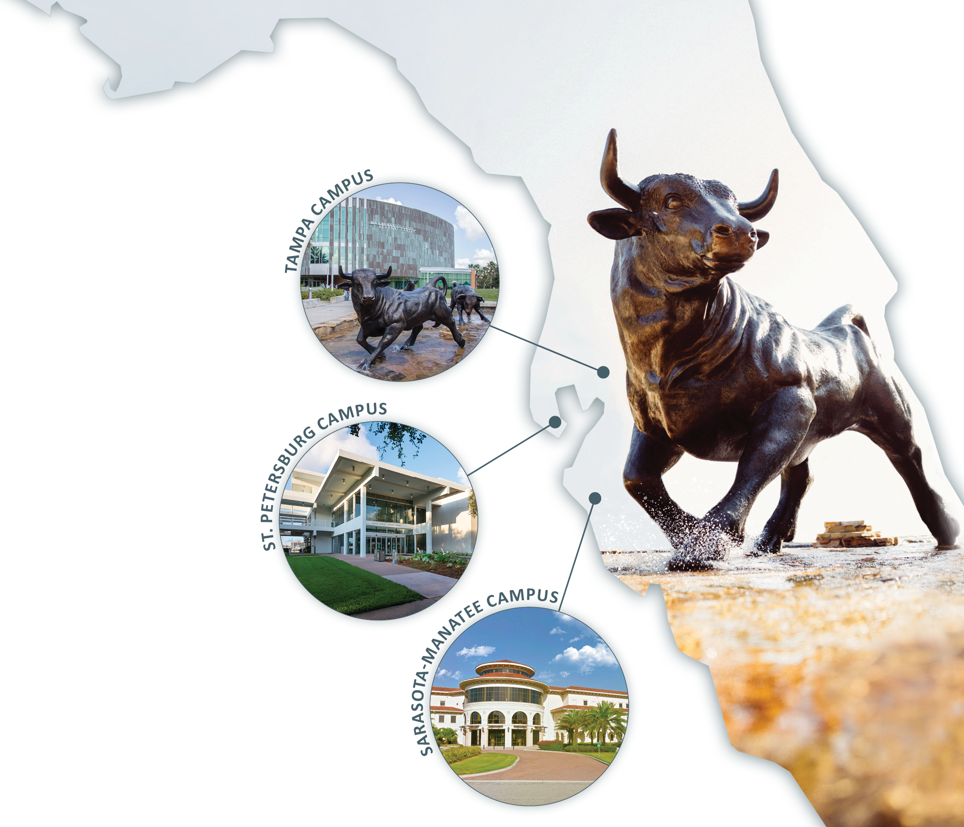
Consolidation
Section 1004.335(5)(c),
Florida Statutes
(c) Requires that, on or before July 1, 2020, the entirety of the University of South Florida, including all campuses and other component units of the university, operate under a single institutional accreditation from the SACSCOC.

Slide 3
Section 1004.341(5), Florida Statutes
The Board of Trustees must publish on its website a biennial regional impact report, beginning July 1, 2021, which details the specific increased investments in university programs located in Pinellas, Manatee, and Sarasota Counties.
The report shall include, at a minimum, trend information related to access to new degree programs for students in those counties, any changes in student enrollment and outcomes at each campus located in those counties, increased research conducted and research infrastructure added in those counties, and any fixed capital outlay projects or property acquisitions planned or completed in those counties.

Slide 4
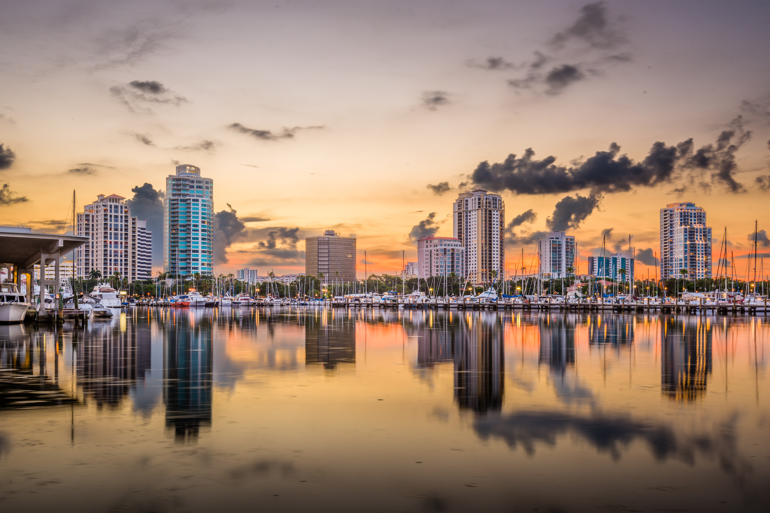
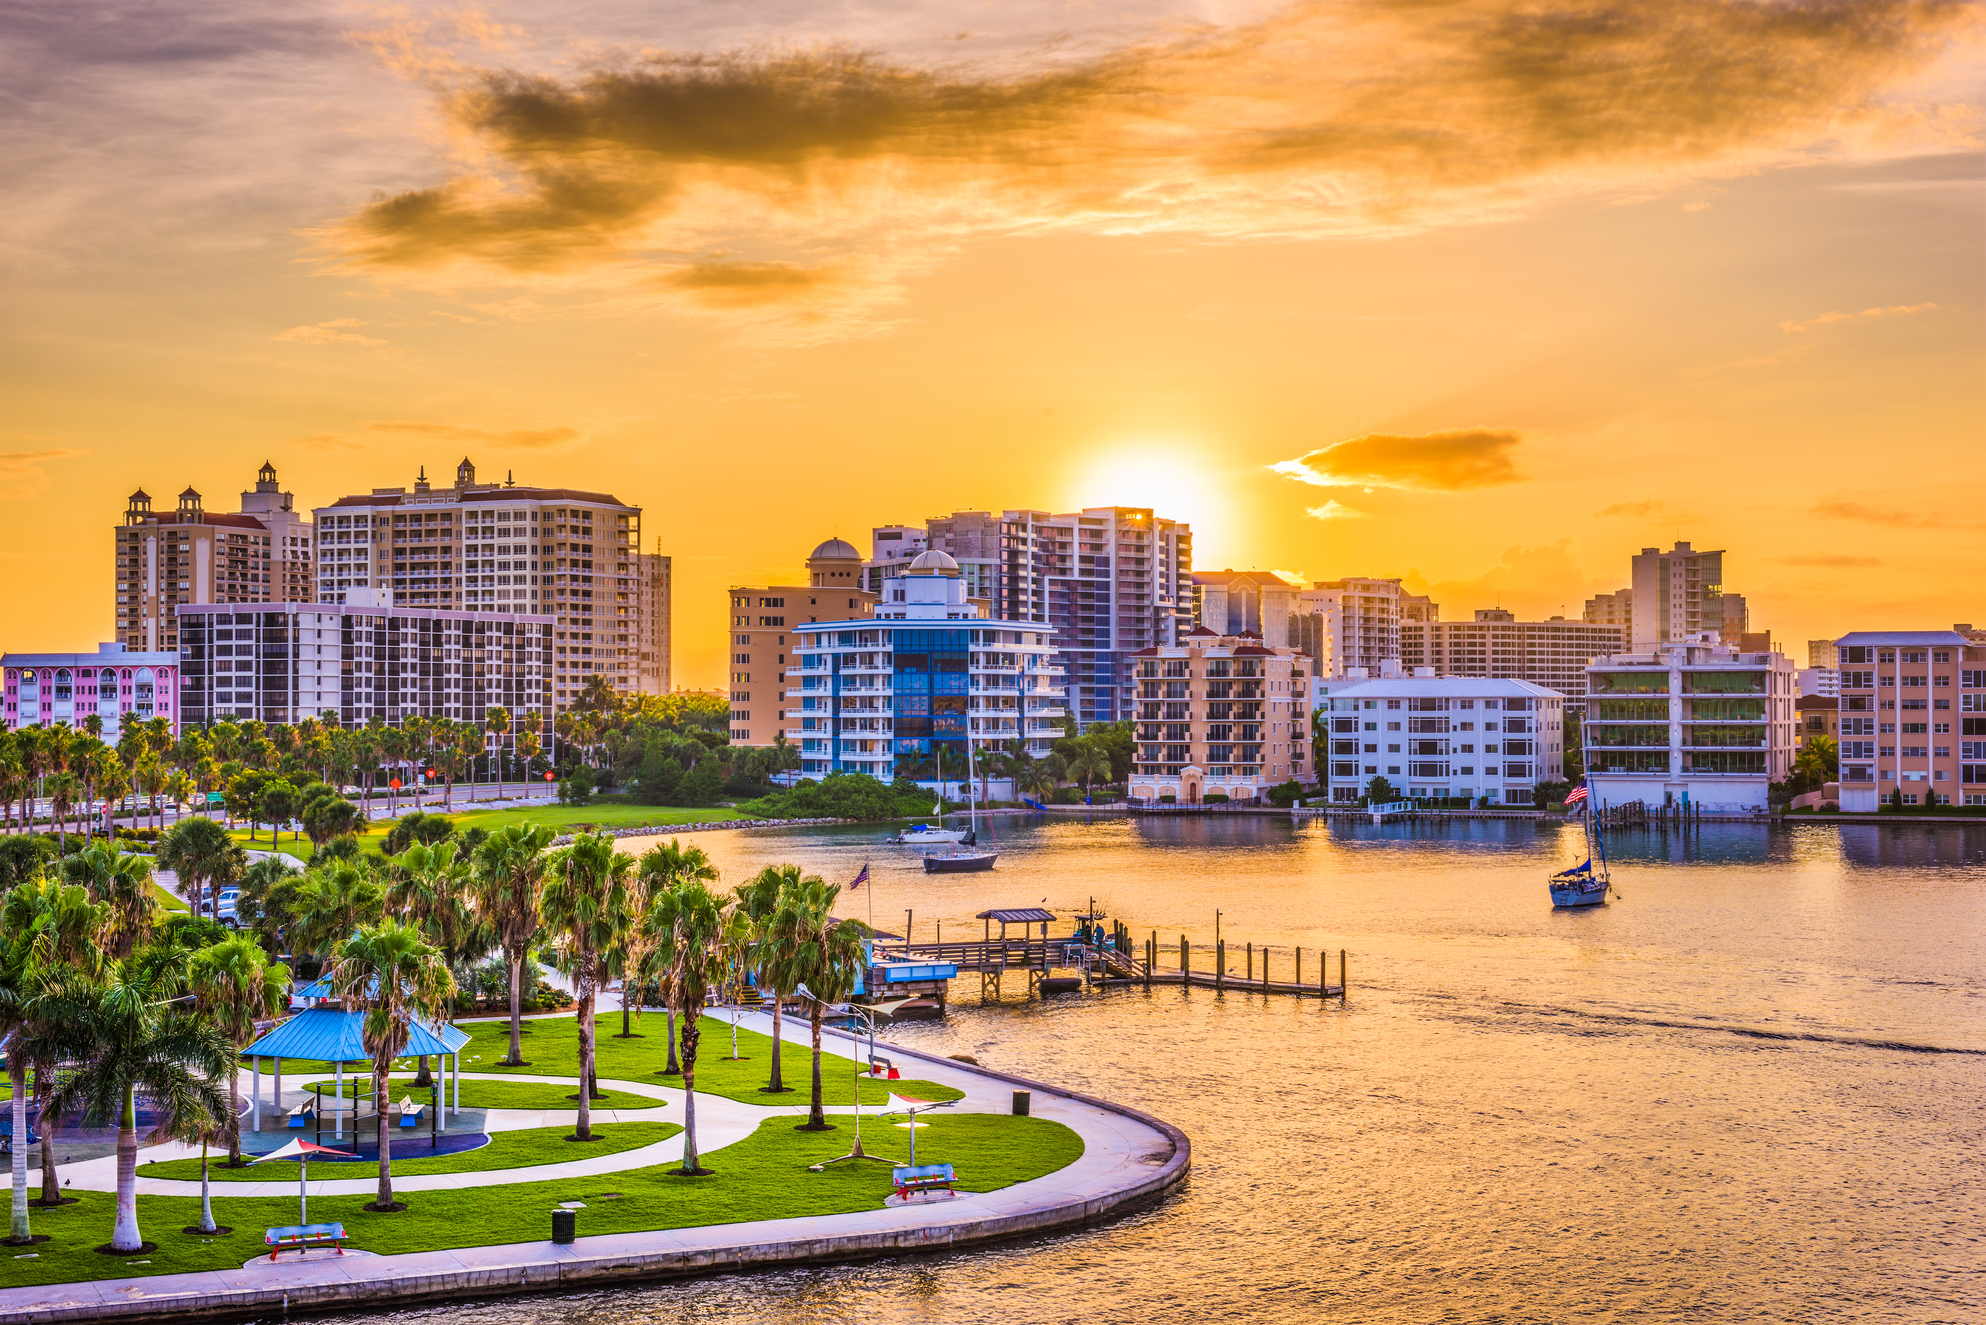
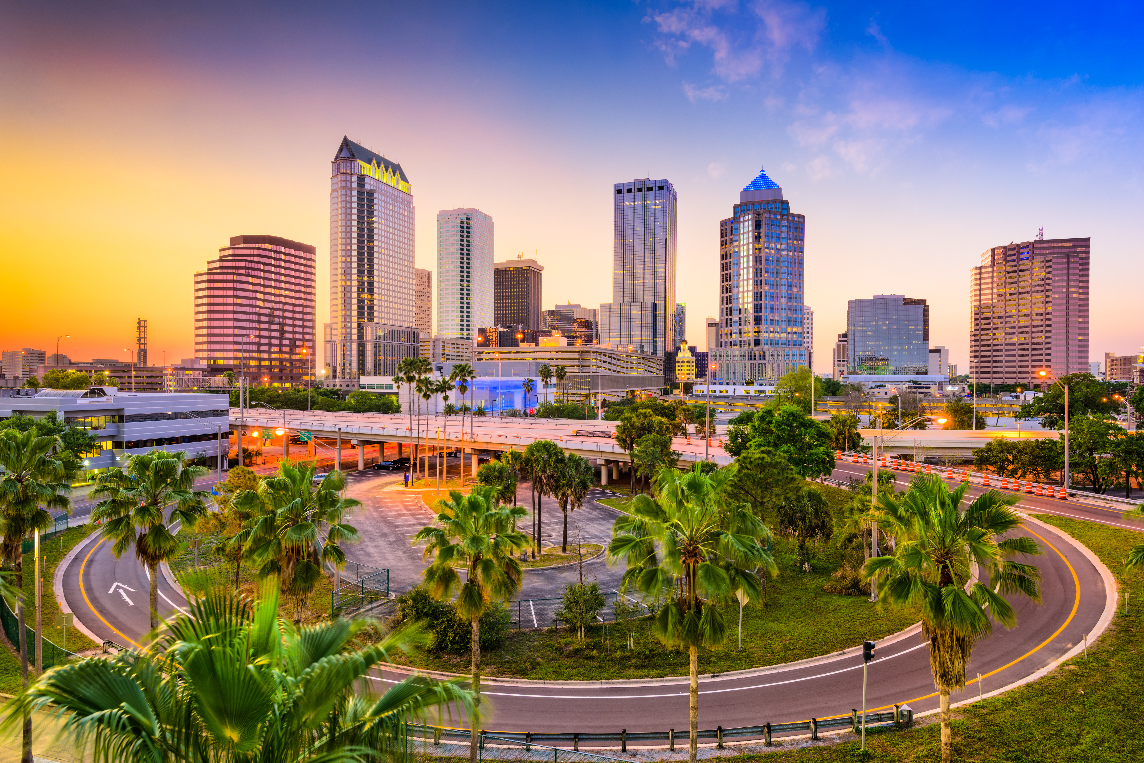
July 1, 2020
The three separately accredited institutions of the former University of South Florida System (USF, USFSP, and USFSM) began operating as a single, consolidated institution: One USF — the University of South Florida with campuses in Tampa, St. Petersburg, and Sarasota-Manatee.

Slide 5
Institutional Recognitions

Slide 6
Institutional Recognitions
One USF has received two of the premier recognitions that higher education institutions can earn:
In 2023, the University was invited to join the American Association of Universities (AAU), an invitation-only group of the 71 leading research institutions in the United States and Canada. AAU considers numerous factors for membership, such as research activity, faculty excellence and the quality of educational programs, as well as graduation rates and number of lower-income students who receive financial aid through the federal Pell Grant program.
In 2018, the University was designated a Preeminent State Research University by the Florida Board of Governors, highlighting its commitment to and achievement in student success, graduation rates, student retention rates, research expenditures, and the number of patents awarded.
Membership in the AAU and Preeminent designation benefit students, faculty, and staff from all three campuses across One USF as the University continues to grow its research profile and increase its economic impact while preparing graduates for the workforce or continued educational opportunities.

Slide 7

Institutional Recognitions
The University’s commitment to student and institutional success is further emphasized by the distinction of being the only university to place in the top four of Performance-Based Funding every year since the program was implemented in 2014.
The University is propelled forward by its 2022–2027 Strategic Plan: In Pursuit of Excellence, which provides a blueprint for the continuation of USF’s ascent in national and global visibility and the strengthening of our regional, national, and global communities.
Read more about the Strategic Plan here.

Slide 8
St. Petersburg & Sarasota-Manatee
Branch Campus Student Opportunities

Slide 9
Student Benefits
Multi-campus college
programs & scholarships
Multi-campus college
internship opportunities
Multi-campus college
expansion of support services, such as advising, tutoring, etc.
Research student scholarships, such as Sarasota-Manatee
Trail Blazer
Students continue to enjoy the immediate benefits of consolidation including:
St. Petersburg and Sarasota-Manatee students may now apply for Judy Genshaft Honors College admission
Expansion of financial aid and college scholarships
Expansion of undergraduate research opportunities
Expansion of course offerings on any campus
Expansion of multi-campus college degrees
Expansion of USF Health college programs, such as nursing, public health, etc.
Expansion of JGHC and USF World travel grants and scholarships

Slide 10
St. Petersburg & Sarasota-Manatee
Branch Campus Faculty Opportunities

Slide 11
Supporting Faculty Success
Benefits
New Faculty Orientation
In-person and virtual workshops and information sessions to integrate new faculty across all three campuses
Enhanced Peer Communities and Network
Equitable access to events for faculty on all campuses
Expanded professional development opportunities
Increased mentoring opportunities for early-career faculty on all campuses
New faculty hires for expanded programs
Increased opportunities for research collaboration with faculty across all campuses
Increased faculty training opportunities and resources
In-person and virtual workshops/ information sessions to integrate new faculty across all three campuses
Enhanced interdisciplinary research grants and faculty awards

Slide 12
Admissions & Enrollment

Slide 13
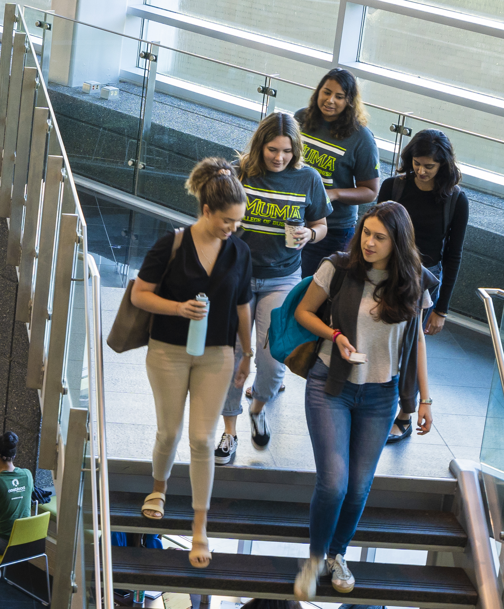
One USF Applications, Admits, Deposits: Summer/Fall 2022
100,762
UG/GR Applications Processed
44,799
UG/GR Students Admitted
23.2% increase from 2021
19.0% increase from 2021
FTIC | Deposits | Class size
2021 | 6727 | 6300
2022 | 7890 | 6879

Slide 14
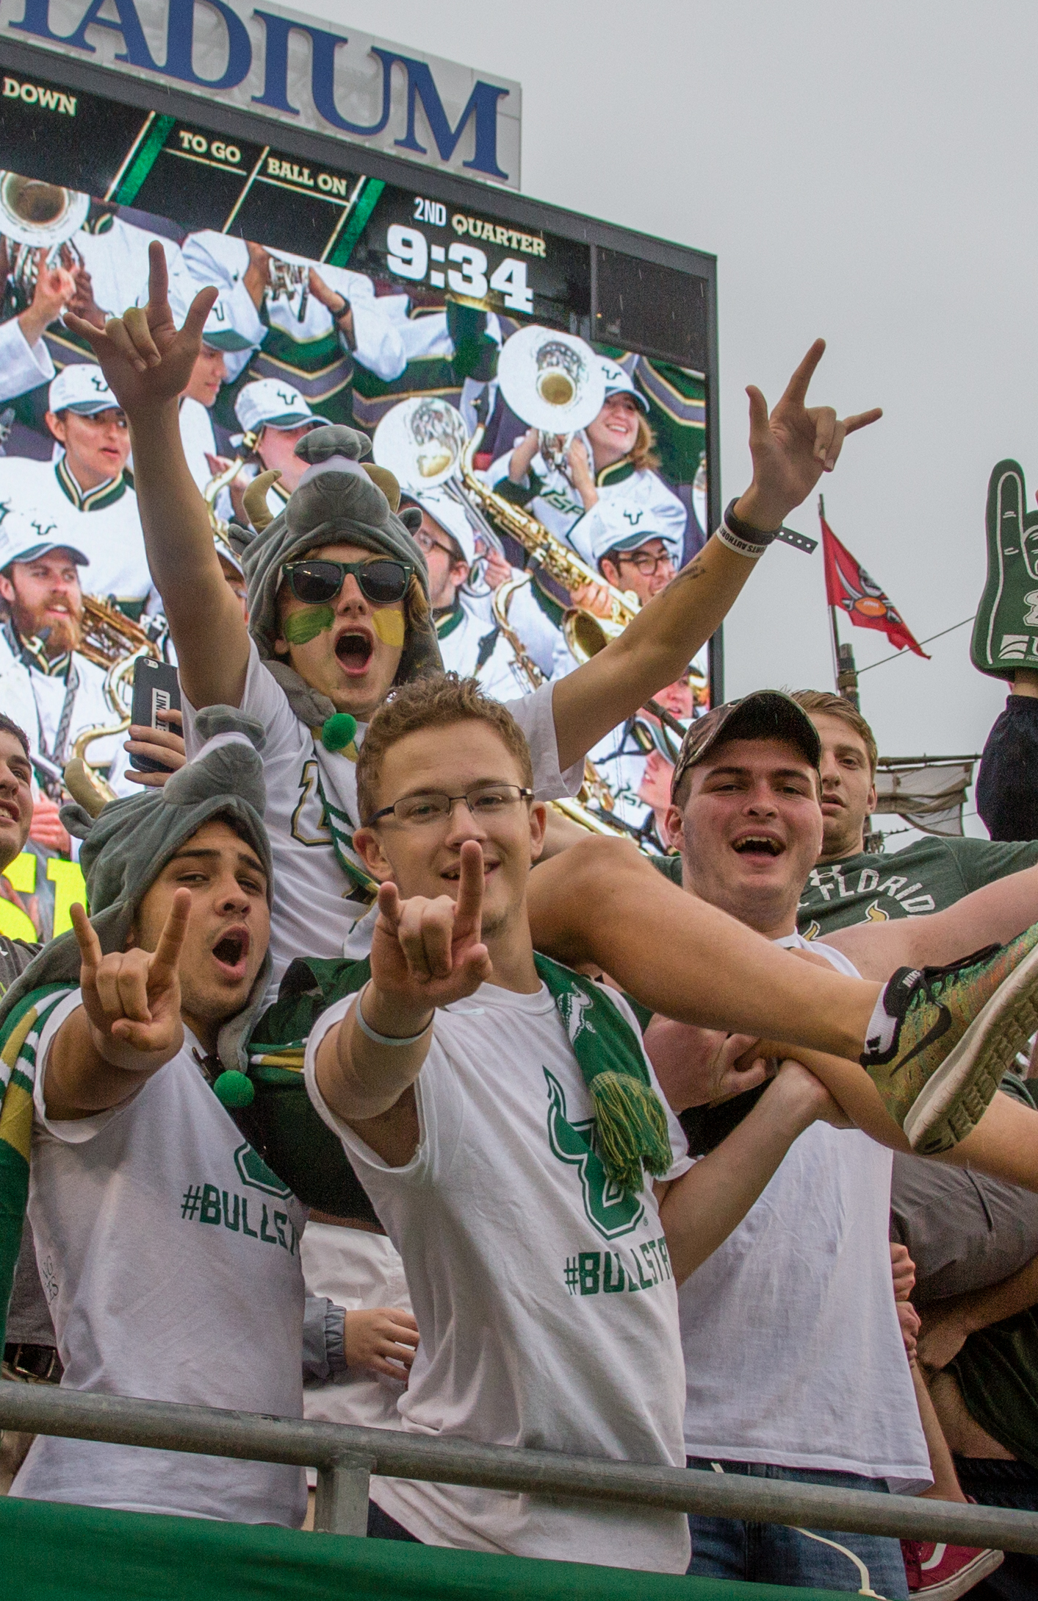
FTIC Fall Student Profiles
CAMPUS | Class of 2017 |  | Class of 2021 |  | Class of 2022 | 2021
Tampa campus | HS GPA | 4.12 | HS GPA | 4.19 | HS GPA | 4.2
 | SAT | 1280 | SAT | 1299 | SAT | 1310
St. Petersburg campus | HS GPA | 3.82 | HS GPA | 4.15 | HS GPA | 4.25
 | SAT | 1209 | SAT | 1277 | SAT | 1297
Sarasota- Manatee campus | HS GPA | 3.87 | HS GPA | 4.32 | HS GPA | 4.17
 | SAT | 1191 | SAT | 1274 | SAT | 1299
One USF | HS GPA | 4.07 | HS GPA | 4.18 | HS GPA | 4.21
 | SAT | 1266 | SAT | 1297 | SAT | 1309

Slide 15
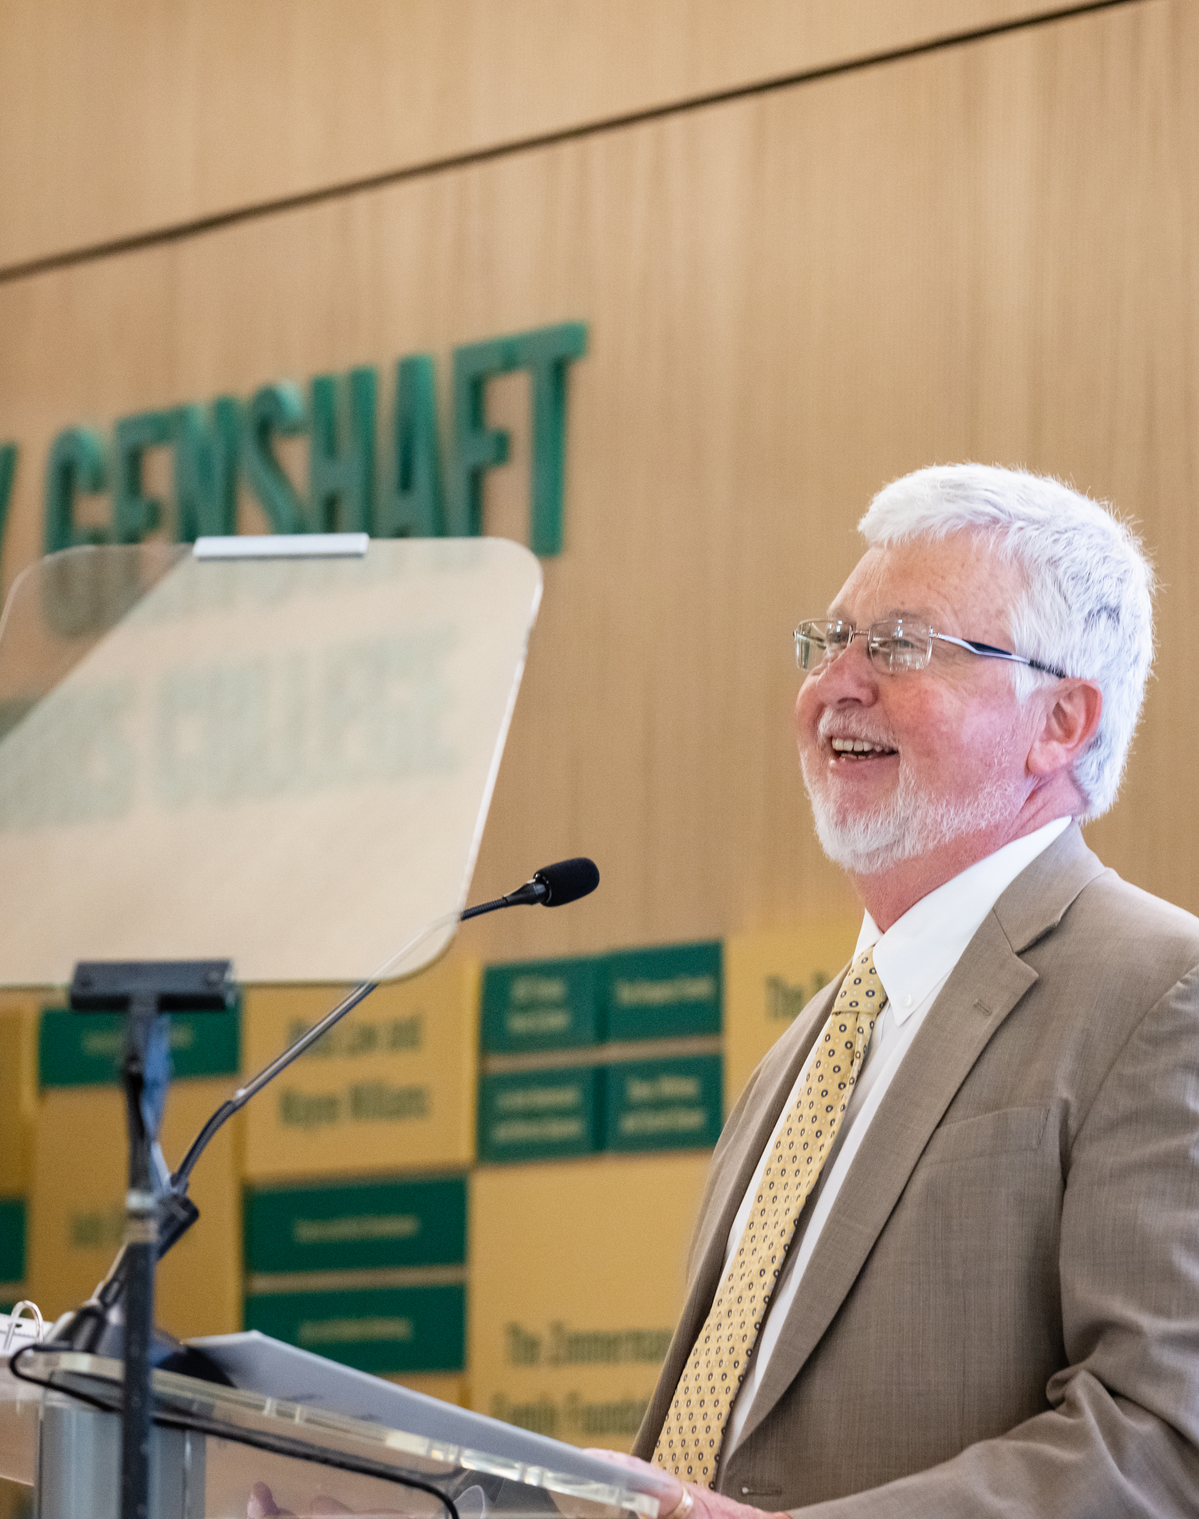
Judy Genshaft Honors College
Academic Student Profile
HS GPA | 4.37
SAT | 1390
ACT | 31
93rd percentile nationally
95th percentile nationally
FTIC Enrollments
 | 2021 | 2022
Tampa campus | 674 | 640
St. Petersburg campus | 69 | 48
Sarasota-Manatee campus | 11 | 8
One USF | 754 | 696
Declines seen due to implementation of all-application admissions process and more selective admissions.
National Merit Scholars
 | 2021 | 2022
Tampa campus | 50 | 66
St. Petersburg campus | 4 | 5
One USF | 54 | 71

Slide 16
Headcount of Students Served by Each Campus
 | 2018-2019 | 2019-2020 | 2020-2021 | 2021-2022 | 2022-2023
Tampa campus* | 53,863 | 54,382 | 56,483 | 56,461 | 56,089
St. Petersburg campus* | 10,504 | 10,524 | 13,752 | 15,636 | 15,163
Sarasota-Manatee campus* | 6,797 | 7,937 | 11,569 | 14,171 | 14,488
Total number of unique students at One USF | 60,280 | 60,600 | 59,959 | 58,933 | 58,020
Source: Office of Decision Support
*Campus data reflects annual unduplicated headcount of all students taking at least one course funded at each campus, i.e., a student could be enrolled in classes at more than one campus during the same semester
Increases in St. Petersburg campus’ and Sarasota-Manatee campus’ headcounts are due to ease of students’ ability to seamlessly take classes across campuses as a result of consolidation and creation of One USF

Slide 17
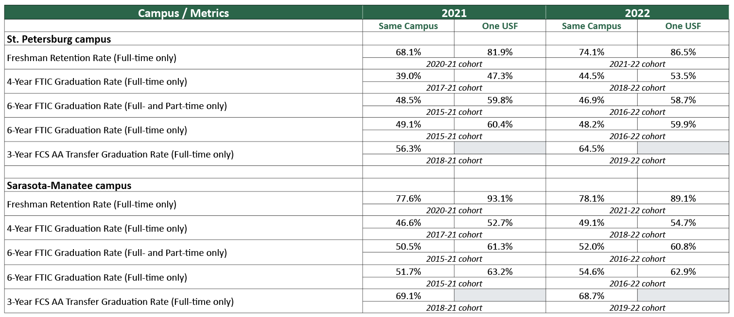
Student Success Rates
Source: Office of Decision Support
“One USF” data reflect students beginning on the campus and retained or graduating from any USF campus

Slide 18
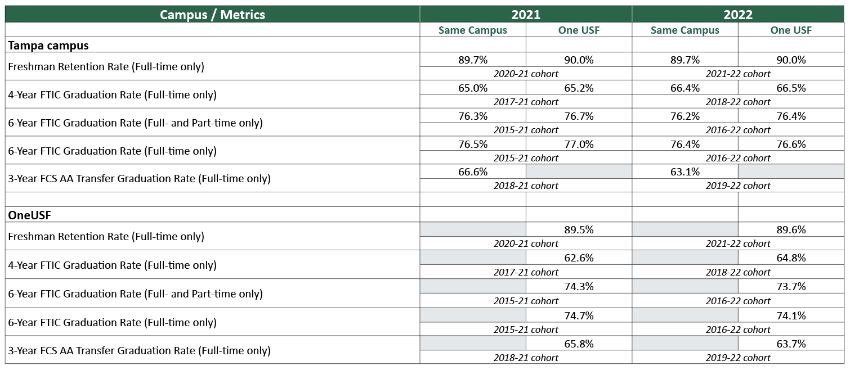
Student Success Rates
Source: Office of Decision Support
“One USF” data reflect students beginning on the campus and retained or graduating from any USF campus

Slide 19
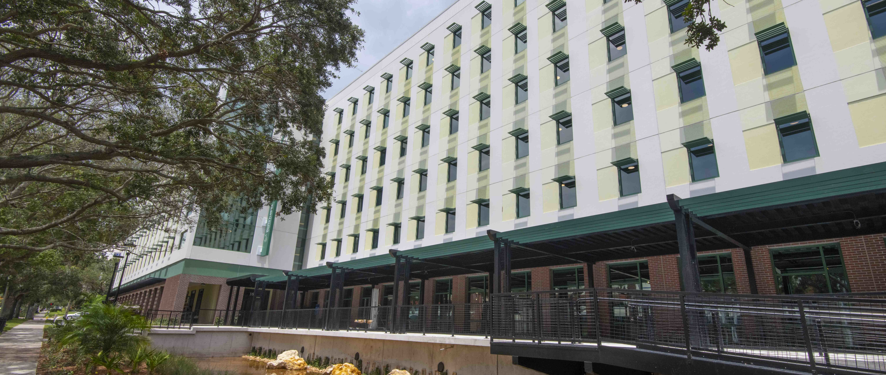
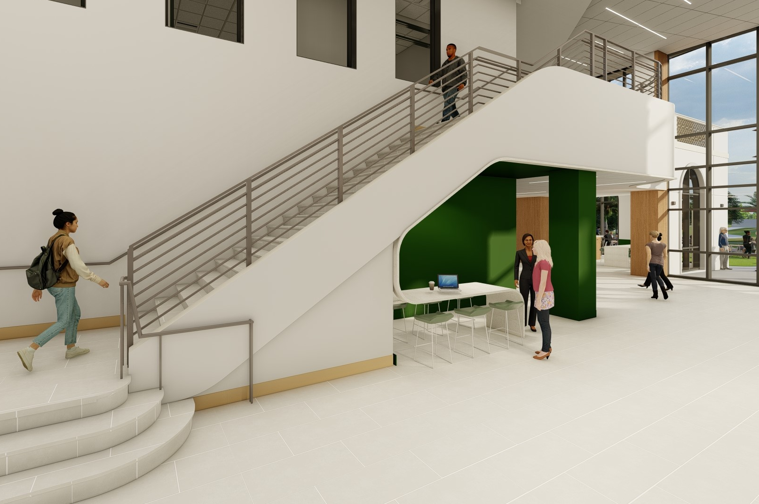
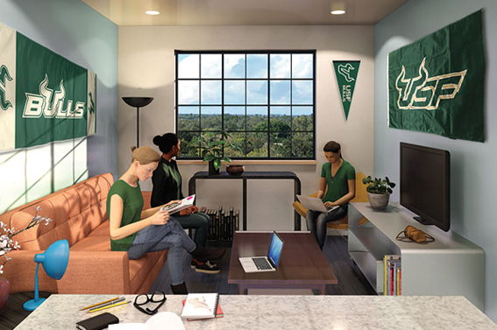
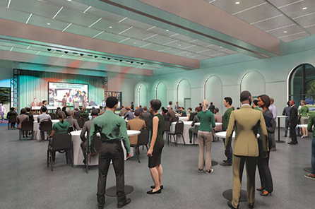
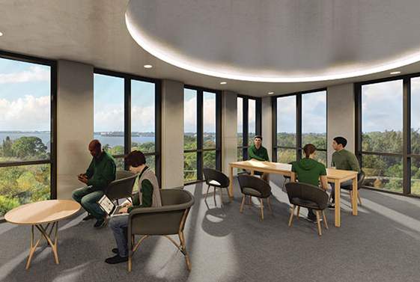
Student Housing
St. Petersburg campus
2021-22 Academic Year
Sarasota-Manatee campus
Opening first residential housing complex fall 2024
908
Total Applications
789
Room Assignments

Slide 20
Research

Slide 21
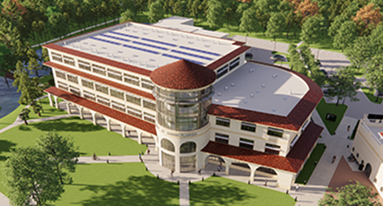
USF Research & Innovation Investments (FY2022)
USF identified a new Grant Management System (GMS)
to optimize operations by enabling real-time analytics and adjustments, and offering faculty and end-users transparency into sponsored research processes across Tampa, St. Petersburg and Sarasota-Manatee. St. Petersburg and Sarasota-Manatee are providing assessment and implementation expertise for GMS launch, scheduled for fall 2024.
USF Research & Innovation and Florida High Tech Corridor
partnering to grow undergraduate research across One USF
USF Research Foundation/USF Research Park
collaborating in the facilitation of the design planning of the Sarasota-Manatee campus nursing/STEM facility

Slide 22
Collaborative Research Efforts
Communications Consolidation Highlights FY22
State appropriations received by Cyber Florida and Cyber Florida’s collaborations with the College of Education, the College of Engineering, and Institute of Applied Engineering
School of Hospitality and Tourism Leadership collaboration on the Immersive Technologies for Cross-Cultural Tourism: U.S. and Serbia on a Pathway to Digital Transformation sponsored by the Department of State.

Slide 23
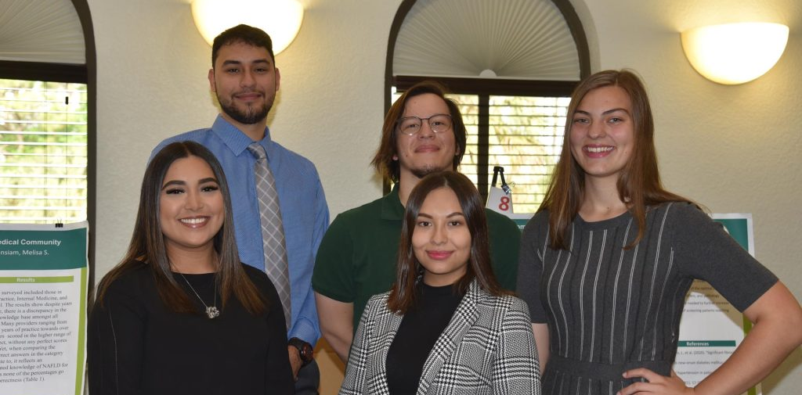

Collaborative Research Efforts
Communications Consolidation Highlights FY22
Mindfulness study supported by SOCOM through the USF Institute of Applied Engineering.
NSF CyberCorps Service Scholarship program in Muma College of Business and College of Engineering.
NIH Spanish Language Toolkit grant continuation and work examining the Effect of Hearing Aid Insurance on under-served populations.
Undergraduate Research Conference Returns To USF Sarasota-Manatee and St. Petersburg Campuses
2022 Summer Grant Writing Workshops Virtual accessibility expands the USF Sarasota-Manatee campus-based program to 120 institutions worldwide.

Slide 24
Fixed Capital Outlay Projects
& Financial Investments

Slide 25
Branch Campus Facilities Projects
5-year Capital Improvement Plan:
$ 80,343,461 #1 on 2023 CIP List: Environmental & Oceanographic Sciences Research & Teaching Facility (St. Petersburg)
$ 61,770,000 #2 on 2023 CIP List: Academic STEM Nursing Facility (Sarasota-Manatee)
CITF Projects
$ 43,950,000 Student Center and Housing $1,384,807 from CITF, $42,565,193 Other Sources (Sarasota-Manatee)
$ 5,000,000* Campus Co-Curricular & Wellness Facilities (St. Petersburg)
$ 2,000,000* University Student Center Remodel (St. Petersburg)
Other projects:
$ 6,571,638 Ongoing Deferred Building Maintenance Program (St. Petersburg)
$ 1,033,199 Genshaft Student Life Center Renovation (St. Petersburg)
$ 710,000 Chiller Replacement (Sarasota-Manatee)
$ 586,000 Rotunda Renovation – 1st Floor Student Affairs (Sarasota-Manatee)
$ 344,000 C306 Board Room Renovation (Sarasota-Manatee)
*Estimated

Slide 26
St. Petersburg Campus Investments through FY2022
Research Faculty Personnel:
$ 4,500,000 Funds held to remodel Research Laboratories
$ 100,000 Various faculty startup packages
Programs/Infrastructure:
$ 604,491 David Hall classroom remodel (started FY22, completed early FY23)
$ 520,321 Adjacent land purchase
$ 125,000 Campus Recreation improvements
$ 91,353 Total operating support for the facilities housing Nursing (FY21 and FY22)

Slide 27
Sarasota-Manatee Campus Investments through FY2022
Research and Faculty:
$ 442,000 New faculty hires in math, humanities, criminology, general education
$ 770,845 New faculty hires in Muma College of Business
$ 797,429 Faculty and administrative alignment for consolidated colleges and departments including personnel changes such as position from Academic Affairs to Office of Research including tenure, promotion investments
$ 152,000 Expansion of the Judy Genshaft Honors College
$ 218,902 New faculty hires in Social work and Criminology
$ 113,850 New faculty hires (2) in Chemistry
$ 372,438 New faculty hires in Marketing, Information Systems, and Hospitality Tourism
$ 160,000 One-time new faculty summer research award of $20,000
Programs/Infrastructure:
$ 144,000 New Director, Assistant Director and OPS hires for Early University Program.
The Early University Programs office was established to support accelerated programs offered in the State of Florida. USF supports school districts, private schools, and homeschoolers statewide with dual enrollment courses that meet the high school graduation requirement.
$ 591,600 Upgrades to 1,648 sf for research (space, annex renovations, and instrumentation support such as computers and smart boards)

