Slide 1
Pending BOT Approval, 4/13/2021

Slide 2
Introduction
The Accountability Plan is an annual report that is closely aligned with the Board of Governors’ 2025 System Strategic Plan. This report enhances the System’s commitment to accountability and strategic planning by fostering greater coordination between institutional administrators, University Boards of Trustees and the Board of Governors regarding each institution’s direction and priorities as well as performance expectations and outcomes on institutional and System-wide goals.
Once an Accountability Plan is approved by each institution’s respective Boards of Trustees, the Board of Governors will review and consider the plan for approval, excluding those sections of the Plan that require additional regulatory or procedural approval pursuant to law or Board regulations.

Slide 3



Accountability Framework History
Per Board of Governors Regulation 2.002 a comprehensive planning & accountability framework is required
Alignment with the BOG Strategic Plan
SUS Accountability Reports:
  2010/11 – 2015/16 (6 years)
SUS Work Plans:
  2012 – 2017 (6 years)
SUS Accountability Plans:
  2018 – 2020 (3 years)

Slide 4
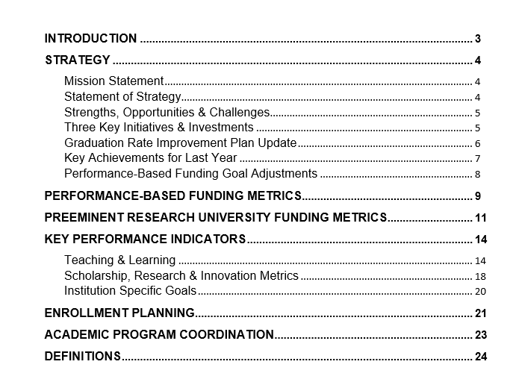
Accountability Plan Table of Contents

Slide 5
Detailed Slides With All USF Metrics

Slide 6
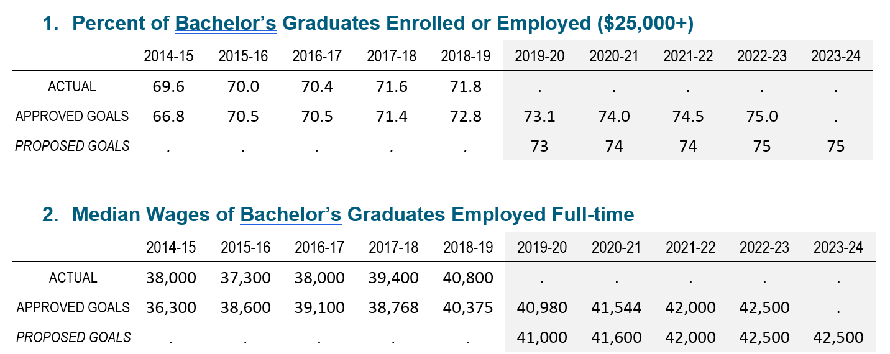
Performance-based Funding Metrics (Pages 9-10)
10 pts = 72.8%
9 pts = 70.5%
10 pts = $40,700
9 pts = $38,200

Slide 7
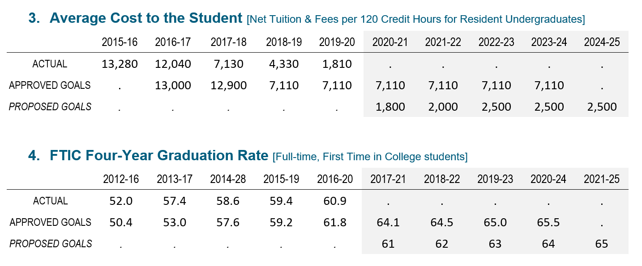
Performance-based Funding Metrics (Pages 9-10)
10 pts = $9,000
9 pts = $10,000
10 pts = 50%
9 pts = 48.8%

Slide 8
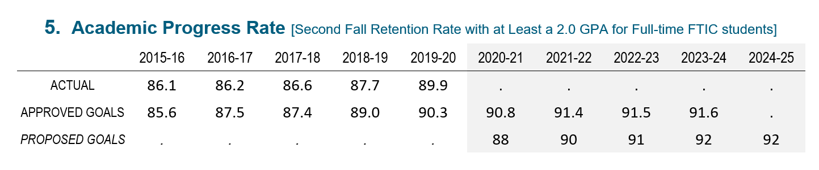
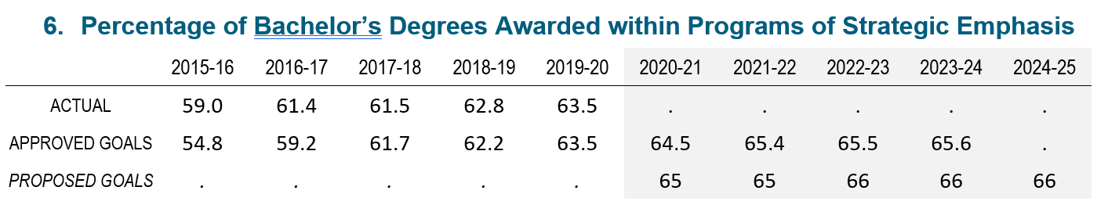
Performance-based Funding Metrics (Pages 9-10)
10 pts = 90%
9 pts = 88.8%
10 pts = 50%
9 pts = 47.5%

Slide 9
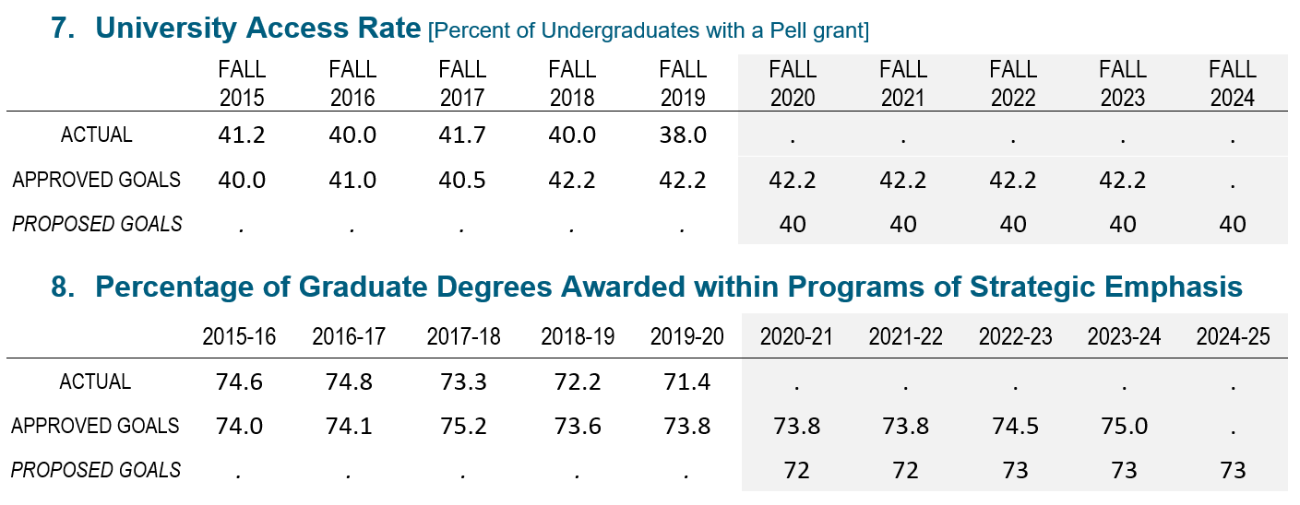
Performance-based Funding Metrics (Pages 9-10)
10 pts = 42%
9 pts = 38%
10 pts = 60%
9 pts = 57.5%

Slide 10
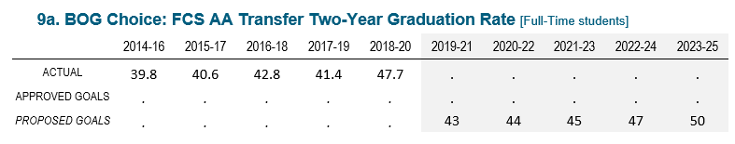
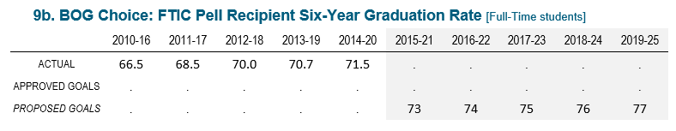
Performance-based Funding Metrics (Pages 9-10)
5 pts = 50%
4 pts = 45%
3 pts = 40%
5 pts = 80%
4 pts = 75%
3 pts = 70%

Slide 11
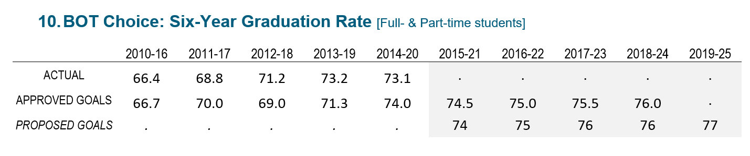
Performance-based Funding Metrics (Pages 9-10)
10 pts = 74%
9 pts = 73%

Slide 12
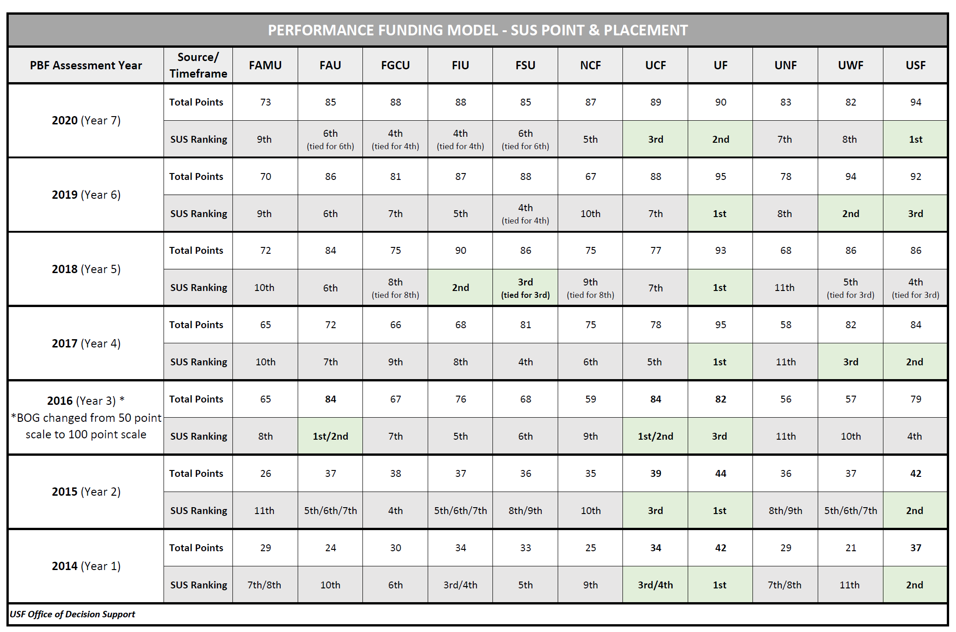
History of PBF
2021 is Year 8 of the Performance-Based Funding Model.
10 metrics in the model selected from over 45 metrics reported in annual University Work Plans (now Accountability Plans).
To ensure universities are striving to excel and improve, there is a “financial incentive” in the model
Significant improvements in metric scores and overall scores for all institutions.
BOG PBF site: https://www.flbog.edu/finance/performance-based-funding/
Notes:
While there are 10 enumerated metrics, there are actually 11 metrics (two of the 11 are 5-point metrics)

Slide 13
USF PBF Performance Summary – 2021
(Met or exceeded goals for 3 of 9 metrics; No goal set for new metric 9a/9b)

Slide 14
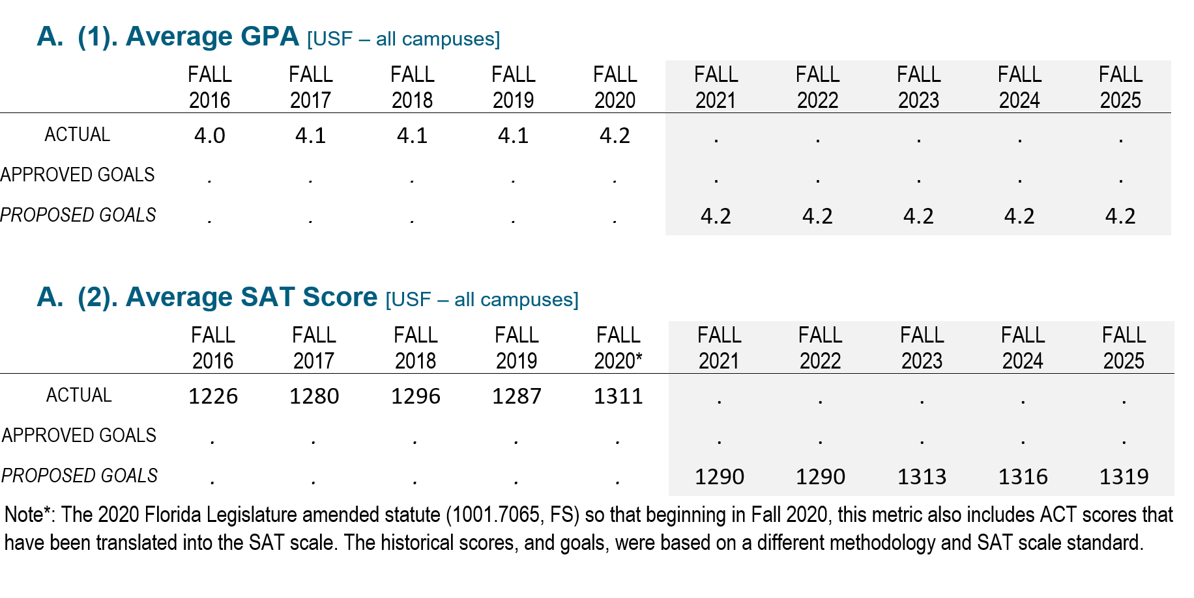
Note: Per Florida Statutes 1004.335, reporting for Preeminent metrics A, B and E through L will reflect USF (all campuses). Preeminent metrics C and D are for Tampa campus only. Effective the 2023 Accountability Plan, all Preeminent metrics will reflect USF (all campuses).
Preeminent Research University Funding Metrics (Pages 11-13)
Benchmark: 4.0
Benchmark: 1200

Slide 15
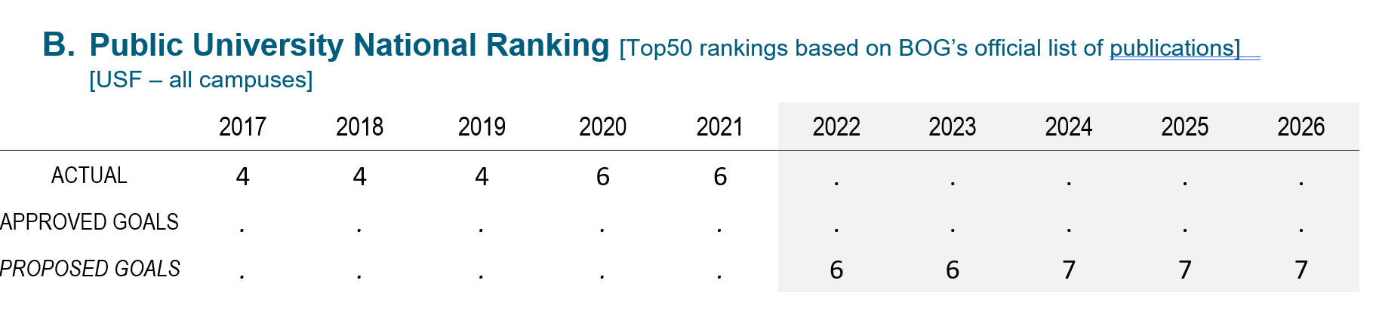
Preeminent Research University Funding Metrics (Pages 11-13)
Note: Per Florida Statutes 1004.335, reporting for Preeminent metrics A, B and E through L will reflect USF (all campuses). Preeminent metrics C and D are for Tampa campus only. Effective the 2023 Accountability Plan, all Preeminent metrics will reflect USF (all campuses).
Benchmark: 2

Slide 16
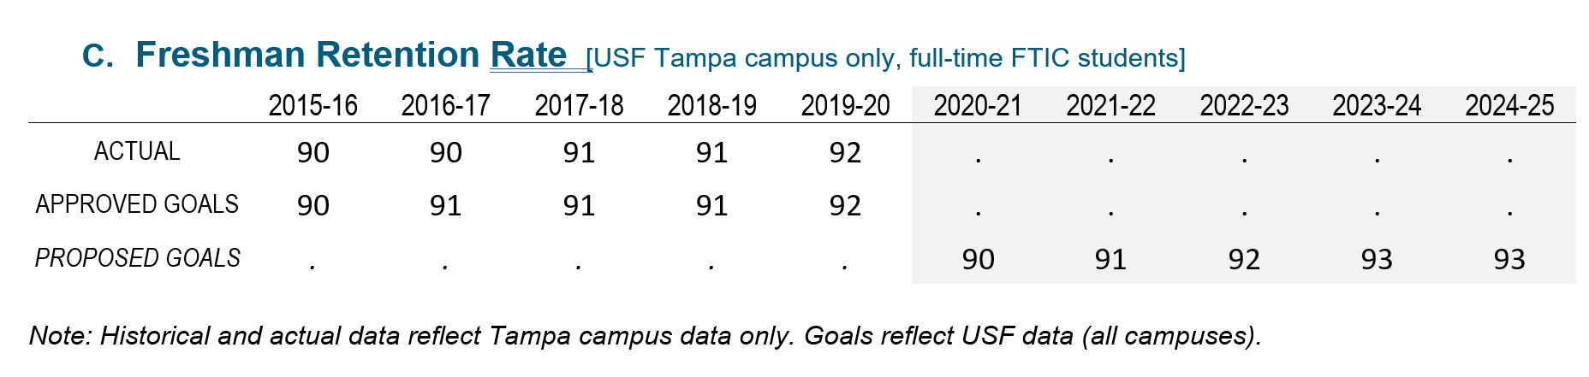
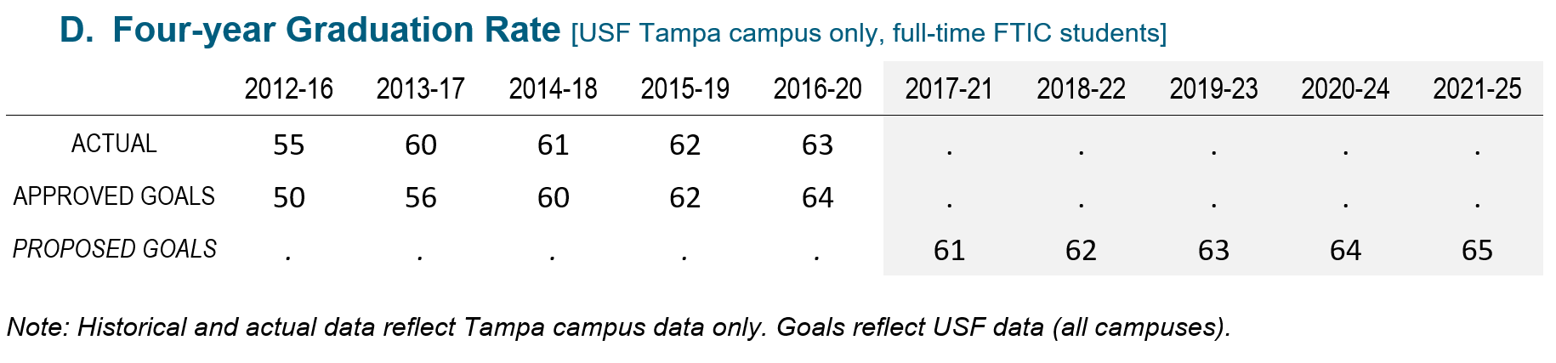
Preeminent Research University Funding Metrics (Pages 11-13)
*USF-TAMPA ONLY*
Note: Per Florida Statutes 1004.335, reporting for Preeminent metrics A, B and E through L will reflect USF (all campuses). Preeminent metrics C and D are for Tampa campus only. Effective the 2023 Accountability Plan, all Preeminent metrics will reflect USF (all campuses).
Benchmark: > 90%
Benchmark: > 60%

Slide 17
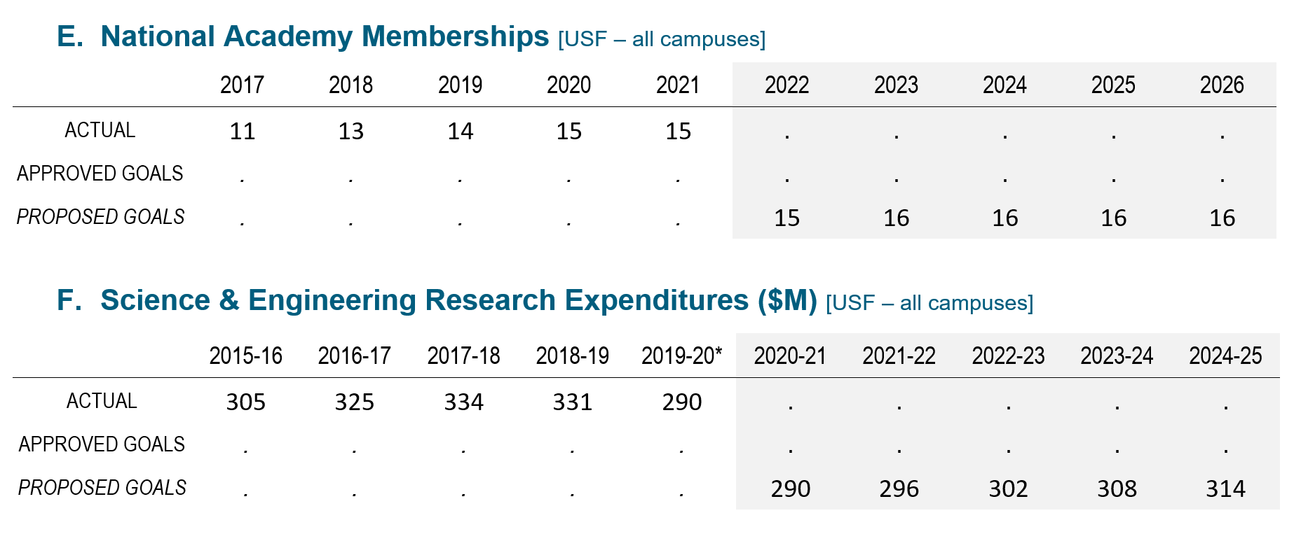
Preeminent Research University Funding Metrics (Pages 11-13)
Note: Per Florida Statutes 1004.335, reporting for Preeminent metrics A, B and E through L will reflect USF (all campuses). Preeminent metrics C and D are for Tampa campus only. Effective the 2023 Accountability Plan, all Preeminent metrics will reflect USF (all campuses).
Benchmark: 6
Benchmark: > $200M

Slide 18
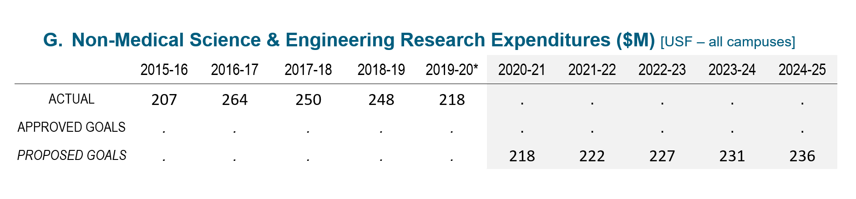
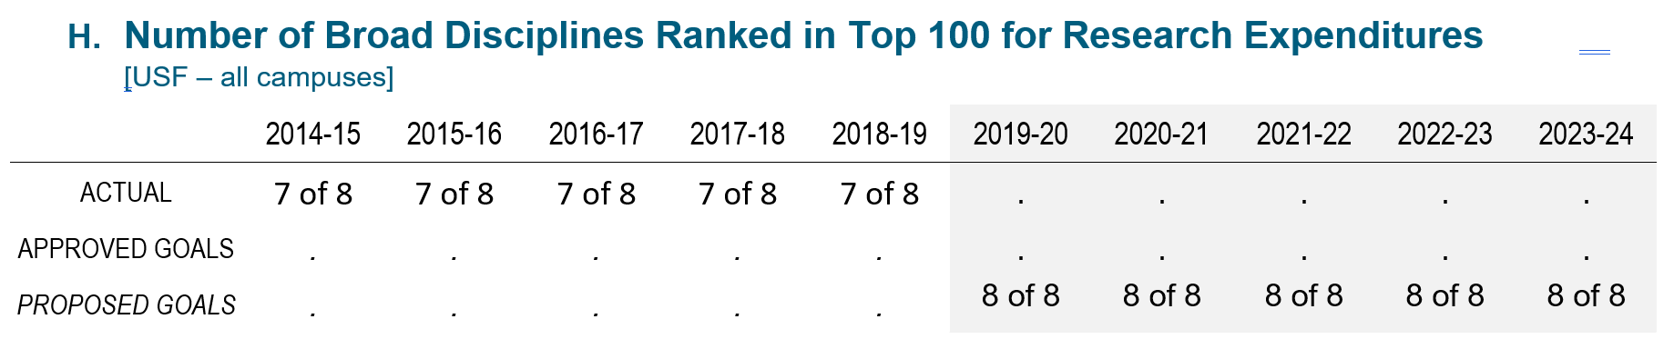
Preeminent Research University Funding Metrics (Pages 11-13)
Note: Per Florida Statutes 1004.335, reporting for Preeminent metrics A, B and E through L will reflect USF (all campuses). Preeminent metrics C and D are for Tampa campus only. Effective the 2023 Accountability Plan, all Preeminent metrics will reflect USF (all campuses).
Benchmark: > $150M
Benchmark: 5

Slide 19
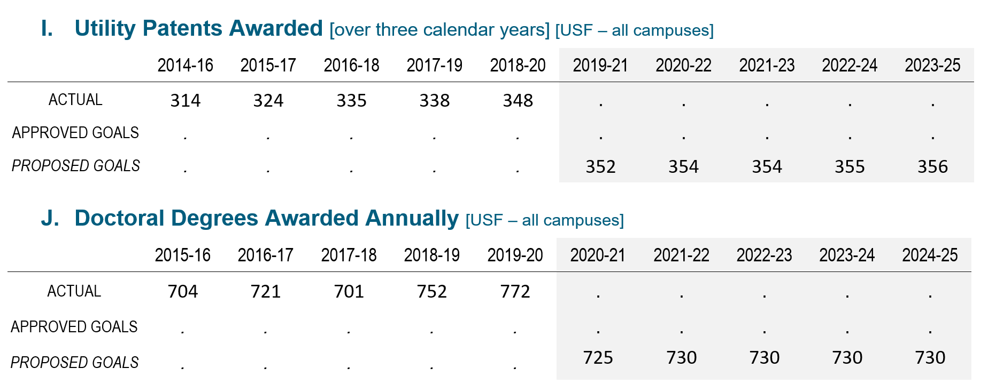
Preeminent Research University Funding Metrics (Pages 11-13)
Note: Per Florida Statutes 1004.335, reporting for Preeminent metrics A, B and E through L will reflect USF (all campuses). Preeminent metrics C and D are for Tampa campus only. Effective the 2023 Accountability Plan, all Preeminent metrics will reflect USF (all campuses).
Benchmark: > 100
Benchmark: > 400

Slide 20
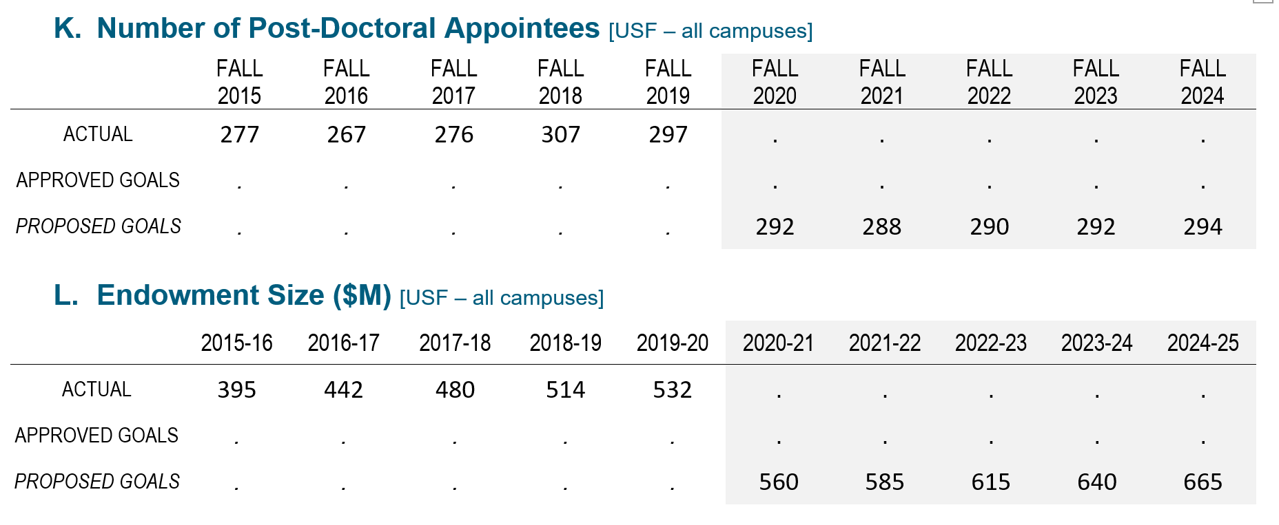
Preeminent Research University Funding Metrics (Pages 11-13)
Note: Per Florida Statutes 1004.335, reporting for Preeminent metrics A, B and E through L will reflect USF (all campuses). Preeminent metrics C and D are for Tampa campus only. Effective the 2023 Accountability Plan, all Preeminent metrics will reflect USF (all campuses).
Benchmark: > 200
Benchmark: > $500M

Slide 21
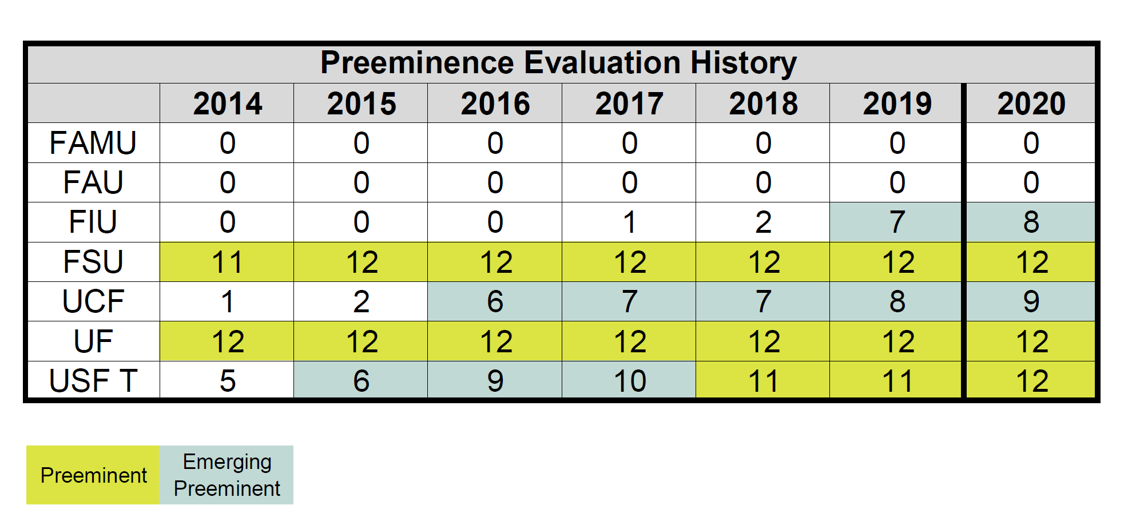
History of Preeminence
2013 - SB 1076 was approved, creating the Preeminent State Research University Program, which established the Preeminence designation
Must meet 11 of 12 benchmarks
2016 – HB 7029 expanded the program with a second designation for Emerging Preeminence for those institutions meeting 6 of the 12 preeminence benchmarks.
USF earned the Emerging Preeminence designation in 2016 and the Preeminence designation in 2018

Slide 22
USF Preeminence Performance Summary – 2021
(All 12 Benchmarks were met)

Slide 23
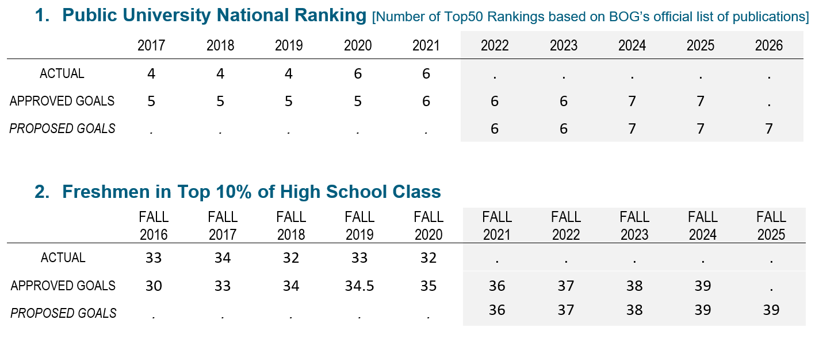
Key Performance Indicators (Pages 14-17)
Teaching & Learning (from the 2025 System Strategic Plan not included in PBF section)

Slide 24
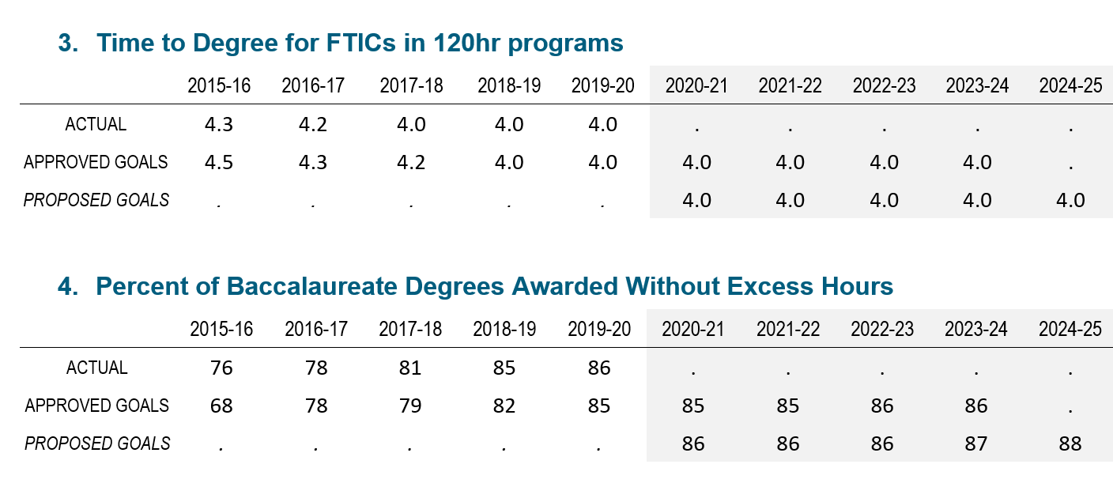
Key Performance Indicators (Pages 14-17)
Teaching & Learning (from the 2025 System Strategic Plan not included in PBF section)

Slide 25
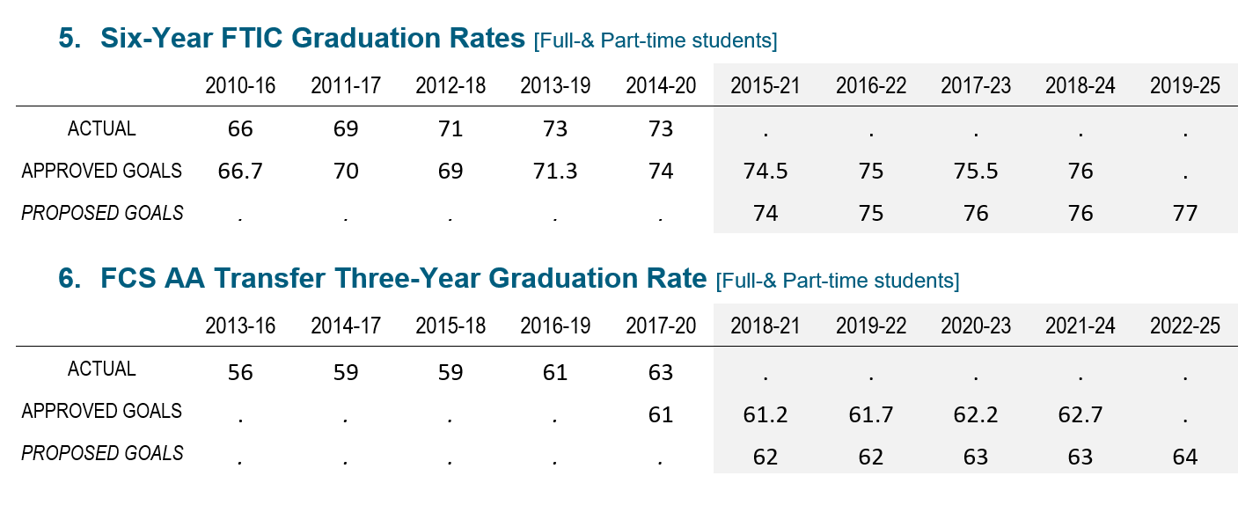
Key Performance Indicators (Pages 14-17)
Teaching & Learning (from the 2025 System Strategic Plan not included in PBF section)

Slide 26
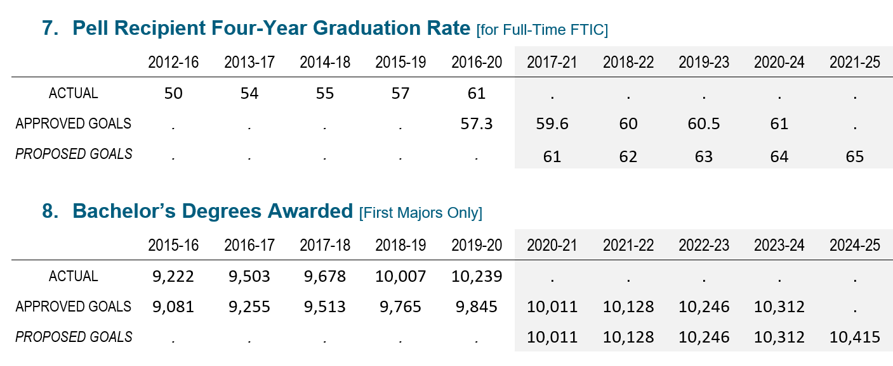
Key Performance Indicators (Pages 14-17)
Teaching & Learning (from the 2025 System Strategic Plan not included in PBF section)

Slide 27
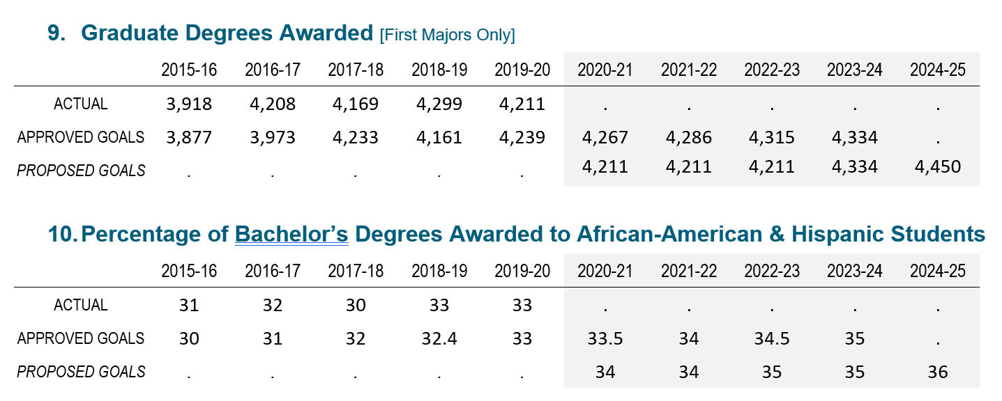
Key Performance Indicators (Pages 14-17)
Teaching & Learning (from the 2025 System Strategic Plan not included in PBF section)

Slide 28
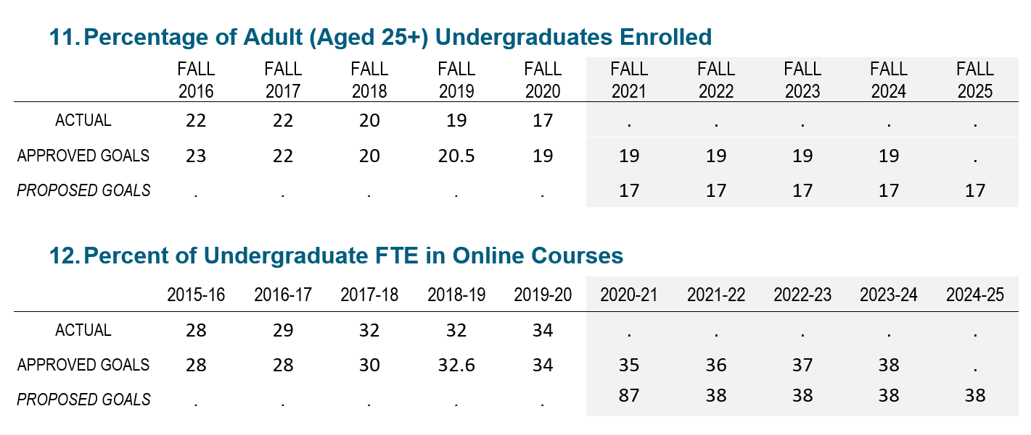
Key Performance Indicators (Pages 14-17)
Teaching & Learning (from the 2025 System Strategic Plan not included in PBF section)

Slide 29
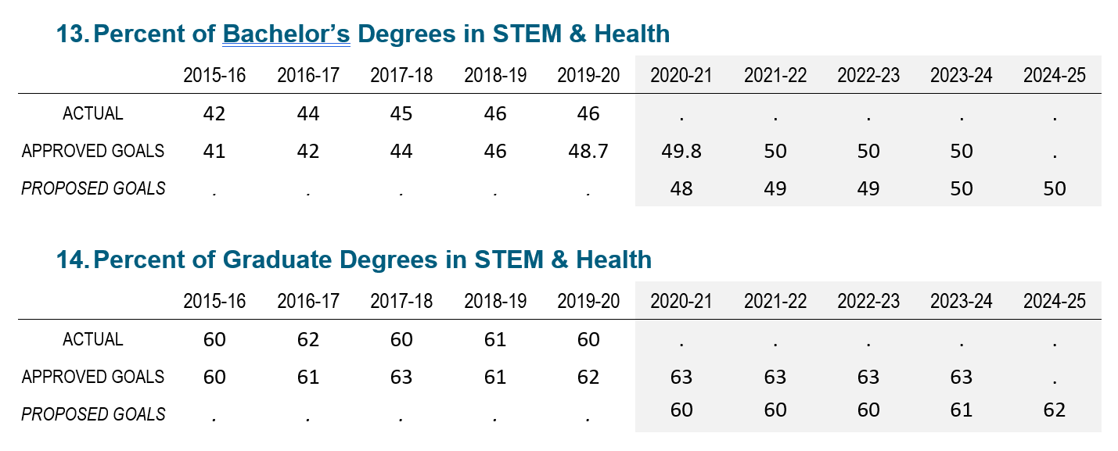
Key Performance Indicators (Pages 14-17)
Teaching & Learning (from the 2025 System Strategic Plan not included in PBF section)

Slide 30
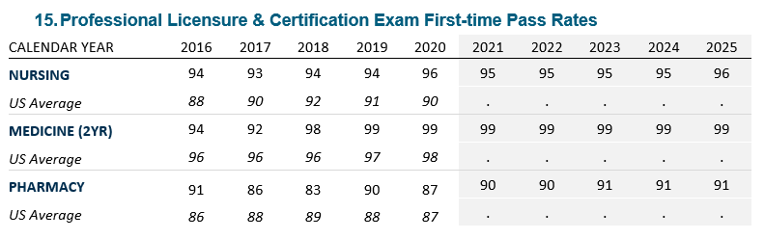
Key Performance Indicators (Pages 14-17)
Teaching & Learning (from the 2025 System Strategic Plan not included in PBF section)

Slide 31
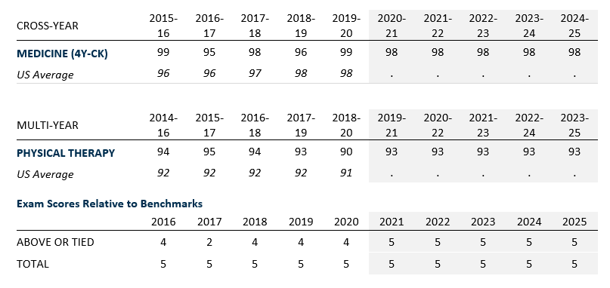
Key Performance Indicators (Pages 14-17)
Teaching & Learning (from the 2025 System Strategic Plan not included in PBF section)

Slide 32
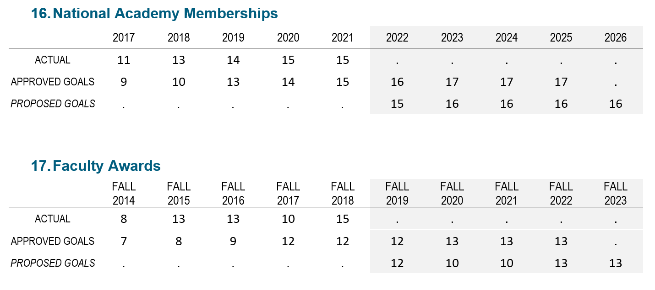
Key Performance Indicators (Pages 18-19)
Scholarship, Research & Innovation Metrics

Slide 33
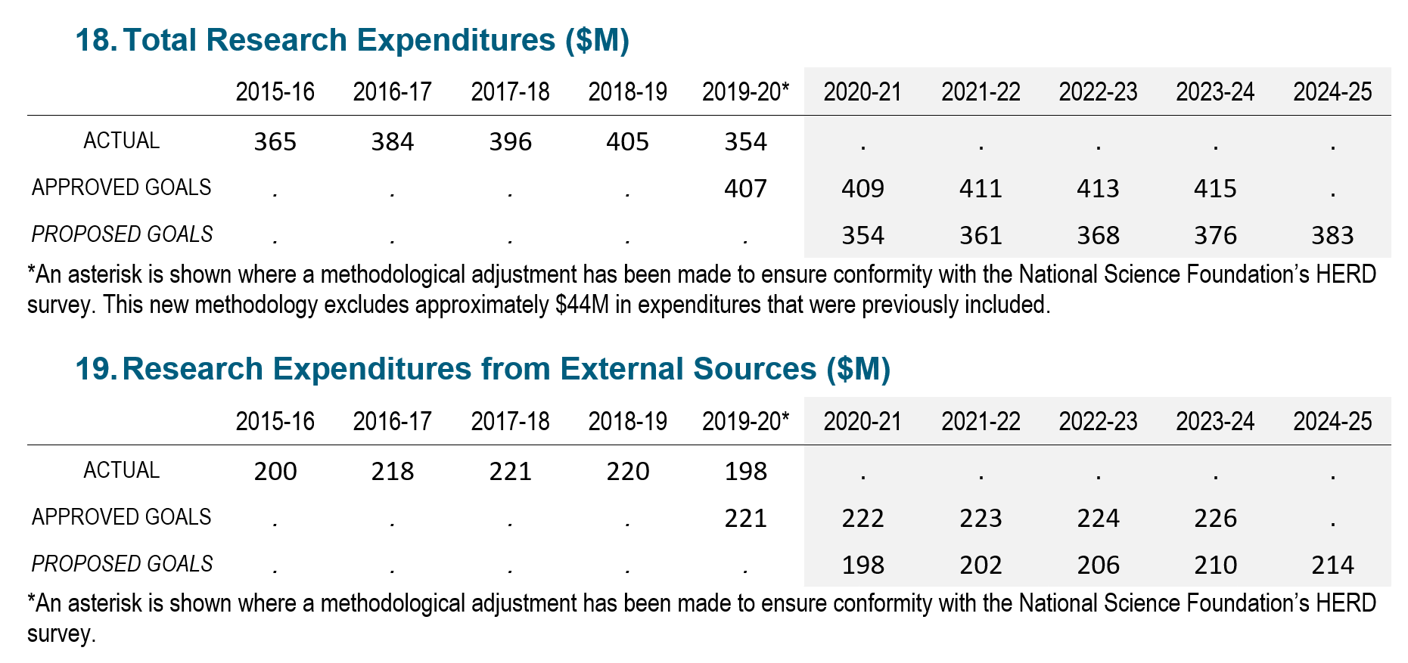
Key Performance Indicators (Pages 18-19)
Scholarship, Research & Innovation Metrics

Slide 34
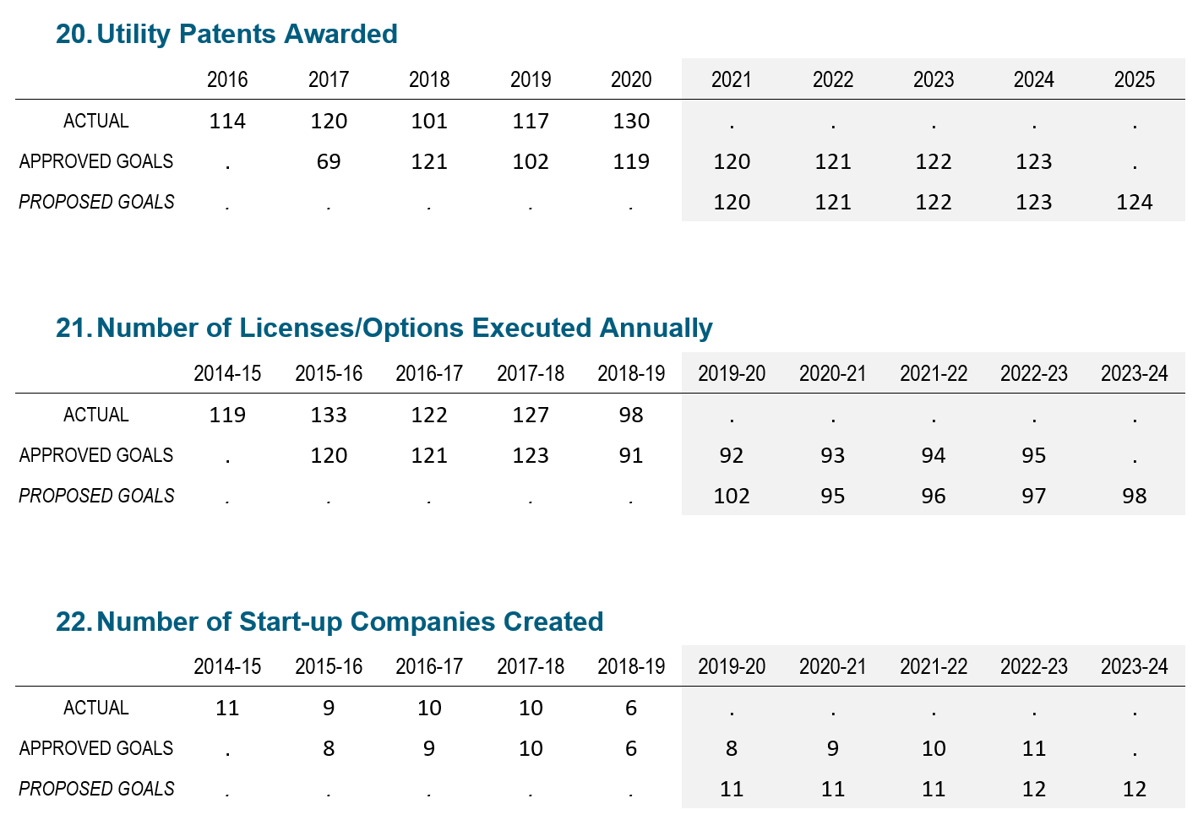
Key Performance Indicators (Pages 18-19)
Scholarship, Research & Innovation Metrics

Slide 35
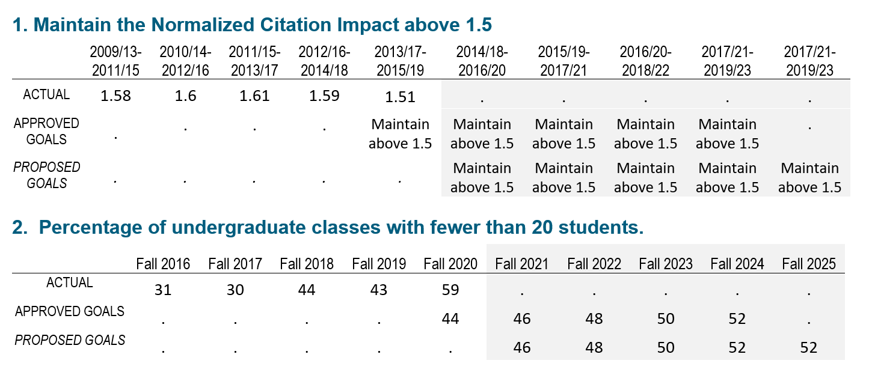
Key Performance Indicators (Page 20)
Institution Specific Goals
To further distinguish the university’s distinctive mission, the university may choose to provide additional metric goals that are based on the university’s own strategic plan.

Slide 36
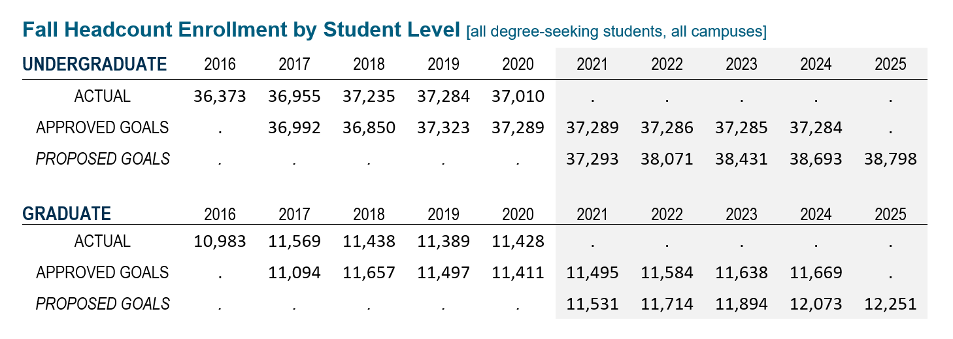
Enrollment Planning (Page 21)

Slide 37
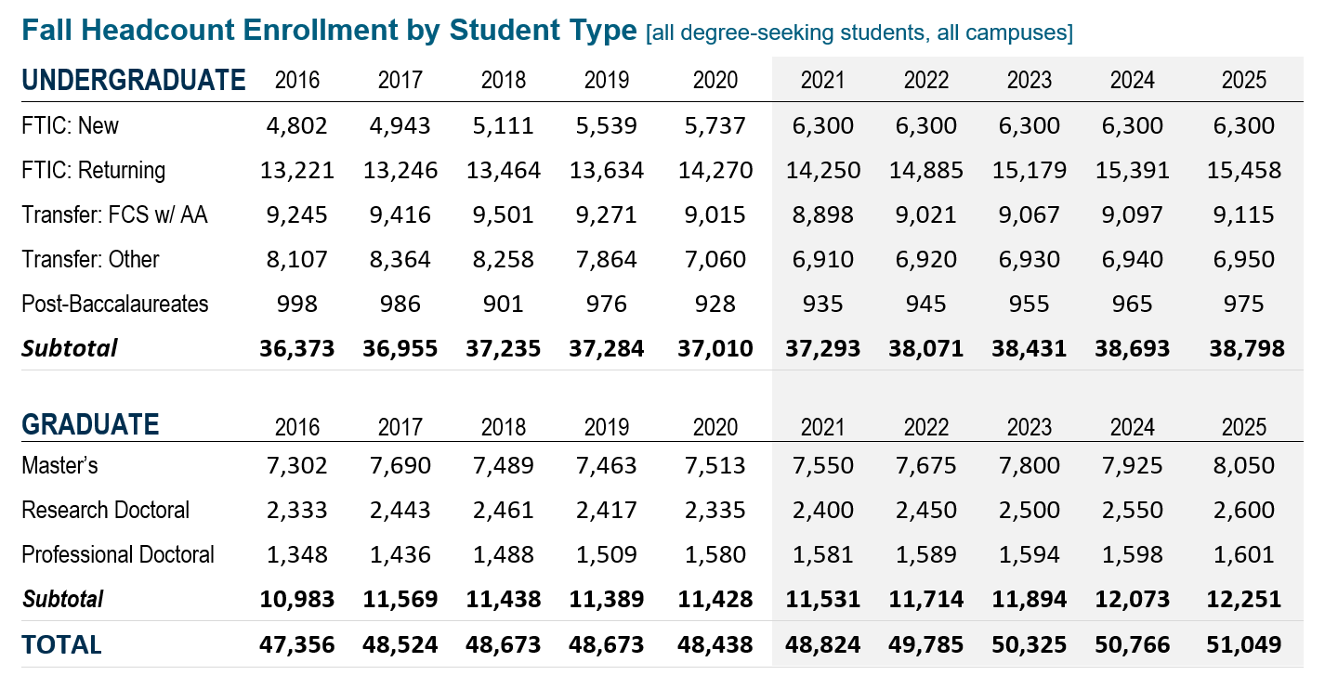
Enrollment Planning (Page 21)
Note: This table reports this number of students enrolled by student type categories. These headcounts only include those seeking a degree – unclassified students (e.g., dual enrolled) are not included. The student type for undergraduates is based on the ‘Type of Student at Most Recent Admission’. The First Time in College (FTIC) student was admitted in the same fall term or in the preceding summer term – this includes those who were re-admitted as FTICs.

Slide 38
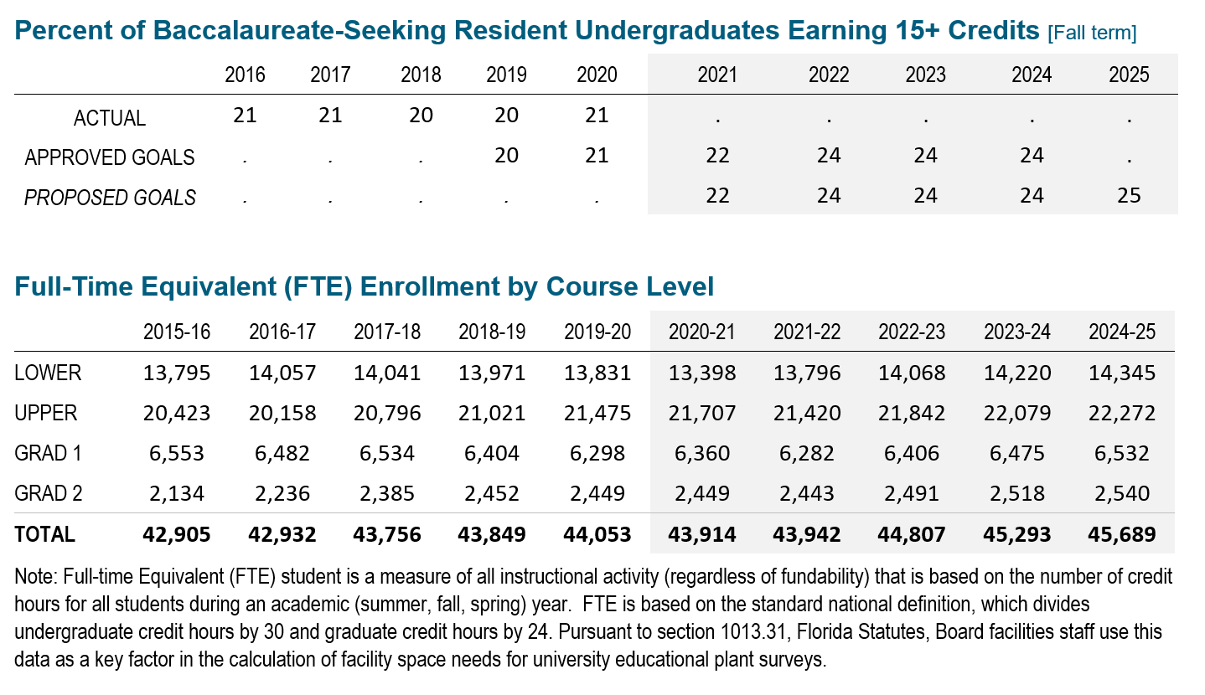
Enrollment Planning (Page 22)

Slide 39
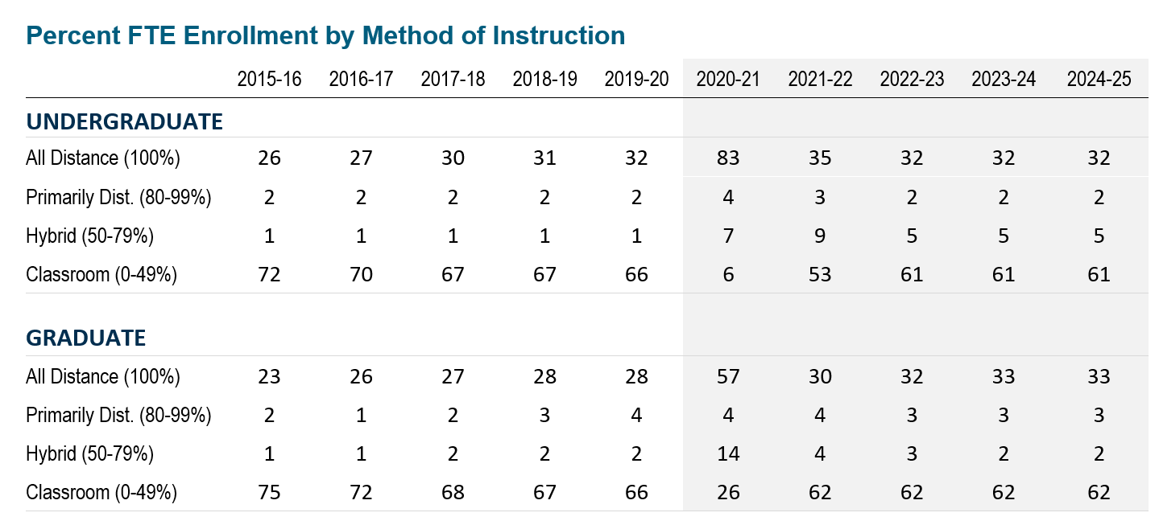
Enrollment Planning (Page 22)

Slide 40
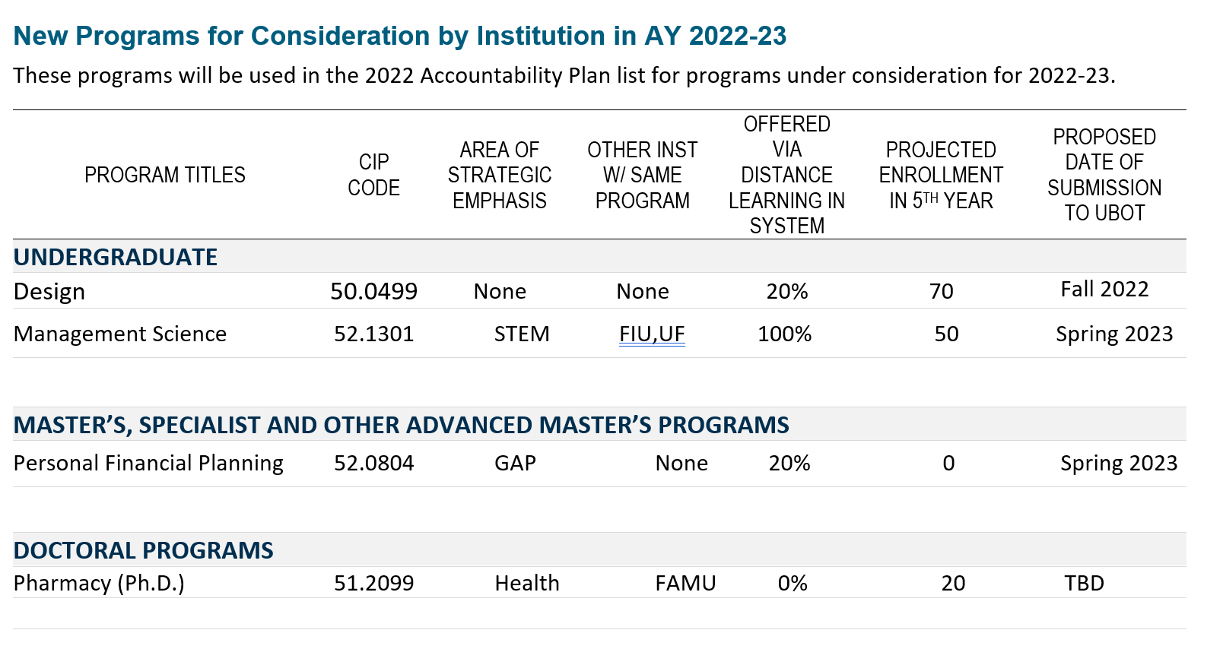
Academic Program Coordination (Page 23)

Slide 41
USF PBF Performance Summary – 2021
(Met or exceeded goals for 3 of 9 metrics; No goal set for new metric 9a/9b)

Slide 42
USF Preeminence Performance Summary – 2021
(All 12 Benchmarks were met)

Slide 43
Enrollment Planning (Page 21)
Note: This table reports this number of students enrolled by student type categories. These headcounts only include those seeking a degree – unclassified students (e.g., dual enrolled) are not included. The student type for undergraduates is based on the ‘Type of Student at Most Recent Admission’. The First Time in College (FTIC) student was admitted in the same fall term or in the preceding summer term – this includes those who were re-admitted as FTICs.

Slide 44
