Slide 1
Budget Update
January 2024
  President’s Cabinet
  Faculty Senate
February 2024
  Budget Workgroup
  University Leadership Council

Slide 2
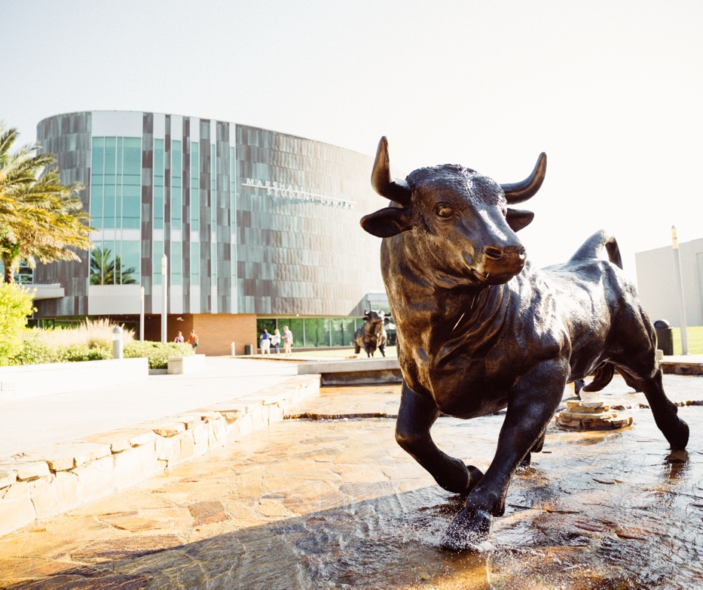
Agenda
Budget Process
Budget Calendar
Fiscal Year 2023-2024 Operating Budget

Slide 3
RCM Takeaways and Lessons Learned
Should:
  Account specifically for President’s Strategic Fund
  Strengthen budget governance
    Decrease decisioning time
    Allocate funds to strategic priorities faster
  Enhance data availability and tools for units to manage budgets
  Formalize mechanism for gathering feedback from key constituencies
  Implement incentive structure to drive the right behaviors across the University
  Include all campuses in the budget process
Should Not:
  Fund administrative or support units based on headcount
  Try to plan everything centrally as it dilutes ownership and strategic thinking

Slide 4
Budget Process

Slide 5
Budget Process Guiding Principles
Transparency
Strategic decision making
Strategic Alignment with the university’s centers of gravity
Incenting cost control and strategic behavior

Slide 6
Filters for Decision Making
Will it support PBF, PE and AAU metrics?
  USF’s commitments to student success, faculty excellence, research and engagement align with performance on these metrics
  USF funding relies on performance on these metrics
Will it support great place to learn, great place to work?
  How students and employees experience USF in physical and digital space
  Includes engagement with the broader USF community, through clinical activities, intercollegiate athletics, and external partnerships
Will it support a competitive advantage?
  There are many great opportunities and initiatives available to USF; not all of them make sense for USF
  Commitment to focus on our strengths

Slide 7
Process Summary
  Alignment with Guiding Principles and Established Filters
  Transition last year’s global budget presentations to local processes
    Dean or Support Unit Leader develops budget with team
    Support for data and analysis from Business and Finance
  Local processes should include the following elements:
    Current year budget performance
    Accomplishments and challenges
    New budget requests tied to Strategic Plan
    Resource optimization plans
  Budget adjustments will happen at various levels
    (analogy: Local/State/Federal)
  New resources will need endorsement from Senior Leader and final approval from the President

Slide 8
Key Elements of the New Process
Budget owners submit funding requests, accompanied by achieved efficiencies and lower priority items that could sunset if state funding is reduced
  Framework is under development to drive efficient use of funds
  Budget calendar is aligned with performance management calendar
Carryforward approach is formalized and provides President and Senior Leadership access when balance exceeds target % of unit’s operating budget
  % being modeled to minimize short-term impact of change to the methodology
Reporting dashboards are standardized to enable budget ownership and synchronized to reconcile data used in analysis

Slide 9
Budget Calendar

Slide 10
Budget Calendar
February - March
University provides recommended budget priorities to Leadership
June – July
August – September
October
Presentations of detailed operating budget and allocations
April - May
are communicated at BOT Budget Workshop
President sets budget priorities and they
BOT approves operating budget
Budget allocated using budget priorities

Slide 11
Detailed Annual Review/Budget Timeline
Employee Self-Assessment
Supervisor’s Assessment
Calibration
Performance Review Meeting
Pay for Performance
6/15 – 7/15
7/15 – 8/1
8/1 – 8/15
8/15 – 9/1
October pay periods
Use the new values-driven Performance Evaluation Form to facilitate discussion between a supervisor and an employee.
Employees should document accomplishments, reflect on major projects or events that may have impacted performance, and develop ideas for growth and professional development.
Supervisors take employees' self-assessments into consideration when completing reviews. Use the values-driven Performance Evaluation Form.
Supervisors can initiate annual performance review meetings after unit calibration sessions are completed.
Note that if applicable, spreadsheets for merit award/bonus pay for out-of-unit employees must be submitted to Comp by the communicated deadline.
Please note that in-unit employees will be compensated in a manner consistent with their respective Collective Bargaining Agreement (CBA).
Pay for performance/
merit/discretionary/
COLA payment. If budget available.
Non-recurring resources / Carryforward
Annual Review
Bulls Budget System
Recurring resources
Performance management calibration sessions enable leaders to apply similar standards to each of their direct reports to ensure everyone in the department is ranked on the same scale. Calibrations can be done not only by department, but also by employee level or job function.
State incremental/decremental resource allocation
Budget
Resources: Three Step Calibration, Performance Management Calibration and Conversations, Performance Calibration Sessions
JAN
FEB
MAR
APR
MAY
JUN
JUL
AUG
SEPT
OCT
NOV
DEC
Develop Carryforward (CF) Plan for % thresholds of recurring budget based on mid-year forecasted balances
Submit incremental recurring resource requests
Load budgets in Bulls Budget System
Units
Submit incremental non-recurring resource requests
Review and prioritize recurring resource requests and submit to President
VP
SVP
Review and prioritize non-recurring requests and submit to President
Review and prioritize recurring resource requests
Finalize resource allocation plan
Allocate approved adjustments to recurring resources
PRES
Review and prioritize non-recurring resource requests
Allocate July 1 CF
Allocate approved adjustments to non-recurring resources
Adjust continuation operating budget for preliminary estimated resource allocations from the State and present to BOT
Finalize Bulls Budget System information
Prepare CF & Fixed Capital Outlay (FCO) plans for BOT presentation
BFA
Update operating budget (if necessary) for BOT presentation
BOT
Budget Workshop
Approve adjusted continuation operating budget
Approve CF & FCO plans
Approve updated operating budget (if necessary)
BOG
State
Provide estimated resources
Finalize resource allocations

Slide 12
Fiscal Year 2023-2024
Operating Budget

Slide 13
Objectives
Fiscal Year 2023-2024
Notable Impacts
Educational and General Budget Priorities
Operating Budget Details

Slide 14
FY2024 Impacts on Budget
Record Legislative Session – State Appropriations
  $63.3M in recurring resources
  $20.8M in non-recurring resources
  $47.3M for new equipment and facilities construction
State Performance Based Funding ~$14.2M incremental ($49.6M Total State Investment)
Enrollment and Tuition Collections
Bargained wage increases, internal equity and state-mandated benefit improvements
Balanced E&G Budget

Slide 15
FY2024 Budget Priorities
Budget Committee made recommendations to President and Provost who reviewed and finalized allocation decisions across all budget entities
All allocations aligned with strategic plan, performance-based funding and our national ranking aspirations
The focus of distributions for FY24 include:
  Faculty and Staff Recruitment and Retention
  Student Success and Outcomes
  Infrastructure Support

Slide 16
FY24 Allocations
New E&G Base Resources
Operational Support | $ 44,000,000
Preeminence | 33,333,333
Performance Based Funding | 14,193,501
Total Available Sources | 91,526,834
Distributions
Presidential Transformation Funding | 25,573,205
Faculty Success | 16,575,028
Student Success | 9,581,203
HSC Direct - Non-Recurring | 14,000,000
People | 16,175,746
Infrastructure | 9,621,652
Total Distributions | 91,526,834
Presidential Transformation Funding allocations are ongoing
Investment are allocated using criteria/filters for decision making
Some funds resolved operating costs previously paid on Carryforward

Slide 17
FY2024 Funding Uses
Budgeted Expenses (in Thousands) | FY22 Plan | % | FY24 Plan | %
Colleges | $ 464,008 | 23.06% | $ 548,426 | 24.70%
Direct Appropriation Units | 10,981 | 0.55% | 21,830 | 0.98%
Support Units - Academic Affairs (AA) | 189,069 | 9.40% | 232,158 | 10.45%
Support Units - Non-AA | 222,712 | 11.07% | 293,959 | 13.24%
 | 886,770 | 44.07% | 1,096,372 | 49.37%
Auxiliary Units | 123,655 | 6.14% | 149,600 | 6.74%
Financial Aid Source | 450,094 | 22.37% | 397,233 | 17.89%
Contracts & Grants | 499,241 | 24.81% | 522,649 | 23.53%
Other | 52,529 | 2.61% | 54,923 | 2.47%
 | 1,125,519 | 55.93% | 1,124,405 | 50.63%
Total Budgeted Expenses | 2,012,290 | 100.00% | 2,220,776 | 100.00%
NOTES:
DSOs and Self Insurance sources are excluded as they are not in USF Financial System.
Figures above do not include Carryforward budgets.
Contracts & Grants source of funds is budgeted at University level during operating budget process.
Other includes held tuition authority and strategic funds.

Slide 18
College and Direct Appropriation Units
Budgeted Expenses (in Thousands) | FY22 Plan | % | FY24 Plan | %
College of Arts & Sciences | $ 128,546 | 6.39% | $ 139,159 | 6.27%
College of Behavioral & Community Science | 32,826 | 1.63% | 38,031 | 1.71%
College of Education | 25,410 | 1.26% | 26,567 | 1.20%
College of Engineering | 39,035 | 1.94% | 51,892 | 2.34%
College of Marine Science | 8,409 | 0.42% | 9,360 | 0.42%
College of Nursing | 20,282 | 1.01% | 32,447 | 1.46%
College of Public Health | 27,928 | 1.39% | 30,387 | 1.37%
College of the Arts | 18,717 | 0.93% | 21,455 | 0.97%
Genshaft Honors College | 4,499 | 0.22% | 5,694 | 0.26%
Morsani College of Medicine | 83,661 | 4.16% | 109,630 | 4.94%
Muma College of Business | 56,909 | 2.83% | 63,598 | 2.86%
Taneja College of Pharmacy | 16,565 | 0.82% | 18,952 | 0.85%
Patel College of Global Sustainability | 1,223 | 0.06% | 1,253 | 0.06%
Total Colleges | 464,009 | 23.06% | 548,426 | 24.70%
NOTES:
Figures do not include Carryforward, Contracts & Grants or DSO sources of funds
College amounts are for all campuses
Budgeted Expenses (in Thousands) | FY22 Plan | % | FY24 Plan | %
Florida Institute of Oceanography | $ 4,120 | 0.20% | $ 6,688 | 0.30%
Cyber Florida | 6,861 | 0.34% | 11,907 | 0.54%
Global and National Security Institute | - | 0.00% | 3,235 | 0.15%
Total Direct Appropriation Units | 10,981 | 0.55% | 21,830 | 0.98%

Slide 19
Academic Affairs Support Units
Budgeted Expenses (in Thousands) | FY22 Plan | % | FY24 Plan | %
Graduate School | $ 3,274 | 0.16% | $ 3,267 | 0.15%
Library | 14,072 | 0.70% | 17,051 | 0.77%
Office of Decision Support | 3,923 | 0.19% | 4,219 | 0.19%
Office of the Provost | 7,628 | 0.38% | 21,417 | 0.96%
Student Success | 69,594 | 3.46% | 78,793 | 3.55%
Student Financial Aid | 26,233 | 1.30% | 26,353 | 1.19%
USF World | 12,925 | 0.64% | 13,528 | 0.61%
VP Office of Research | 14,875 | 0.74% | 13,692 | 0.62%
Health | 5,817 | 0.29% | 4,726 | 0.21%
Sarasota-Manatee campus AA | 11,018 | 0.55% | 25,709 | 1.16%
St. Petersburg campus AA | 19,711 | 0.98% | 23,403 | 1.05%
Total Support Units - AA | 189,069 | 9.40% | 232,158 | 10.45%
NOTES:
Figures do not include Carryforward, Contracts & Grants or DSO sources of funds
Faculty and Student Success Hiring funds included in Office of the Provost have since been allocated across campuses

Slide 20
Non Academic Affairs Support Units
Budgeted Expenses (in Thousands) | FY22 Plan | % | FY24 Plan | %
Advancement | $ 2,190 | 0.11% | $ 12,322 | 0.55%
Facilities Operation | 48,292 | 2.40% | 51,283 | 2.31%
Human Resources | 6,216 | 0.31% | 12,912 | 0.58%
Office of Compliance and Ethics | 1,406 | 0.07% | 2,036 | 0.09%
Office of General Counsel | 3,764 | 0.19% | 4,620 | 0.21%
Sr VP Financial Strategy | 7,279 | 0.36% | 20,093 | 0.90%
VP Business and Finance | 12,779 | 0.64% | 14,632 | 0.66%
VP Information Technology | 57,630 | 2.86% | 66,890 | 3.01%
VP Executive Offices | 4,841 | 0.24% | 5,830 | 0.26%
University Audit | 1,552 | 0.08% | 1,690 | 0.08%
University Communications and Marketing | 2,904 | 0.14% | 5,313 | 0.24%
University Community Partnerships | 3,534 | 0.18% | 5,927 | 0.27%
University Police | 9,247 | 0.46% | 13,295 | 0.60%
Utilities & Risk Management | 19,680 | 0.98% | 19,275 | 0.87%
Health | 18,826 | 0.94% | 31,003 | 1.40%
Sarasota Manatee campus units | 8,334 | 0.41% | 9,654 | 0.43%
St. Petersburg campus units | 14,238 | 0.71% | 17,185 | 0.77%
Total Support Units - Non-AA | 222,712 | 11.07% | 293,959 | 13.24%
NOTES:
Figures do not include Carryforward, Contracts & Grants or DSO sources of funds
Advancement, IT, Executive, UCM areas had operating costs paid on Carryforward funds in FY22 that were resolved/partially resolved in FY24 ($17.75M )
In FY22, HR was standalone; in FY24 it reflects the combined Chief Administrative Officer areas including HR, Payroll, HRIS, and OEO
In FY24, Sr VP Financial Strategy holds some equity for On Campus Stadium
Health amounts include funds not yet allocated to colleges

Slide 21


