Slide 1
FST 108: PCardholder Training
University of South Florida
Purchasing Services
Please sign the attendance roster.

Slide 2
Housekeeping
Sign the attendance roster.
Do NOT write on the folders.
Please keep all phones on silent.
Please raise your hand if you have a question.
Break
FST108: PCardholder Exam

Slide 3
Purpose of the PCard Program
Facilitates small dollar purchases.
For example: office supplies or lab supplies.
Provides ease of travel without waiting for reimbursement.
Reduces costs associated with processing other forms of payment.
For example: purchase orders.
Provides a fast and convenient payment to vendors.
Supports the strategic initiatives around supplier diversity.

Slide 4
SUPPLIER DIVERSITY

Slide 5
What is Supplier Diversity?
A proactive business strategy that seeks to provide suppliers equal access to sourcing and purchasing opportunities. Supplier diversity encourages the use of suppliers from a diverse mix of ownership including women, minorities, and veterans.

Slide 6
What We Do…
Work with USF system purchasing agents, departmental buyers, and facilities, planning, and construction.
Responsible for monitoring, implementing, progress tracking, and adjusting the USF diverse business utilization strategic plan.
Identify and reward USF Supplier Diversity Champions!

Slide 7
Why is Supplier Diversity important?
Supports the USF Board of Trustees approved strategic initiative to increase spend with diverse suppliers.
Drives competitive pricing and expands product categories and service offerings which, in some cases, can be larger than other competitors.
Helps USF’s supply chain better reflect the demographics of our community.

Slide 8
How You Can Help…
Include diverse owned businesses when making purchases.
Make a “Good Faith Effort.”
Track and report spend for all PCard purchases made with a diverse business.
Spend Reporting Form can be found at WWW.USF.EDU/OSD
Remember every purchase you make no matter the amount, whether $1 or $100 million helps us reach our utilization goal.

Slide 9
What is our goal?
13% - 20%*
*Addressable Spend, upon full supplier diversity program implementation as outlined in the USFOSD Strategic Plan.
Addressable Spend is defined as spend that has the potential to be competitively sourced. This addressable spend number base excludes spend/payments to government entities, sub-agreements, utilities, DSOs, and employees as defined in raw data.

Slide 10
Need Help Finding a Diverse Supplier?
Visit the USFOSD website: WWW.USF.EDU/OSD
Send an email: OSD@USF.EDU

Slide 11
General PCard Information

Slide 12
Where Can I Use My PCard?
The USF System PCard can be used at any business that accepts Visa.
A PCard may be used:
In person at the merchant location
Over the phone
Online
All purchases must be in accordance with established USF System policies, procedures, and regulations.

Slide 13
How Do I Apply For A PCard?
Complete the FST 108: PCardholder Training course.
All cardholders are required to retake FST 108: PCardholder Training every 3 years.
Complete the Cardholder Profile Form.
The form MUST be signed by your Area VP or other authorized designated individual.
The form MUST have a valid working USF email address.

Slide 14
Important Account Information
The USF System PCard billing cycle:
Starts: On the 5th of each month.
Ends: On the 4th of the following month.
Please Note: If the 4th of the month falls on a weekend the billing cycle will end at 11:59pm on the following business day.
The USF System PCard billing address:
4202 East Fowler Ave, SVC 1073
Tampa, FL 33620
The billing address is different from the shipping address. The shipping address MUST be a USF System address.

Slide 15
Credit Limits
Standard credit limits for a USF System PCard are:
Monthly Transaction Limit: $5,000.00
Single Transaction Limit: $2,000.00
Higher credit limits can be requested on a temporary or permanent basis.
Cardholders should submit a Limit Change Request using the Cardholder Profile Form.
Temporary Limit Increases:
Require approval from the cardholder’s Area VP or authorized designated individual and the Purchasing Director.
Granted for up to a maximum of three months.
Processing Time: 3-5 business days.
Permanent limit increases:
Require the approval of the Area VP or authorized designated individual, Purchasing Director and the University Controller.
Processing Time: 7-10 business days.

Slide 16
Cardholder Responsibilities
Submit receipts to your reconciler within 3 business days of your purchase.
Traveling Cardholders: Must submit receipts within 3 business days after returning from travel.
Sign the monthly cardholder activity statement.
Ensure Florida sales tax is not paid.
Ensure PCard transactions are reconciled on time.
PCard transactions should be approved (reconciled) in FAST within 7 business days of their load date.

Slide 17
Cardholder Responsibilities
You are responsible for keeping your PCard secure.
The card and the account number should not be shared with others.
The account number should not be emailed or written on any document (including receipts).
PCards should always be maintained in a wallet or locked cabinet/drawer.
When leaving USF or switching departments stop using the PCard, destroy & dispose of the card, notify PCard Services to have your account closed.
Do not leave this responsibility to another person (such as your reconciler or verifier).

Slide 18
Cardholder Responsibilities
Report a lost or stolen PCard:
Immediately contact JP Morgan Chase: (800)316-6056.
Request the account be closed.
Request a new PCard be ordered and shipped to the bulk shipping address. Rush delivery is not allowed.
Contact PCard Services in order to complete the Account Closure Form and coordinate the pick up of your new PCard.
Filing a Dispute Claim or Fraud Claim with the bank:
Dispute claims and fraud claims must be filed with JP Morgan Chase within 60 days of the post date of the transaction in question.
Fraud Claim: The bank will close your account and have a new card ordered for you. PCard services must be contacted to complete an Account Closure Form and coordinate the pick up of the new card.
Dispute Claim: Dispute claims should be filed after attempting to receive a credit from the vendor.

Slide 19
Escalation Processes

Slide 20
Escalation Process: Statements & Receipts
Activity Statements are available for download in FAST on the 10th of the statement month.
The signed cardholder activity statement and ALL receipts are due to PCard Services by the last day of the statement month.
Escalation Date | Escalation Process
5th of the next month. | Escalation notification is sent your college administration.
10th of the next month. | Escalation notification is sent your VP administration.
15th of the next month. | The PCard account is suspended until the statement package and receipts are submitted.

Slide 21
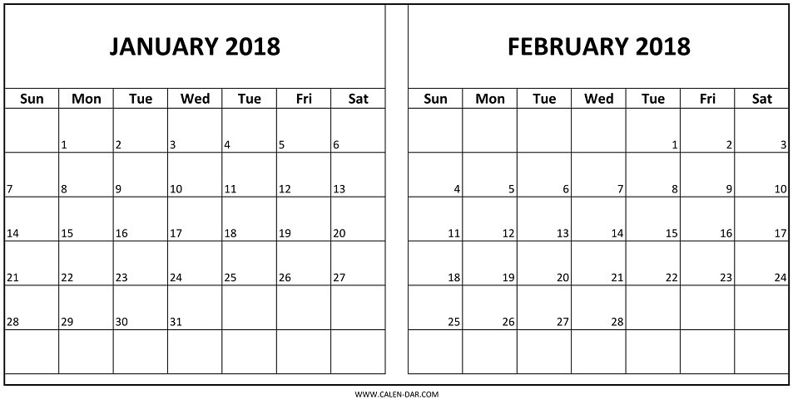
Escalation Process: Statements & Receipts
For Example: The 1/4/2018 activity statement is available for download on 1/10/2018. Receipts for the 1/4/2018 statement package are due to PCard Services on 1/31/2018.
Escalation notices are sent out
Activity Statement Available for Download
Activity Statement & PCard Receipts Due To PCard Services

Slide 22
Escalation Process: Inadequate Statement Packages & Receipts
When reviewing statement packages and receipts, PCard Services will email cardholders and reconcilers regarding missing or inadequate documentation.
Escalation Date | Escalation Process
1 Week Unresolved | Escalation notification is sent your college administration.
2 Weeks Unresolved | Escalation notification is sent your VP administration.
3 Weeks Unresolved | The PCard account may be suspended.

Slide 23
Escalation Process: Reconciliation of Charges
Weekly notifications are sent to cardholders and reconcilers when transactions are unapproved (unreconciled) in FAST for more than 7 business days.
Weekly notifications are sent to cardholders and their travel delegates when travel transactions are not associated with a travel request number within 7 business days.
Escalation Date | Escalation Process
14 Days | Escalation notification is sent your college administration.
21 Days | Escalation notification is sent your VP administration.
28 Days | The PCard account is suspended until transactions have been approved (reconciled) in FAST.

Slide 24
Statement Package & Receipt Requirements

Slide 25
PCard Receipt Requirements
Cardholders should ensure a “complete” receipt is provided for every transaction.
Missing receipts should be supplemented with the Exception to Required Receipt form.
Receipts for PCard and travel transactions should be submitted with the activity statement to: pcardreceipts@usf.edu
Required | Criteria
✓ | Name of Vendor
✓ | Date of Purchase
✓ | Itemized Description of Items Purchased
✓ | Unit Cost of Item
✓ | Total Amount of Purchase
✓ | Business Purpose
✓ | USF Billing & Shipping Address

Slide 26
PCard Statement Package Requirements
The activity statement is downloaded/printed from FAST.
Receipts are arranged in the same order in which they appear on the activity statement.
A complete itemized receipt is provided for each transaction.
Credit card numbers and personal information are redacted.
Activity statement must be signed by all three required signers: cardholder, cardholder’s supervisor, and the reconciler.

Slide 27
Restricted Purchases

Slide 28
Restricted Purchases
Items Not Allowed to Be Purchased On A PCard
Dining Dollars & Bull Bucks | Greeting Cards | Prepaid Phone Cards | Congratulatory & Condolence Flowers | Cash Advances
Insurance | Gifts of Appreciation | Personal Convenience Items¹ | Florida Sales Tax² | Independent Contractors
Financial Institutions | Capital Equpiment³ | USF Parking Permits⁴ | USF Departments⁴ | USF Post Office⁴
Examples of personal convenience items include room service, wall clocks, and coffee makers. Exceptions may be granted for items like a refrigerator or microwave depending upon the business purpose.
USF is exempt from paying Florida sales tax. You may pay sales tax when making purchases in other states.
Capital Equipment = a stand alone item, with a lifespan of one year or more, and costs $5,000.00 or more (including shipping & handling).
USF Departments may only be paid using an Interdepartmental Transfer. Your PCard may be used at the
USF Computer Store and Barnes & Noble bookstore (which are considered external vendors).

Slide 29
Restricted Purchases
Item | Allowable Under Specific Circumstances
Office Supplies | Office supplies must be purchased from Office Depot regardless of the USF contract price. An exception to this rule can only be made when an item is out of stock. Office Depot Representative: Michael Kort (727)726-5954 Michael.kort@officedepot.com Use the following link to register your PCard and receive the USF contract price and tax exempt status while shopping both In-Store and Online: https://odams.officedepot.com/registrations/usf.php Use the following link to shop online: https://business.officedepot.com/

Slide 30
Restricted Purchases
Item | Allowable Under Specific Circumstances
Food | Food is considered an allowable purchase on a PCard if (1) the cardholder has “food permission” set up on their account, and (2) the food is paid for using an appropriate funding source. Cardholders should reference the Expenditure Matrix Guide for valid business purposes and funding sources related to the purchase of food. Food purchases are classified as either Event Meals or Business Meals. All receipts for the purchase of food should include the following information: (1) name of the event, (2) date of the event, (3) number of attendees, and (4) business purpose of the event. Receipts for business meals should be accompanied with a business agenda and the names of the attendees. Alcohol is NEVER allowed to be purchased using a PCard.

Slide 31
Restricted Purchases
Item | Allowable Under Specific Circumstances
Gift Cards | Can only be purchased for research study participants. The cardholder must complete a Request To Purchase Form for gift cards before making their purchase.
Software | Software is considered capital equipment when its unit price is $1,000.00 or more. Software with a unit price of $1,000.00 or more must be approved by UTSB before it can be purchased on a PCard.
Clothing | Clothing to be used for identification purposes of a USF employee must have a perquisite form on file with Purchasing Services.
Entertainment Vendors | USF PCards are not allowed to be used for purchases with entertainment vendors (museums, theaters, resorts, etc.). Special exceptions can be granted. Exceptions are granted on a case-by-case basis. Please contact pcard@usf.edu to inquire whether an exception can be granted.

Slide 32
Restricted Purchases
Item | Allowable Under Specific Circumstances
SunPass | A SunPass can only be purchased for a university state-owned vehicle. The cardholder must contact pcard@usf.edu and complete a Request to Purchase Form for a SunPass.
Repairs To Equipment | Repairs to equipment can be paid for using a PCard. The cardholder should include the item’s tag number (or serial number) and the location of where that piece of equipment is stored.
Cellphones, Cell Data, & Computer Air Cards | A PCard can be used to purchase cellphones and computer air cards. PCards may also be used to pay for cellphone service and cell data service. The cardholder must submit a Request to Purchase Form to PCard Services on behalf of the employee using the cellphone, cell data, or air card.
Contractual Services | Contractual services can be paid for using a PCard only AFTER the contract has been reviewed and approved by USF Contract Management System.

Slide 33
Restricted Purchases
Item | Allowable Under Specific Circumstances
iTunes Accounts & iTunes Apps | iTunes accounts and apps can only be purchased for USF-owned devices. On the receipt for the purchase, the cardholder should provide the device’s serial number and the department/area it belongs to.
Amazon, PayPal, & eBay Accounts | The account must be completely unique and separate from the cardholder’s personal account. Amazon Prime is an allowable purchase on a PCard.
Gasoline | Gasoline can only be purchased for a university state-owned vehicle or a rental vehicle. Gasoline can never be purchased for a personal vehicle. The cardholder must provide the vehicle’s tag number on the receipt.
Technology Items | Technology items are an allowable purchase using a PCard. They must be purchased in accordance with the universities technology acquisition policy (00-518).
All USF Logos & The USF Seal | The use of a USF Logo or the USF Seal must be approved by University Communications & Marketing prior to its use.

Slide 34
Restricted Purchases
Item | Allowable Under Specific Circumstances
Books | Books can be purchased using a PCard ONLY if the unit price of the book is $249.99 or less.
Memberships | Memberships can be purchased using a PCard. The cardholder should provide a justification which explains the benefits of the membership to the university. This justification should be included with the receipt in the monthly Activity Statement.
Class 3B & Class 4 Lasers¹ | Each Class 3B or Class 4 Laser you acquire must be registered with the USF Laser Safety Program. A Laser Registration Form must be completed for each laser you acquire. The form can be found in the USF Laser Safety Manual on the USF Laser Safety webpage. Laser Safety training is required per the USF Laser Safety Manual.
Please contact the USF Laser Safety Officer with questions you have regarding their program: (813)974-1194 or radiation.lasersafety@usf.edu.
PCard Services MUST be contacted regarding any exception to these restrictions. The exceptions must be documented and should be included with the receipt when preparing the monthly Activity Statement.

Slide 35
Competitive Quotes

Slide 36
For the purchase of Commodities, Goods, and Services…
$0.01 - $5,000.00
Formal written price quotes are not required.
However, verbal quotes should be documented.
$5,001.00 - $25,000.00
At least two quotes are required (either verbal or written)
Verbal quotes must be documented in a requisition.
$25,001.00 - $75,000.00
At least three written quotes are required.

Slide 37
PCard Best Practices

Slide 38
Statement Packages & Receipts
Items purchased on a PCard should be shipped to the cardholder’s USF system address.
Contact PCard Services if you need permission to ship to a non-USF system address.
Ask questions when in doubt about a purchase.
Request a limit increase if the cost of your purchase is higher than your transaction limits.
Notify PCard Services if you are leaving USF or switching departments.
The cardholder should immediately stop using the PCard, destroy it, and contact PCard Services in order to complete the Account Closure Form.

Slide 39
Statement Packages & Receipts
Original copies of your PCard receipts should be retained by your department for 5 years.
Original copies of PCard receipts paid for using grant funds should be retained for 5 years after the final reporting date of the grant.
Travel receipts should follow the travel department’s receipt retention policy.
Vendors should not charge your PCard until the item is shipped.
Contact the vendor with any questions you may have.

Slide 40
Reconciliation of Transactions
PCard Transactions
Travel Transactions
Must be approved in FAST within 7 business days.
Once approved, any budget errors should be corrected in order to ensure the transaction posts to the General Ledger in a timely manner.
Receipts are submitted with the signed monthly Activity Statement.
Must be associated with an approved Travel Request (TR) number in FAST within 7 business days.
Once travel has occurred, all charges should be pulled into the Expense Report and submitted to the Travel Department within 30 days of the last day of travel.
Travel receipts are submitted with PCard receipts and the signed monthly Activity Statement to pcardreceipts@usf.edu.

Slide 41
Travel Information
Topic | Comments
Food | Food must be paid for out-of-pocket when traveling on university business (due to a statutory meal allowance). Exception: A PCard may be used to pay for a conference registration or event that includes a meal.
Gasoline | A PCard can only be used to purchase gasoline for a university state-owned vehicle or a rental vehicle. A PCard can never be used to purchase gas for a personal vehicle while traveling on university business (due to mileage reimbursement).
Ground Transportation Services | While on university business, taxis, trains, buses, uber, lyft, and other mass transit may be used when these modes of transportation result in a cost savings to the university.
Travel Request (TR) | A travel request must be submitted and fully approved in Archivum Travel before traveling.
Travel Training | For additional information regarding travel cardholders can register for FSTTR2: Travel Rules and Requirements via GEMS Self Service.

Slide 42
Travel Information
Travel Items Not Allowed To Be Purchased On A PCard
Early Bird Check-In¹ | Seating Assignments | Room Service | In-Room Movies | Alcohol
Valet Parking² | Transportation to Restaurants | Extraneous Rental Car Amenities³ | Travel Insurance (Airfare) | Airfare Upgrades⁴
(1) This applies to both airfare and hotels.
(2) This applies where self-parking is available.
(3) For example: Toll device, GPS device, roadside assistance, etc.
(4) This applies to upgrades beyond economy and coach seating.
This is not an all-inclusive list of prohibited items. Please see the Travel Manual for further details.
Anytime a personal element is present in business travel a PCard should not be used.

Slide 43
PCard Misuse

Slide 44
PCard Misuse
What is considered misuse on a PCard?
Purchasing non-allowable goods & services | Shipping items to a non-USF address without prior permission | Allowing others to use your PCard | Not keeping your PCard in a secure location
Using your PCard for personal gain | Paying Florida sales tax | Accepting cash credits | Fraud conducted by the cardholder
Falsification of records | Splitting charges to circumvent your single transaction limit | Negligence in performing your duties¹ | Violating any other university or department-related policy, procedure, or rule
(1) Negligence = Failing to submit receipts on time, failing to sign & submit the monthly activity statement, failing to reconcile transactions in FAST on time, and failing to follow up with the bank regarding dispute claims and fraud claims.

Slide 45
Consequences of PCard Misuse
Loss of PCard privileges either temporarily or permanently
Disciplinary action
Reimbursement to USF
All documentation of reimbursement should be included in the activity statement with the receipt.
Documentation of reimbursement can also be emailed to pcard@usf.edu. The email should include the cardholder’s name, employee ID number, and a brief statement regarding the reason for reimbursement.
Loss of job
Prosecution

Slide 46
Additional Information

Slide 47
Additional Information
Using a PCard has no effect on a cardholder’s personal credit rating.
Cardholder’s are now able to sign up for access to the bank web portal.
Ability to view available credit, transaction history, and accepted/declined transactions.
Contact pcard@usf.edu to request access.
Cardholder’s can also check their balance by calling 1-(800)-316-6056.
When traveling out of town contact the bank and notify them of your dates and locations of travel.
Cardholder’s will be automatically loaded on to their PCard accounts in FAST.
Ability to view transactions and print the monthly activity statement.
Cardholder’s should make a good faith effort to do business with diverse suppliers by
using USFOSD initiatives.

Slide 48
Additional Information
Visit the PCard Services website for additional information regarding rules, training materials, forms, etc.
http://www.usf.edu/business-finance/purchasing/staff-procedures/usf-pcard/index.aspx
All cardholder’s are automatically added to the PCard Listserv.
Important information and announcements will be sent via email.
Questions regarding Travel issues: travelhelp@usf.edu
Questions regarding PCard issues: pcard@usf.edu

Slide 49
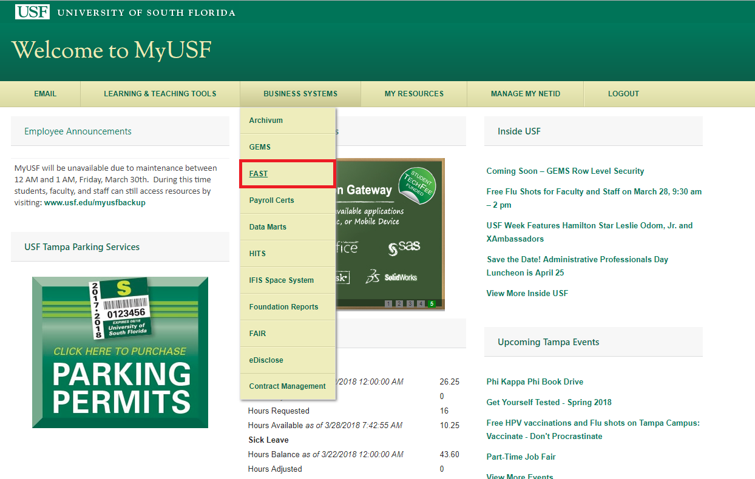
How To Find FAST

Slide 50
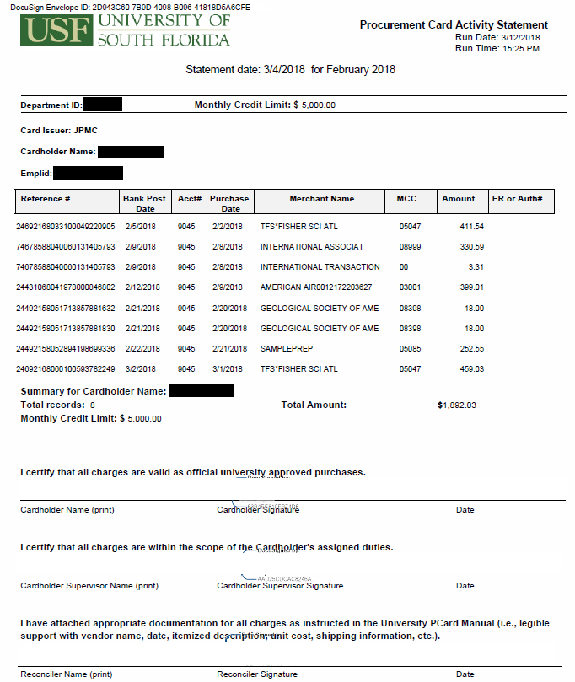
Monthly Cardholder Activity Statement
A PCard Activity Statement will not be available for download if no transactions were made during the billing cycle.
A receipt is not required for international transaction fees.

Slide 51
Export Control Regulations

Slide 52
What are Export Control Regulations?
A complex set of US laws and regulations designed to:
Restrict the use/access to sensitive technical information, materials, and technology for reasons of national security.
Ensure that sensitive items, technology, and know-how are not used for nefarious purposes.
Restrict financial transactions and the provision of services to certain entities.
Can result in large fines and/or prosecution.

Slide 53
Examples of university activities that may be subject to export controls:
Buying an item from a foreign company or university.
Purchasing equipment designed/modified specifically for military end use.
Purchasing an item where the vendor is imposing restrictions on the operation, installation, maintenance, repair, overhaul, and/or refurbishing of the item, the manual, or its blueprints.
Shipping an item internationally to a foreign entity.
Purchase of drones and/or biological toxins

Slide 54
USF Office of Export Controls
Export Control Email Inbox: exportcontrol@usf.edu
Export Control Officer
Marsha Pesch
mpesch@usf.edu
(813)974-6368
Assistant Export Control Officer
Victoria Poindexter
vcp1@usf.edu
(813)974-0554
Website: www.research.usf.edu/export-controls

Slide 55
Questions?

