Slide 1
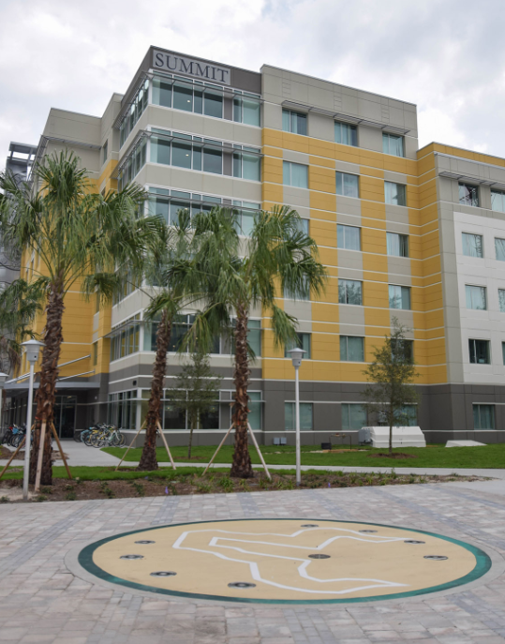
USF St. Petersburg Housing Project
Housing Update & Approval
July 24, 2018

Slide 2
Today’s Objectives:
Review the project:
Timing
Particulars of the project
Financing
Obtain approval of resolution authorizing issuance of debt to finance the project at a rate not to exceed 5.25% and $37 million and requesting the BOG to approve the issuance of the debt
to finance the costs of the project.

Slide 3
Strategy Alignment:
Underscores our commitment to student success
Demonstrates sound financial management/use of resources
Leverages USF System resources and capabilities to
advantage of St. Petersburg campus
Project has support of USFSP student body*
* Student support indicated through focus groups, survey and student body leadership

Slide 4
Timeline
Necessitates:
USF Finance Corp Meeting – July 9, 2018
USFSP Campus Board update – July 19, 2018
BOT approval – July 24, 2018
Circulate RFP for Design/Build – late July 2018
BOG submittal – before August 8, 2018
BOG Staff/DBF Briefings – July 23, 2018
BOG Briefings – October 2018
BOG approval – November 8, 2018 meeting
Award contract – after BOG approval
Issue bonds – after BOG approval
Begin Construction – as soon as practicable after award
Expedited Target: August 2020 Completion
* If deemed necessary.

Slide 5
Since June Update:
Have obtained updated demand study
Have visited informally with BOG / DBF staff relating to timing
Revisited the project with the USFSP campus board
Refined project pro-formas, modified scope

Slide 6
Design and Estimated Cost / Disclosures & Assumptions:
Design Component | Source / Support
375 Beds* | Third party demand study
Conservative Enrollment Growth | Embraces board enrollment plan
Estimated cost | Based on Village project forward inflated
Suite style housing | Complements existing inventory
Includes shelled dining | Cost for dining based on Village
Dining build-out | To be covered by external food vendor
Design/build | Use of competitive procurement process
* Does not assume a live-in requirement.

Slide 7
Financing Details / Disclosures / Assumptions:
Finance Aspect | Source / Support
Estimated rental rates | Below off-campus market / similar to Tampa Uses BOT approved rental rates
375 bed size | Supported by demand study
Borrowing rate – 5% | Current market is in the 4.0% - 4.1% range
Uses system rating | System rated A1 / A+
Projected System coverage – 1.5x | Exceeds BOT and BOG standards
Projected Project coverage – 1.3x | Exceeds BOT and BOG standards
Project break-even | Occupancy at 83%
Parity and par bonds | Allows gross revenues pledge
Built in reserve fund | Per bed reserve requirement plus net cash flow

Slide 8
Project Sources and Uses:
Sources |  | Uses
Bonds, at Par | $33.0 | Estimated Cost –housing | $27.2
 |  | Estimated Cost – dining | 3.5
 |  | Total estimated cost | 30.7
 |  | Capitalized Interest | 2.8
 |  | Debt service reserve | **
Campus equity contribution | 0.8 | Costs of issuance | 0.3
Total Sources | $33.8 | Total uses | $33.8
** Debt service reserve accomplished via internal restriction of funds

Slide 9
Comparison of Housing Rates:
Housing Unit or Comparator | Rates
Board approved 2019 rental rates – single occupancy suite | $4,671*
Board approved 2019 rental rates – double occupancy suite | $4,505*
Off-campus 2 bedroom comparable | $5,097 to $5,849 ¹
* Note these rates were utilized in creating the projections.
¹ Source: Brailsford & Dunlavey demand study.

Slide 10
Dining Structuring:
Dining will be a shelled structure
Estimated $3.5 million of cost
Cost will be partially offset by $800k of campus contribution
Annual commissions pledged revenue to project
Outsourced operator will build-out space
Operated by third party (currently Sodexo)
Meal plan prices jointly determined w/ operator
Operating risk transfers to operator
Assumes mandatory meal plan

Slide 11
Why Internally-Finance this Project v. P3 Approach?
Factor | Favors
 | USF | P3
Cost of borrowing / cost to student
Total return to the campus
Size / scale
Student life
Project delivery
In addition, because of the size of the project,
the fact that our balance sheet has strengthened,
and our ratings outlook has improved since the Village P3
make the impact on the University’s balance sheet very manageable.

Slide 12
Project sensitivities / Other factors:
Completion date
Project cost / budget contingency
Enrollment / retention
Interest rate cushions
Cost estimation methodology
Additional equity

Slide 13
Requested Action
Approve the resolution authorizing the issuance of debt
at an interest rate not to exceed 5.25% or $37 million
and requesting the Board of Governors to approve the issuance of debt
to finance the costs of the USF St. Petersburg housing.

Slide 14
Thank You!

