Slide 1
Developing a Study Abroad Course
An example considering the preparation of a 2 week study abroad course to the United Kingdom
By
Dr. Jennifer Collins
School of Geosciences

Slide 2
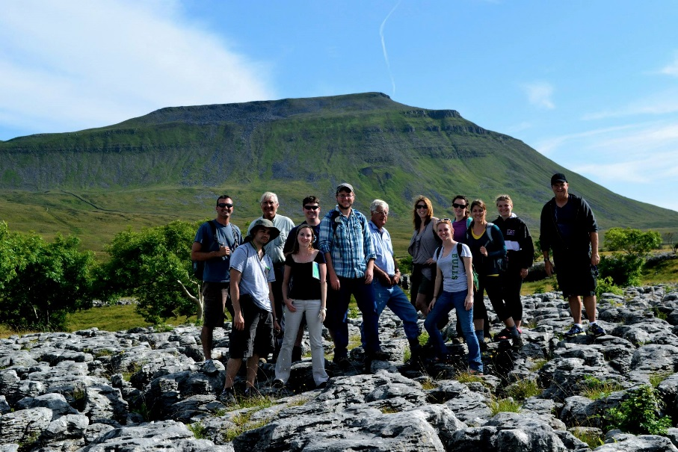
The University of South Florida provided an education abroad experience to the United Kingdom during the Summer B 2013 semester. A group of USF and Plymouth State University students and faculty visited London, the Jurassic Coast, Cornwall, Dartmoor National Park, Barmouth, and Lancaster during a 2 week experience.
Students and faculty observed and studied physical geography and environmental science while in the United Kingdom. The focus of the discussions was a comparison of the features and policies compared with the U.S., examining similarities and differences.
Education abroad is a unique experience for each student and faculty member. While being provided with an enriching academic curricula, being able to gain knowledge and understanding through visual examples, students were also exposed to a new culture which heightened their experiences on the trip.
The group included 10 students (6 graduates and 4 undergraduates), 3 faculty members and a third party travel agency representative. The mixture of graduate and undergraduate students had several advantages including peer mentoring of the undergraduate students as the graduate students gave advice related to applying for graduate school.

Slide 3
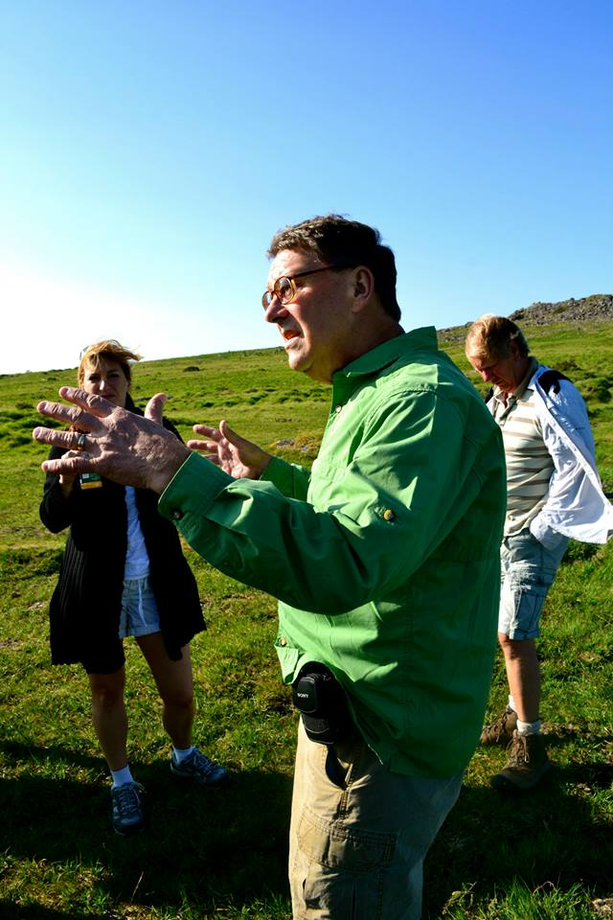
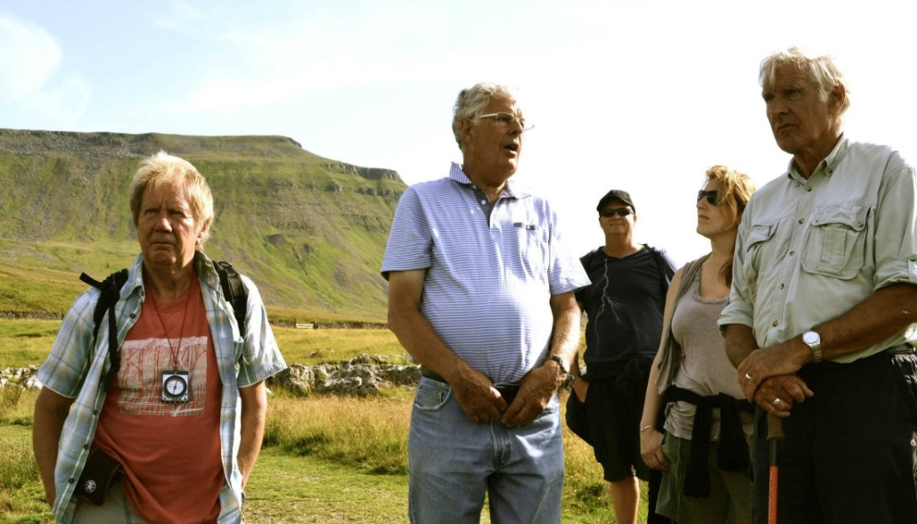

Slide 4
Is it the right time in your career?
Pre- vs. Post- Tenure?
My experience:
CU study abroad
PSU and J1 Program
Chair’s advice

Slide 5
Timing: when you should start preparing

Slide 6
Before course is even approved, there are a lot of logistics:
Choosing your location, activities
Proposal to Study Abroad Office
Do you have a third party travel company like CIS Abroad involved?

Slide 7
Third Party Travel Agency:
Both positive and negative aspects to having a third-party provider involved with the trip and having a representative come on the trip.
Positive:
Students:
Thought agent helped with managing finances and logistics
Thought agent provided cultural experiences and information
Thought agent managed ‘worst-case’ scenarios
Faculty:
Thought agent’s help was most useful for the first day as students arrive
Thought agent provided some help with some non-academic logistics

Slide 8
Third Party Travel Agency (continued):
Negative:
Students:
Thought having a third party took away from the trip due to the agent’s inexperience in the UK
Thought agent had a lack of understanding of the environmental science that was being studied on the trip.
Faculty:
The faculty had no control over the money that could be spent in-country and would have used the money more towards the academic part of the trip.
Thought that some of the logistics that the third-party provider was responsible for, the faculty had to follow up with.
Student and faculty perspectives were sometimes different
The biggest difference, as noted above, was the student and faculty perspective on how the finances were “managed”
Student and faculty perspectives were sometimes similar
Both groups thought that the agent’s inexperience with the UK and the subject matter detracted from the trip

Slide 9
From CIS Abroad website:
We guarantee great value, exceptional support, cultural immersion, and a personalized advising experience when choosing your courses or internship.
Link to reviews: http://www.studyabroad101.com/programs/cisabroad-center-for-international-studies-paris-intern-in-paris/reviews/15448
Negotiate your budget with USF study abroad, especially if not using a company like CIS Abroad.
Discuss having authorization to spend money for the course activities while over seas.

Slide 10
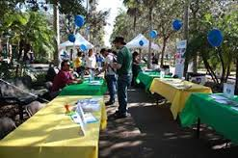
Timing: when and how you should start recruiting
Orientation and Recruitment Fair
Difficulties in recruiting:
$$: Made higher if a company like CIS Abroad is involved
Timing of the course: Spring with summer offering vs. just summer

Slide 11
Timing and uncertainty: When you will find out if your course will really be offered

Slide 12
Many logistics
Once course has been approved with students signed up…
Passport/visa
Health Preparations
Flights, more expensive when approved close to travel time
Securing on the ground logistics
Intense course prep – pre-info for students and info for students during the study abroad

Slide 13
Assignments:
Except for the graduate paper, the assignments were for both graduate and undergraduate students:
PowerPoint Presentations and Articles
Review presentations and articles associated with the assigned topics
Papers:
2-3 pages on selected topics:
National parks and visitors’ attitudes
Mining practices and its environmental impacts
Protecting coasts in the United Kingdom
Graduate paper:
Analysis of the article, “Climate forcing of geological and geomorphological hazards…” by Dr. Bill McGuire, whose presentation we attended at UCL

Slide 14
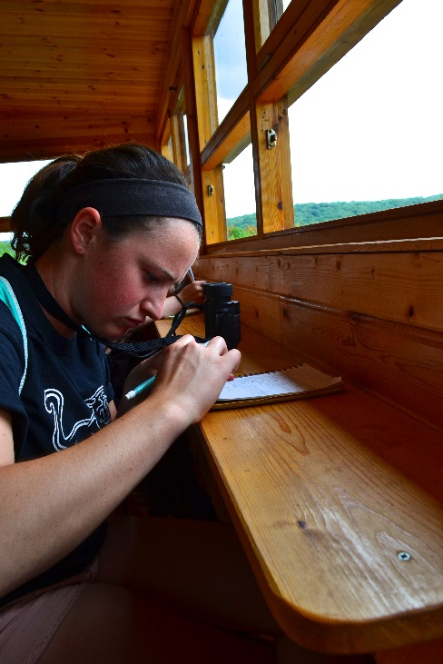
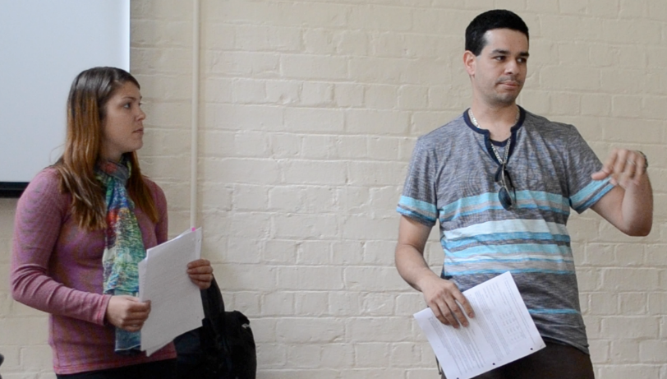
Assignments (continued):
Presentation
Two-student team
Topics:
UK versus USA national park system; environmental ethics in the UK; UK’s environmental movement; glacial history in the English Lake District; coastal processes; UK’s history of air quality; natural hazards in the UK; and flooding in the Lake District
Field Journal
Note taking from topic discussions and speakers
Make observations including description of physical features and policies of management, weather and location information, and personal experiences

Slide 15
Special Assignments:
Each student/team was assigned to one special assignment:
“Google Tour”
Finished prior to trip to give students an itinerary, locations, key features, and pictures of sites to visit
Weather Reports
To provide weather reports and forecast, prior to and during the trip, as well as a summary for the blogging team
Blogging
4 students were assigned the task to maintain a blog to describe the events of the day and to display the pictures.
The students worked in teams of two and took the lead alternating nights (with the other nights just reviewing the other team's blog).
Dr. Collins reviewed overnight and provided feedback by the morning.

Slide 17
Special Assignments (continued):
Website
Created by 2 students following the trip including excerpts from the blog, pictures, video clips, and field journal information
DVD
Includes footage from discussions and presentations given over the 2 week period and post-trip reflection videos from students to recollect their experiences

Slide 18
You will start by
Visiting web sites and read books about the history, geography and customs of the countries you plan to visiting; study maps; read newspapers with good international news coverage; and watch videos of the places you'll visit.

Slide 19
Potential Issues while overseas
Mental health
Stress
Culture shock
Someone ill ****
Alcohol/drugs
Traffic and swimming accidents are the leading cause of death in travelers.

Slide 20
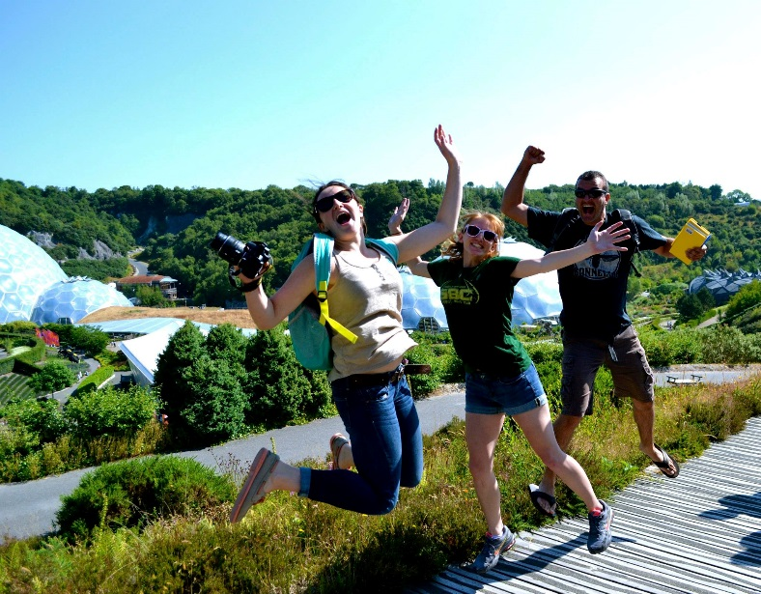
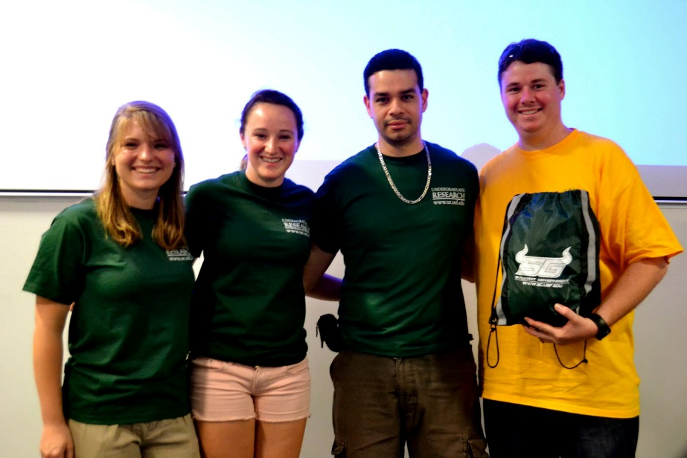
Reflections
“I was really blown away on every front… It was pretty amazing the amount of information we received. I was also culturally amazed. Our group as a whole surprised me too. [We were] total strangers a couple weeks ago that came together and we were able to enjoy each other’s company.” – BJ Quinton
“The professors went above and beyond the original curriculum to add in things on management and different botany. I thought that range was really great.” – Nicole Hutton

Slide 21
What you should expect to get from the study abroad trip:
Rewarding experience
Do it because you have a passion to do this, not for the money.

Slide 22
Summary:
Time: A lot of faculty time (between 1-2 year’s worth of effort) is required ahead of the trip to develop the course, including logistics and assignments
Assignments: Students benefitted academically from the range of assignments. However, spreading the load among all students of an assignment which occurs on the trip is suggested (e.g. the blogging)
Third-party provider: Having an in-country contact for the first day of the trip is useful, but a lot of the logistics are still planned by the faculty, so no need to have the added expense of the third party provider
Work with the Study Abroad office to see if they would be willing for an in-country budget to be available for the faculty to manage

Slide 23
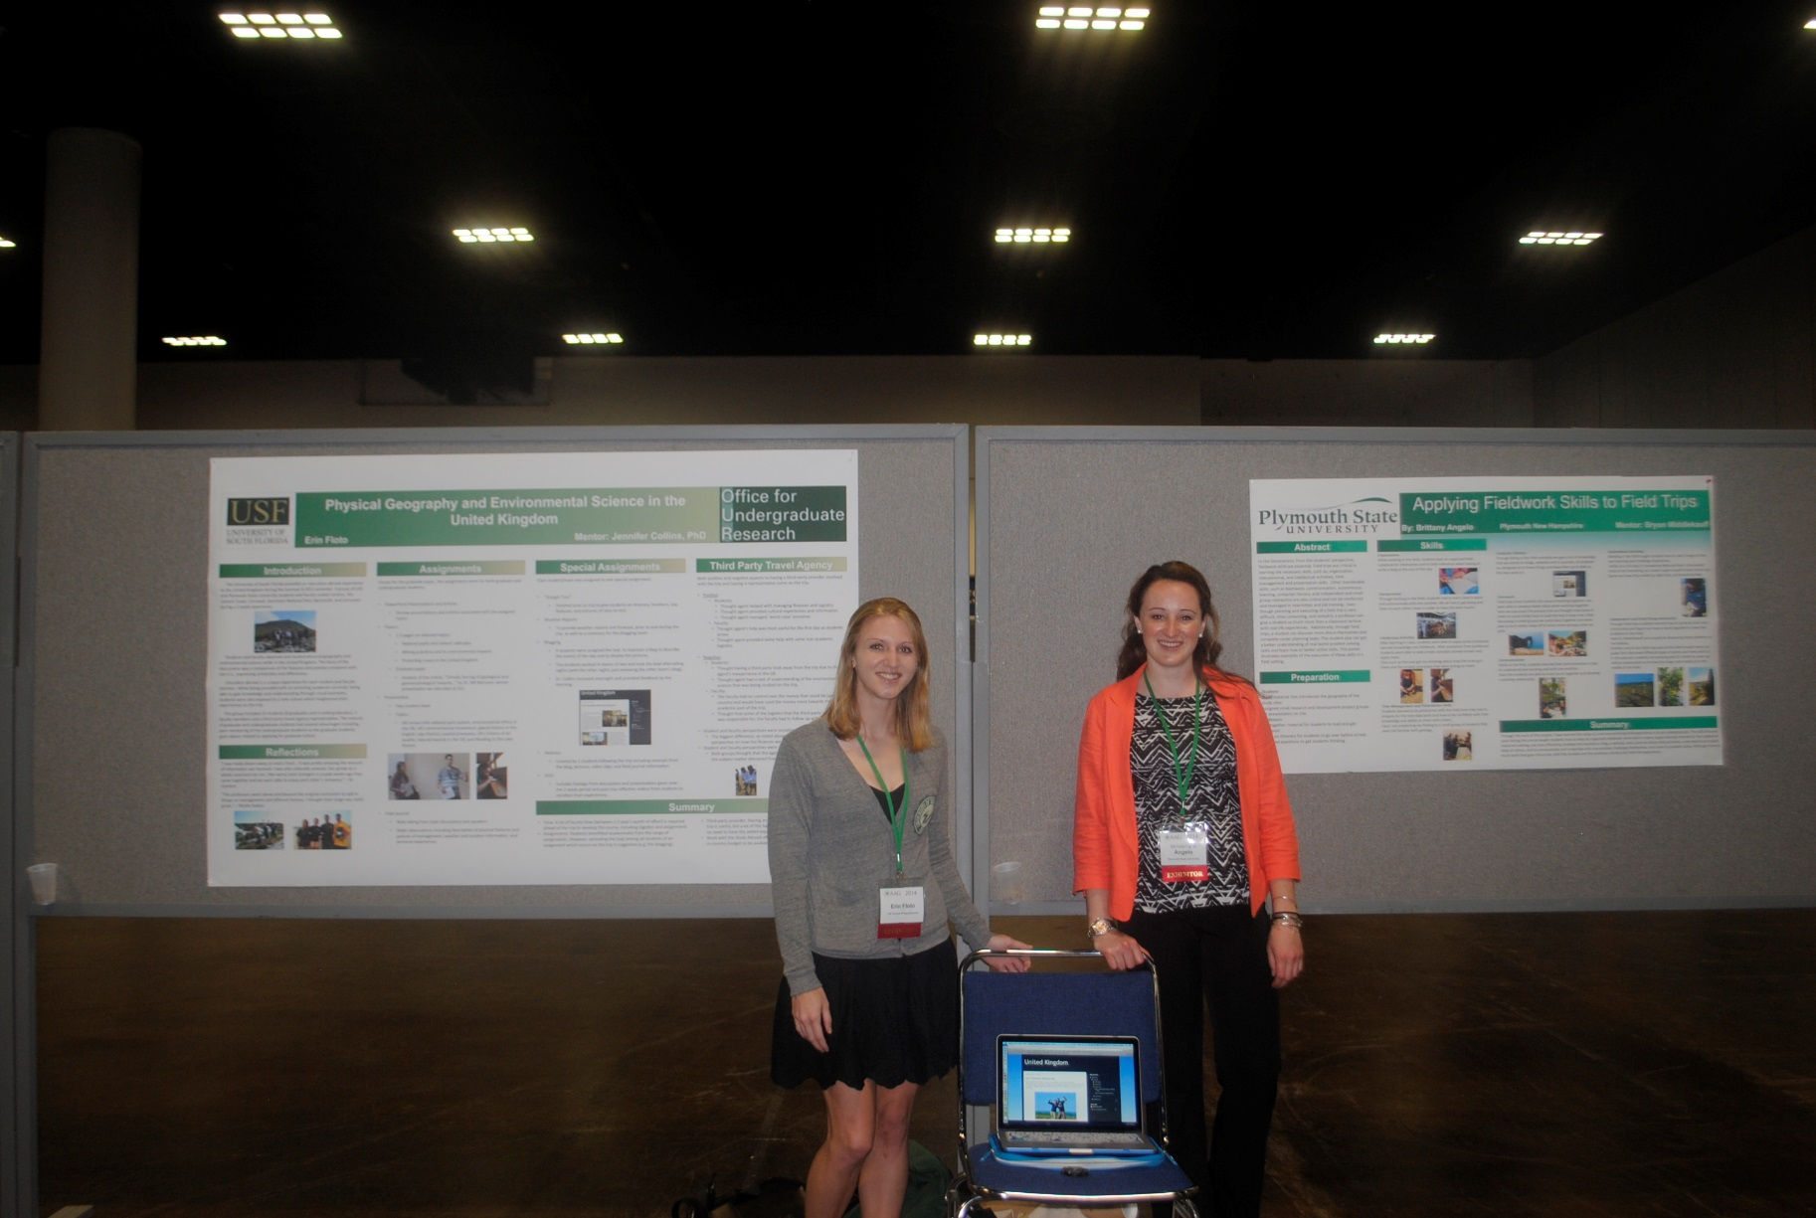

Slide 24
Completed the first trip, what next? Another study abroad?
http://hennarot.forest.usf.edu/main/depts/geosci/ug/study_abroad/

