Slide 1
CABH
CHILD AND ADOLESCENT BEHAVIORAL HEALTH
MASTER OF SCIENCE PROGRAM
Debra Mowery & Laura Rodríguez López

Slide 2
University of South Florida
USF is accredited by the Southern Association of Colleges and Schools Commission on Colleges.
The Princeton Review listed USF as a Best Value College in 2020.
USF Tampa graduate level programs continue to be ranked among the best according to the 2021 U.S. News and World Report.
USF ranks 30th among U.S. public institutions and in the top 250 best universities in the world according to the 2020 Times Higher Education World University Rankings.
USF Tampa is ranked among the best in the 2020 U.S. News and World Report Online Education Program rankings.
2019 & 2020
Notes:
The University of South Florida is a high-impact global research university dedicated to student success. Over the past 10 years, no other public university in the country has risen faster in U.S. News and World Report’s national university rankings than USF. Serving more than 50,000 students on campuses in Tampa, St. Petersburg and Sarasota-Manatee, USF is designated as a Preeminent State Research University by the Florida Board of Governors, placing it in the most elite category among the state’s 12 public universities. USF has earned widespread national recognition for its success graduating under-represented minority and limited-income students at rates equal to or higher than white and higher income students. USF is a member of the American Athletic Conference. Learn more at www.usf.edu.

Slide 3
College of Behavioral & Community Sciences
FY19*
Notes:
Established in 2008 with an emphasis on behavioral sciences.
Home to the Louis de La Parte Mental Health Institute.
Has 17 specialized research centers and Institutes.
2,600 students with eight undergraduate, nine master's, and seven doctoral programs housed in six academic departments.
8,296 graduate students enrolled in online courses (FY18-19).
86% retention rate
400+ graduate degrees awarded annually.

Slide 4
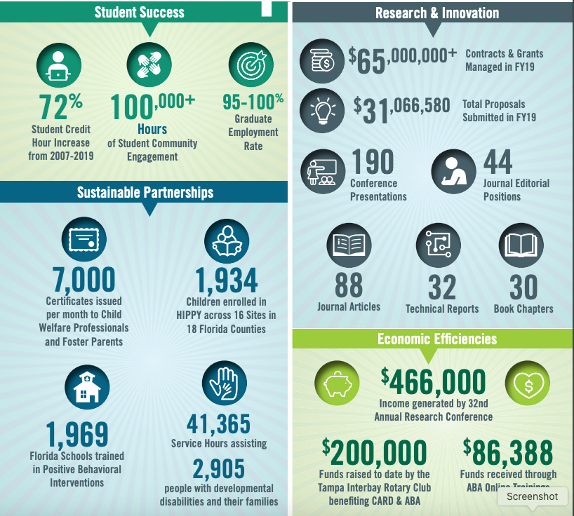
Child & Family Studies Creating Healthy Communities
CFS Vision
CFS is committed to improving the well-being of individuals, children, and families within communities across the country through promoting respect, inclusion, development, achievement, mental health, and an optimum quality of life.
FY19*
Notes:
CFS waseEstablished in 1984.
Home to the Florida Center for Inclusive Communities & the Rightpath Research & Innovation Center.
95-100% Graduate Employment Rate

Slide 5
CABH Program: OVERVIEW
Prepares professionals to serve in public and nonprofit agencies and schools
Graduates serve as: program directors, supervisors, consultants, case managers, evaluators
Graduates work in: NPOs, mental health, substance abuse, juvenile justice, developmental disabilities, child welfare, schools
Advancement to doctoral programs in public health and the behavioral and social sciences
NONCLINICAL program; does not prepare students for certification or licensure unless paired with enrollment in the Addictions & Substance Abuse Certificate. Visit https://bit.ly/2E2HG7q for more info
Notes:
Nonclinical unless paired with enrollment in Addictions & Substance Abuse Certificate

Slide 6
CABH Program: OVERVIEW
100
Percent Online
Full-Time
Part-Time
4
Focus Areas
Developmental Disabilities
2
Tracks
Thesis
Applied (Field Experience)
Leadership
Youth & Behavioral Health
Research & Evaluation
Asynchronous

Slide 7
CABH Program: CURRICULUM
Program Hours: 39
Core Courses:12 credit hours
Comp Exam:
1
Track
Hours:
6
Thesis OR
Applied (Field Experience)
Required Courses: 21 credit hours

Slide 8
CABH Program: ADMISSIONS
Application Deadlines: February 15th & October 15th
University Minimum Requirements
Bachelor’s degree
GPA 3.00
3 letters of recommendation
One-page statement of goals/career objectives
Resume/CV
GRE is required for Thesis Track only
Writing Sample
Additional Program Requirements

Slide 9
CABH Program: GRADUATE CERTIFICATE OPTIONS
Easily integrate one of four graduate certificates into your program of study:
Children’s Mental Health
Positive Behavior Support
Translational Research in Adolescent Behavioral Health
Addiction & Substance Abuse Counseling

Slide 10
CABH Program: TRACKS
Thesis Track
6 credit hours over two semesters
Original research designed and conducted by the student under the supervision of a faculty advisor
Design and propose the thesis project
Collect and analyze data and write the thesis document
Defend the study before a faculty committee

Slide 11
CABH Program: TRACKS
Applied Track (FE)
6 credits hours over two semesters
Work part time at an agency or organization on a child/adolescent behavioral health issue of importance to that entity and of professional interest to the student
Project examples:
Conduct a needs assessment
Develop social marketing strategies
Help develop a strategic plan
Support program development and implementation
Conduct community-based research and evaluation

Slide 12
CABH Program: FIELD EXPERIENCE SITES
FE
Where can I complete my FE?
Encourage students to obtain the site/agency/organization where they will complete their field experience
Has relationships with local agencies/organizations
Can complete FE in present agency/organization but FE must be different from present job
Student Testimonials: https://www.usf.edu/cbcs/cfs/academics/cabh/student-resources/testimonials.aspx

Slide 14
CABH Program: JOBS
Biggest question we get asked:
What jobs are available with this degree?

Slide 15
Potential Areas of Employment Here are some examples: (Please note that many of these jobs require prior experience. USF or any of its affiliates cannot guarantee job placement.)
Education
Employment Specialist
Human Services Coordinator
Special Education Program Coordinator
Director of School Improvement
Program Director
Education First Coordinator
Program Coordinator
Government/Business (Not-for-Profit or other)
Assistant Director
Regional Director of Mental Health Program
YMCA Program Coordinator
Boys & Girls Club Program Director
Admissions & QA Director
Caseworker
Child Protective Investigator
Behavioral Health
Behavior Coach
Child, Youth & Family Trauma Assessment Clinician (no license)
Case Evaluator
Family & Community Engagement Manager
Children’s Behavioral Health Coordinator
Support Counselor (non-clinical)
Behavioral Specialist Consultant
Behavioral Intervention Specialist
Life Child Specialist
Qualified Intellectual Disabilities Professional
Registered Behavior Technician
Criminal Justice
Child Protective Investigator
Case Manager
Sentencing Advocate

Slide 16
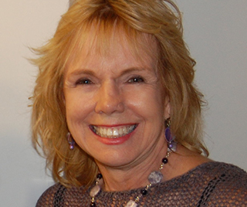
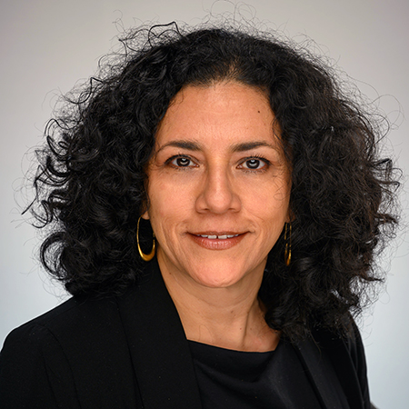
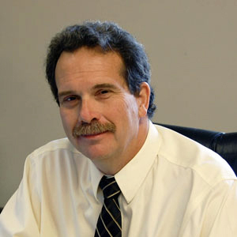
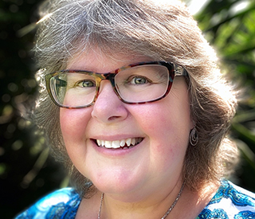
A word from our Faculty Leads
Christopher Vatland (DD)
Elizabeth Perkins (DD)
Linda Callejas (LEAD)
Tom Massey (Research)
Carol Lewis (YBH)

Slide 17
QUESTIONS? CABH Program: CONTACTS
Program Director
Dr. Debra Mowery
mowery@usf.edu | 813-974-6191
New Student Coordinator
Laura Rodríguez López
lrodri11@usf.edu | 813-974-3126
CABH Website
https://www.usf.edu/cabh

Slide 18
THANK YOU!
APPLY NOW

