Slide 1
Spring Faculty Assembly Dean’s Report
Friday April 8, 2016

Slide 2
CBCS SCH Productivity

Slide 3
CBCS SCH Productivity: UG and GR

Slide 4
CBCS Degrees Granted

Slide 5
What are we doing about our decreasing head count?
Marketing our programs
Adding on-line programs
Supporting on-line course conversion
Increasing our study abroad opportunities

Slide 6
Marketing Campaign

Slide 7
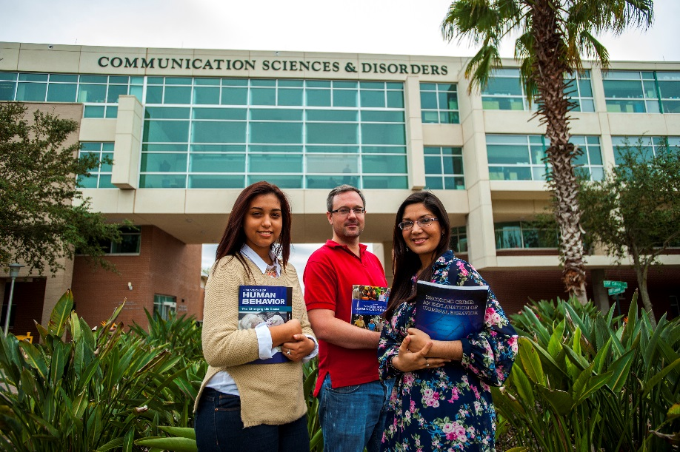
Outreach: Marketing Investments
Admissions Office:
Undergraduate program email marketing campaign
Target HS Seniors and those in CC interesting in transferring
Campaign in Fall 2015/Spring 2016
Over 8,500 emails sent as of 3/4/16
Programs Targeted:
Behavioral Healthcare (27% open rate)
Social Work (27% open rate)
Gerontology (57% open rate)
Long Term Care Administration (57% open rate)
Criminology (32% open rate)
Language-Speech-Hearing Science (62% open rate)

Slide 8
Outreach: Marketing Investments
Innovative Education
Online Criminology Program
Campaign in Fall 2015/Spring 2016
14,000 landing page hits, about 400 viable leads
Social Media Digital Ads
Third Party Website Digital Ads
On-campus Media Ads
Website Landing Page
Digital Brochures for Community College Outreach Efforts

Slide 9
Outreach: Marketing Investments
University Communications & Marketing Campaign
Campaign Spring 2016
Long Term Care Administration, Gerontology, Behavioral Healthcare
Pandora
Facebook
Digital display banners
Mobile geo-targeting
Over 16,000 clicks to our website for more information

Slide 10
Outreach: Marketing Investments
Innovative Education
Online Pre-Req Courses for MS in Speech-Language Pathology
Campaign started March 2016
Social Media Digital Ads
Third Party Website Digital Ads
On-campus Media Ads
Website Landing Page
Digital Brochure

Slide 11
On-line course offerings and programs

Slide 12
CBCS Online Programs and Courses
M.A. in Child & Adolescent Behavioral Health
Post Baccalaureate SLP Sequence
M.S. in Applied Behavior Analysis
M.S.W. in Social Work

Slide 13
CBCS Online Course Conversions
30 courses converted to online in AY2015-16
23 courses scheduled for conversion in AY 2016-17

Slide 14
CBCS Online Courses

Slide 15
Study Abroad

Slide 16
CBCS Study Abroad Initiative
2016 Programs: Brazil, Florence, India, Ireland, London, Rome
New CBCS Study Abroad Scholarship program
15 scholarships
Range from $500 to $1500

Slide 17
Contracts and Grant Awards

Slide 18
Number of CBCS Contract & Grant Awards (as of 4-01-16)

Slide 19
CBCS Research: Awards (as of 4/01/16)

Slide 20
Proposal Submitted and Sponsored Award Total $$
Millions of dollars

Slide 21
Effective Indirect Cost Rate

Slide 22
Development

Slide 23
YTD Commitments
*27% Increase In Commitment From Fiscal Year 2015 to Fiscal Year 2016 through 03/12/16

Slide 24
Source of funds

Slide 25
Progress towards Goal

Slide 26
Challenges and Opportunities

Slide 27
Student Success: Ready, Set, Work
Criminology and Psychology programs statewide = 100%
Criminology graduates: 67% employed + 18% continuing education
Infusion of career development and employability into curriculum in several courses and/or one course

Slide 28
Outreach: Social Media
Review of social media sites within college:
Facebook: CBCS, SAS, SSW, CFS (grant project)
Twitter: CBCS, CFS (grant projects)
Instagram: CBCS, CFS (grant projects)
Goals:
Unify and coordinate social media presence
Provide training to staff who manage social media sites
Create “Like” campaign to promote social media sites

Slide 29
