Slide 1
College of Behavioral & Community sciences
FALL Faculty & Staff assembly
October 18, 2019
Notes:
The Fall Semester agenda for the Faculty Assembly shall be prepared by the Faculty Council Chair in consultation with the Dean. The Agenda shall include a report from the Dean of achievements of the past year, progress made toward Strategic Plan goals, a report of the College’s finances; a report of the Faculty Council, reports of the activities of the Standing Committees.

Slide 2
Agenda
Welcome
Welcome New Faculty & Staff
Report of the Faculty Council
USF Senate Updates
Curriculum Committee Report
Report of the Research Council
Dean’s Report & Updates
CBCS Healthy Culture Crew
Research Presentation- Dr. Soomi Lee
Open Discussion; Questions & Answers
Faculty Voting- open discussion (Staff Dismissed)

Slide 3
Welcome New Faculty
Front row from left to right: Nasreen Sadeq/ Aging Studies/ Visiting Instructor I; Gizem Hülür / Aging Studies / Assistant Professor; Dean Julie Serovich; Nicoleta Zenn / MHLP / Instructor I; Hannah Gospodinsky / CSD / Visiting Clinical Instructor; Lauren Baxley / Rehab / Instructor I
Back row from left to right: Natalie Mikkelson / CSD / Visiting Clinical Instructor I; Micah Johnson / MHLP / Assistant Professor; Kelli Gorajec / CSD / Visiting Assistant Professor; Pamela Alvarez / SOW / Instructor I; Matthew Moore / SOW / Assistant Professor; Mateus Renno Santos / Criminology / Assistant Professor;
Not pictured: Adithya Chandregowda / CSD / Visiting Assistant Professor; Chris Groeber / SOW/ Instructor

Slide 4
Welcome New Staff
First Name | Last Name | Department Name | Job Title
Wrenita | Allen | Child & Family Studies | Community Outreach Caseworker
Yaritza | Carmona | Child & Family Studies | Research Support Specialist
Yazmin | Castellano | Child & Family Studies | Human Services Practitioner
Candice | Cohens | Child & Family Studies | Fiscal & Business Specialist
Elizabeth | Davis | Child & Family Studies | Assistant Director
Katrina | Emerich | Child & Family Studies | Human Services Practitioner
Morgann | Frazee | Child & Family Studies | Human Services Pgm. Specialist
Christopher | Gore-Gammon | Child & Family Studies | Media Technologist
Gladys | Herrera Gil | Child & Family Studies | Community Outreach Caseworker
Flandra | Ismajli | Child & Family Studies | Social & Behavioral Researcher
Maria | McDonald | Child & Family Studies | Research Support Specialist
Gwen | Nguyen | Child & Family Studies | Community Outreach Caseworker
Lourdes | Quinones | Child & Family Studies | Human Services Practitioner
Paola | Ramirez | Child & Family Studies | Learning & Devt Facilitator
Diego | Vergaray | Child & Family Studies | Staff Assistant
Jennifer | Pedraza | Communication Sciences & Disorders | Clinical Research Associate
Carrie | Secor | Communication Sciences & Disorders | Speech-Lang Pathologist/Audio
Kathy | Williams | Communication Sciences & Disorders | Administrative Specialist
John | Everett | Dean's Office | Fiscal & Business Specialist
Eric | Hill | Dean's Office | Building & Security Assistant
Noemy | Pita | Dean's Office | Executive Administrative Spec.
Travis | Taylor | Dean's Office | Academic Advisor I
Kavitha | Gopalakrishnan | Mental Health Law & Policy | Data Management Analyst
Sandra | Johnson | Mental Health Law & Policy | Staff Assistant
Abigail | Shockley | Mental Health Law & Policy | Program Director
Megan | Anthony | School of Aging Studies | Academic Program Specialist
Notes:
24 new hires!

Slide 5
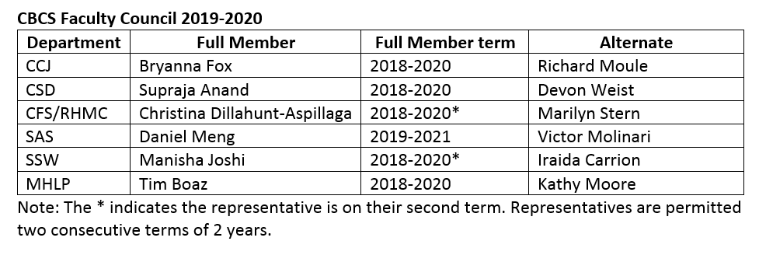
2019-20 Faculty Council Members
Christina Dillahunt-Aspillaga, Chair
Bryanna Fox, Vice-Chair

Slide 6
Faculty Council - Governance
Faculty members have the principal responsibility for originating policy in the following areas:
Academic policy, including initial authorization & direction of all courses, curricula, & degrees offered;
Scholastic policy, including scholastic standards for admission, grading, continuation, graduation, and honors;
Academic ethics, including development of policies & procedures;
Research.

Slide 7
Faculty Council - Governance
With collaboration with the administration make recommendations in the areas of:
Policies and procedures for faculty appointment, promotion & tenure review, reward systems;
Discipline & termination;
Student conduct & activities;
Budgetary review & strategic planning;
Selection & review of academic administrators;
Development of policy concerning the general academic welfare of the University.

Slide 8
Shared Governance
The Faculty Council is responsible for ensuring that the Faculty’s role in the shared governance process of CBCS is consistent with the USF Faculty Senate principles of shared governance.
Representation needed on the Undergraduate Council
CBCS Governance Document- CBCS Intranet
Councils & Committees Document
https://intra.cbcs.usf.edu/FacultyGovernance/

Slide 9
Faculty Council Activities/Updates
Deans Awards Spring 2020
Continued CBCS Diversity Committee
Student diversity climate survey
Subcommittees: Physical environment, Events, Training/Resources, Student issues, Communication
Attend to Faculty Concerns
Notes:
College Awards
•2 international travel and 1 internal research grants
•Dean’s Awards for:
•Outstanding Undergraduate Student Research
•Outstanding Graduate Student Research
•Outstanding Graduate Faculty Mentor
•Outstanding Faculty Service
•Outstanding Research Accomplishment
•Increase participation
December announcement.

Slide 10
Faculty Senate Update
Tim Boaz

Slide 11
Faculty Senate Overview & Updates
The Faculty Senate is the primary faculty advisory body to the University of South Florida President, Provost, and Vice President for Health on all matters that pertain to the academic climate of the university.
President: Tim Boaz (CBCS, MHLP) MHC2736, Ext. 4-1933; E-mail: boaz@usf.edu

Slide 12
Faculty Senators from CBCS
Brent Small – SAS (2019-21)
Kimberly Crosland – CFS (2018-20)
Ray Miltenberger – CFS (2018-20)
Ann Eddins – CSD (2019-21)
Nan Sook Park – SSW (2019-21)
Lyndsay Boggess – CRIM (2020-22)
Timothy Boaz – MHLP (2019-21)

Slide 13
Faculty Senate Council Representatives from CBCS
Graduate Council
• Amy Davis - CSD (2018-21)
• Ray Miltenberger, Chair – CFS (2018-21)
Educational Policy & Issues
• Elizabeth Cass – CRIM (2019-22)
Undergraduate Council
• TBD
Publications Council
• Matthew Foster – CFS (2018-21)

Slide 14
Faculty Senate Council Representatives from CBCS
Faculty Issues
Debra Dobbs - SAS (2017-20)
Student Admissions
Steve Surrency – CSD (2017-20)
General Education
William Haley – SAS (2018-21)
Samantha Thomas – CSD (2018-21)

Slide 15
Faculty Senate Council Representatives from CBCS
Technology in Instruction & Research
• Timothy Boaz – MHLP (2018-21)
Honors & Awards
• Victor Molinari - SAS (2019-22)
Research Council
• Marilyn Stern – CFS (2019-22)
Library Council
• Amy Vargo – CFS (2017-20)

Slide 16
Faculty Senate - Consolidation
Done
• Tenure & Promotion Guidelines
• Curriculum Alignment
In Progress
• Develop Governance Documents
To Be Done
• Instructor Promotion Guidelines
• Put New Faculty Senate & Councils in Place

Slide 17
Faculty Senate
Provost's Initiatives
Building a Digital Ecosystem
Graduate and Professional Student Success
Faculty Success

Slide 18
Tenure and Promotions

Slide 19
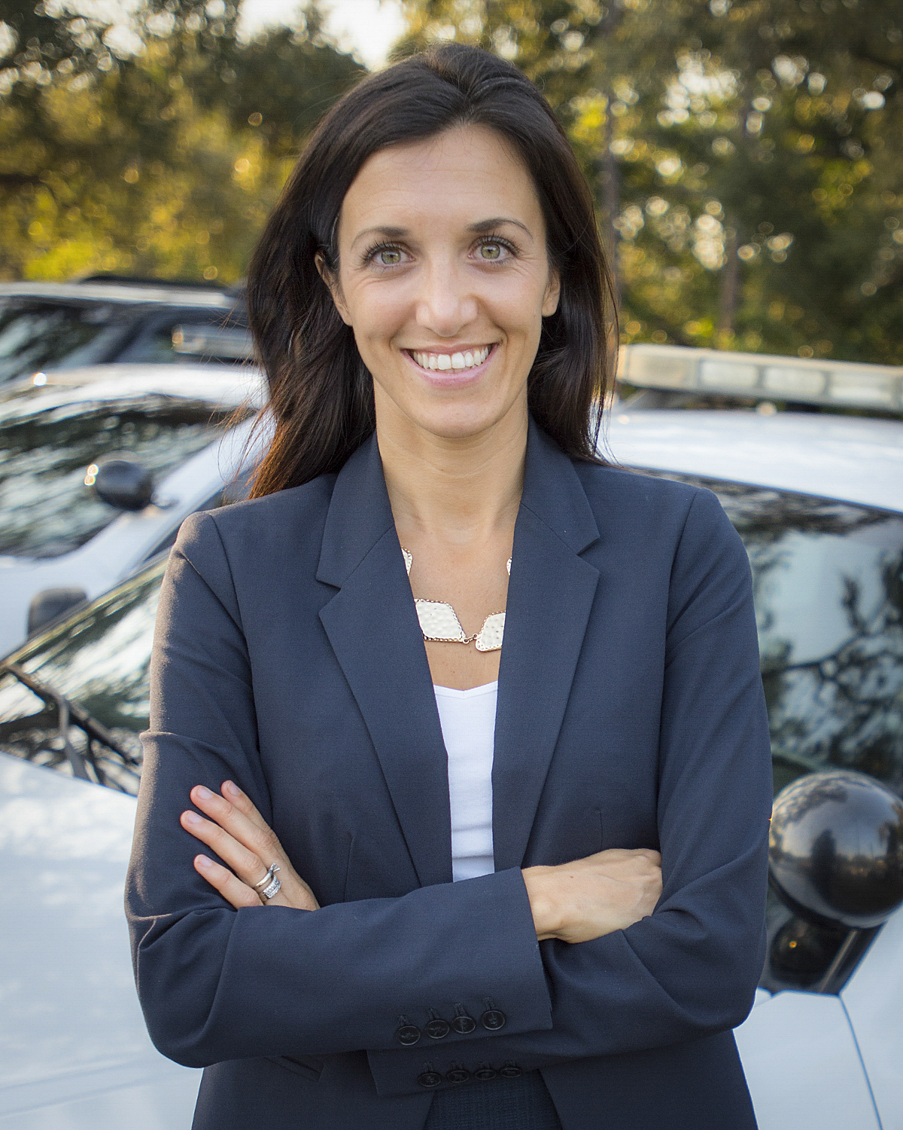
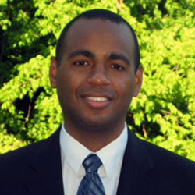
Tenure & Promotion
Bryanna Fox: Criminology Associate Professor
Khary Rigg: Mental Health Law & Policy Associate Professor

Slide 20
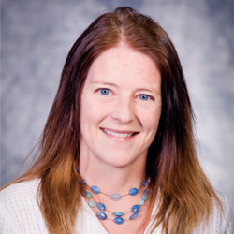
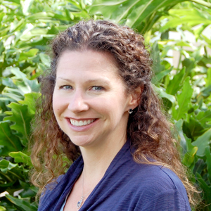
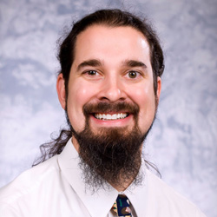
Research Promotions
Kathleen Moore, Mental Health Law & Policy Research Professor
Heather George, Child & Family Studies Research Professor
Scott Young, Mental Health Law & Policy Research Associate Professor

Slide 21
CBCS T&P Applications
List of committee members distributed
Tenure and Promotion update
T&P Applications
Associate: 1
Full: 2
Research Associate: 0
Research Professor: 3
Instructor: 6
Mid-tenure review: 2

Slide 22
Curriculum Committee Update
Chris Simmons

Slide 23
CBCS Curriculum Committee 2019-20
Andrea Smith, Communication Sciences & Disorders
Chris Simmons, School of Social Work, Chair
Tammy Jorgensen Smith, Child & Family Studies
Khary Rigg, Mental Health Law & Policy
Bill Haley, School of Aging Studies
Andrew Franz, Criminology

Slide 24
CBCS Curriculum Committee Charge:
Meets monthly in Fall and Spring semesters.
Reviews all proposals for new undergraduate and graduate courses and programs, including minors and certificates.
Reviews all substantive undergraduate/graduate catalog changes, and curriculum changes.
Makes recommendations to the USF Undergraduate Council and Graduate Council regarding action on such proposals. If needed, returns proposals to departments or programs with suggested revisions.

Slide 25
Diversity Committee Update
Maria Carlo

Slide 26
CBCS Diversity & Inclusion Committee
Kerianne Beckford, Dean’s Office
Kwang-Sun Blair, Child & Family Studies
Maria Carlo, Child & Family Studies
Yazmin Castellano, CFS Florida Center for Inclusive Communities
Jerome Galea, School of Social Work
Rocky Haynes, Child & Family Studies
Alejandra Montoya, Dean’s Office
Cheryl Paul, Communication Sciences & Disorders
Sara Rhode, Mental Health Law & Policy
Therese Sandomierski, CFS Florida Center for Inclusive Communities
Michon Shaw, Communication Sciences & Disorders
Steven Surrency, Communication Sciences & Disorders
Melissa Thompson, School of Social Work
Tracy-Ann Gilbert-Smith, Child & Family Studies

Slide 27
CBCS Diversity & Inclusion Committee
The CBCS Diversity and Inclusion Committee was established in 2017 by the CBCS Faculty Council.
In 2019 we began efforts toward helping CBCS achieve recognition as a National Model of Diversity.
During the 2019-2020 academic year the committee will work on two of the ten criteria outlined under the model
conduct a climate survey intended for students, faculty and staff
survey courses that address diversity content

Slide 28
CBCS Research Council Update
Howard Goldstein
Associate Dean for Research

Slide 29
CBCS Research Council Members 2019-2020
Marilyn Stern (Chair), Child & Family Studies
Amber Gum (Vice Chair), Mental Health Law & Policy
Brent Small (Fall sabbatical)/Bill Haley (Fall member), School of Aging Studies
Joseph Walton, Communication Sciences & Disorders
Maayan Lawental, School of Social Work
Mike Lynch, Criminology
Howard Goldstein (ex officio), Dean’s Office
Julie Kuhn (ex-officio), Dean’s Office

Slide 30
Awards & Application Due Dates
CBCS International Collaborations Grant: due October 25, 2019
Amount: up to $2,000
CBCS Internal Grant: due November 1, 2019
Amount: up to $20,000
Applications are currently being accepted for both CBCS award opportunities. Please email cbcsresearchcouncil@usf.edu with any questions or to submit your application.
*There are also internal grants available through USF. Additional information can be found on the USF Sponsored Research website. https://www.usf.edu/research-innovation/sr/internal-awards-program.aspx

Slide 31
2018-19 CBCS Research Productivity
 | Prior Year | Achieved (prelim data)
Grant Proposals submitted | $158,204,046 | $ 152,110,931
Grant Awards | $ 28,880,923 | $ 30,962,265
Total Expenditures | $ 27,045,645 | $ 28,765,403
Overall F&A Rate | 14.26% | 13.81%

Slide 32
Healthy Culture Crew Update
Brenda Clark

Slide 33
CBCS Wellness- Healthy Culture Crew
Join us every Wednesday for Walking Wednesdays at noon in the MHC Atrium for a 30-minute walk around the college.
Thursdays, you can stretch & unwind during Yoga at noon in room MHC 2625, starting September 19th.
Monthly newsletter, share it with your friends & subscribe! Newsletter sign up
Join The Crew, attend our next planning meeting November 13th at 10 a.m. in MHC 1141.

Slide 35
Dean’s Report/State of the College
Dean Julie Serovich

Slide 36
CBCS Strategic Plan Goals
Goal 1: Promote Student Success
Goals AY 18-19 | Goals AY 19-20
Sustain four-year graduation rate at 70% or higher: Achieved; 75% | Undergraduate Research Certificate Program: Restructure Expand Increase Enrollment Establish Task Force
Graduate 90% students without excess hours: Achieved; 91%
Increase doctoral stipends to $22,500: Achieved
Finalize courses for Gen Ed Tier 3 and 4: Achieved: 3 courses approved in the Personal & Social Responsibility Tier with 1 additional course resubmitted for review; 2 courses approved in the Integrative & Applied Learning Tier (HIP)
Expand Study Abroad Student Participation: Achieved: 105 participants (goal was 92)
Publicize multi-year course timetables: Achieved

Slide 37
CBCS Strategic Plan Goals
Goal 2: Deliver High Quality Academic Programs that respond to societal needs and student interests
Goals AY 18-19 | Goals AY 19-20
Pursue Master’s degree in Marriage & Family Therapy: Achieved | Continue to increase the “Getting Started Module” to facilitate student success in online courses: Achieved as of 8/30/19
Increase undergraduate student headcount: Achieved (1,926) | Explore the possibility of offering education/training on tele mental health, integrated health/behavioral healthcare, and other inter-professional opportunities
Collaborate with USF Consolidation Initiative: Achieved | Explore if there are additional Study Abroad Programs that BCS should be offering
 | Develop Instructor Pathway

Slide 38
CBCS Strategic Plan Goals
Goal 3: High Impact Research
Goals AY 18-19 | Goals AY 19-20
Continue positive trajectory of external funding: Achieved | Review departmental mentor plans.
 | Increase awareness of faculty teaching and research through multiple media outlets.
Continue to increase number of tenure-line faculty: In Progress
Implement Path to Professorship program: Achieved
Expand number of faculty pursuing National Awards: Achieved

Slide 39
CBCS Strategic Plan Goals
Goal 4: Engage Community in All Aspects of CBCS Mission
Goals AY 18-19 | Goals AY 19-20
Promote community awareness of the relevance of CBCS research to community issues: In Progress | Actively Engage Community Advisory Committees in academic programs and student career development Engage business community to advise on initiatives related to mental health Lunch & Learn in business community to expose BCS unites work Mirror or replicate office of community engagement
Sponsor two college-wide community colloquia: Achieved
Engage Community Advisory Committees in academic programs: In Progress

Slide 40
CBCS Strategic Plan Goals
Goal 5: Diversify funding sources
Goals AY 18-19 | Goals AY 19-20
Continue to explore feasibility of a cost-recovery program in every unit: In Progress (Cybercrime, ABA, Social Work); SAS in the proposal phase | Continue plans to increase donor funding for CBCS programs and students by 10% each year
Increase donor funding, particularly for student scholarships: In Progress | Ensure each department/school has a systematic communication plan with alumni Will be seeking a presentation during the year about what all units are doing

Slide 41
CBCS Strategic Plan Goals
Goal 6: Engage Faculty/Staff in Shared Governance
Goals AY 18-19 | Goals AY 19-20
Continue ongoing dialogue on strategic plan implementation: In Progress, strategic plan discussions held at Faculty Assembly | Continue town hall meetings to obtain input on important college issues
Identify factors that limit participation & develop strategies to support faculty/staff participation in governance: In Progress, All standing committees constituted with one exception; Faculty Council active and functioning; still need to do more to achieve intent | Continue to increase the number of faculty nominated for and receiving awards

Slide 42
Budget

Slide 44
Budget

Slide 45
Budgetary challenges
Potential Recurring Costs Covered on Cash:
T&P Increases - $72,500 (Estimate)
GA Increases - $50,500 (Estimate)
Adjunct Union
Pay Increases

Slide 46
Pay increases

Slide 47
Budgetary challenges
Potential Recurring Costs Covered on Cash:
T&P Increases - $72,500 (Estimate)
GA Increases - $50,500 (Estimate)
Adjunct Union
Pay Increases
Possible overall budget cut

Slide 48
budget

Slide 49
Consolidation Update
Notes:
http://r20.rs6.net/tn.jsp?t=84efxa6ab.0.0.mxxqjaeab.0&id=preview&r=3&p=https%3A%2F%2Fwww.fulbright.org.au%2Falumni%2Ftedxfulbright%2F

Slide 50
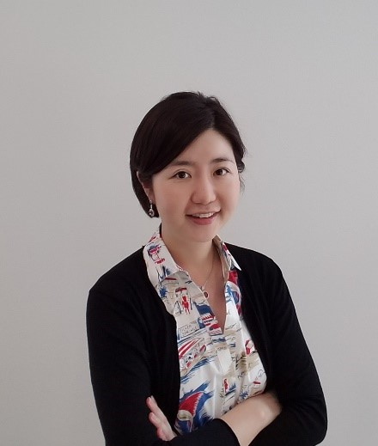
Presentation - Sleep, Stress & Health
Soomi Lee, PhD
School of Aging Studies
Notes:
http://r20.rs6.net/tn.jsp?t=84efxa6ab.0.0.mxxqjaeab.0&id=preview&r=3&p=https%3A%2F%2Fwww.fulbright.org.au%2Falumni%2Ftedxfulbright%2F

Slide 51
Men’s Health: Better Sleep, Less Swelling & Reduced Risk of Inflammation JULY 29, 2019 RESEARCH AND INNOVATION
https://www.usf.edu/news/2019/lee-sleep-study-oa.aspx

Slide 52
Questions?

Slide 53
Faculty Discussion
Staff Excused
Time for Faculty discussions and presentation of any items that may necessitate a Faculty vote.

Slide 54
Thank you!

