Slide 1
Faculty Diversity Best Practices:
DEI and your Search Committee
Presented to CBCS | September 12, 2022
Clara Buie, M.Ed.
Director, Diversity, Equity, and Inclusion

Slide 2

Why do Diversity, Equity, and Inclusion matter in the search process?

Slide 3
Presentation Overview
Equity-Minded Questions and Interactions
Leveraging the Network
Proactive Efforts
Implicit Bias

Slide 4
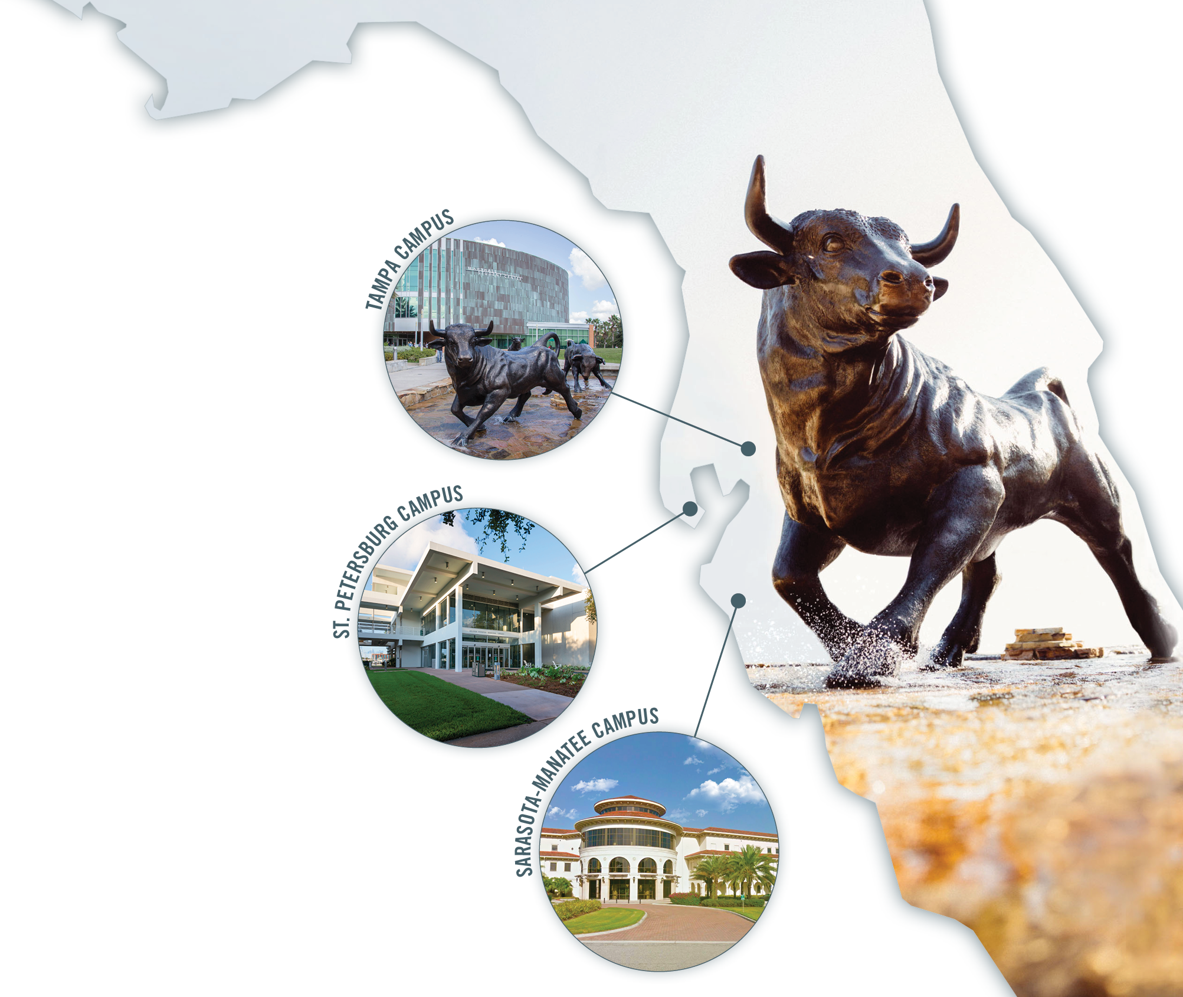
Inclusive Excellence
Diverse student body and community
Elimination of achievement gap in retention and graduation
Anti-Racism Initiative: $500K Grants
Staff Salary Equity Taskforce
USF Faculty Senate Resolution and Council on Racial Justice
New Strategic Plan: DEI is a core institutional commitment

Slide 5


Faculty vs. Student Diversity at USF
 | STUDENTS | FACULTY
White | 53% | 66%
Hispanic/Latino | 22% | 6%
Asian | 8% | 16%
Black/African American | 10% | 5%
Two or more | 4% | 4%
*These numbers were provided by the Office of Decision Support as part of the 2020-2021 USF pocket fact book and the USF Equity Report (2019-2020). Figures are rounded for convenience of reporting.

Slide 6
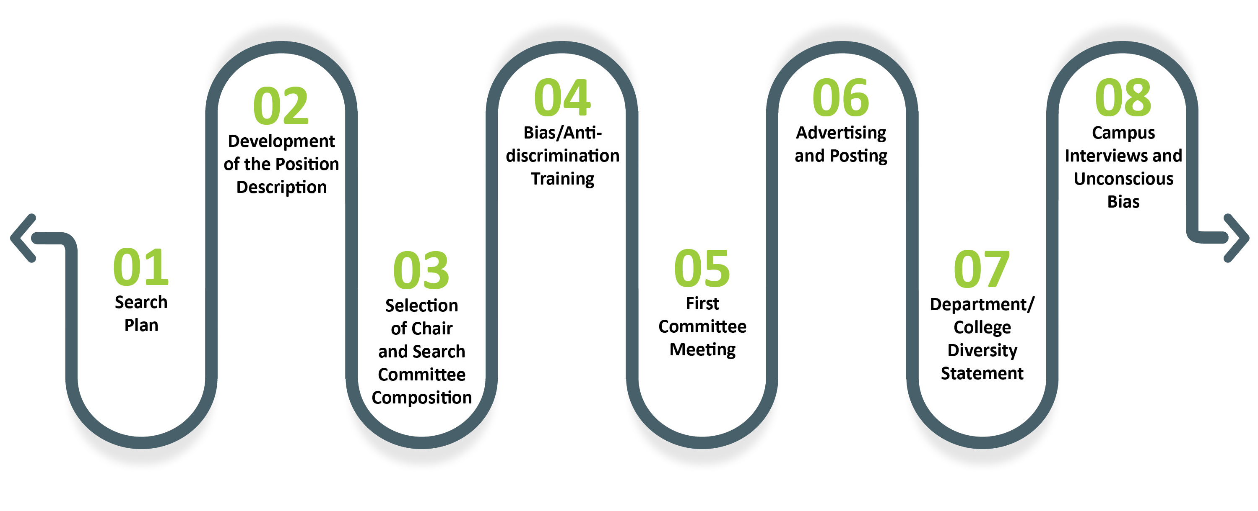
Visual Representation of the Process
Personal connections should be cultivated throughout the process to diversify faculty pool.

Slide 7
Strategies Before Search
  Showing commitment to diversity
  Ensuring a diverse search committee/diversity search advocate
  Support for diversity as an institutional value
  Ensuring a strong pool of diverse applicants
  Understanding diversity resources on campus, including affinity groups/employee resource groups/Presidential Advisory Committees

Slide 8

Position Description
Frame the position as broadly as possible
Clarify required versus preferred qualifications
Request that candidates describe experience working with diverse populations
Highlight interdisciplinary opportunities
Include AA/EO language that strongly conveys your DEI commitment
Consider an enhanced diversity statement

Slide 9
Position Description Sample Language
Experience with a variety of teaching methods and/or curricular perspectives
Previous experience interacting with communities of color
Experience in cultures other than their own
Academic experiences and interests in culturally diverse groups
Interest in developing and implementing curricula that address multicultural issues
Demonstrated success in working with diverse populations of students

Slide 10




Proactive Recruiting: Advertising and Posting
Traditional ad placement:
Diverse: Issues in Higher Education
Women in Higher Education
Hispanic Outlook in Higher Education
Insight into Diversity
Search committee members are active participants
in the process.
Engage your DEI councils
in your relationship-
building efforts.

Slide 11








The Search Plan: RECRUIT!
Engage all members in efforts to promote DEI
Create diverse lists of nominators and potential nominees
Identify list-serves, blogs, journal editorial boards, past colloquia, etc.
Attend conferences
Utilize award and fellowships lists
Consult with colleagues from underrepresented groups at and beyond USF
Update web presence and include DEI statement
Articulate your goals and priorities
Personal connections may be the most effective way to diversify the pipeline.

Slide 12
Identifying Diverse Talent
Pursue ad placement in your national association job bank and send individual postings to smaller sections and sub-disciplines.
Review the research presentation titles given at national conferences to identify diverse faculty (Example: Association of Black Sociologists conference; Society of Hispanic Engineers; Society of Women, etc.).
Fellowship and award programs: Target fellowships that recognize diverse scholars (Ford, McKnight, FL-AGEP, and target post-docs)
Consider faculty who might be at institutions undergoing turmoil.
Send a personalized email** from the Search Chair inviting people to apply
Personal connections may be the most effective way to diversify the pipeline.

Slide 13
Candidate Evaluation and Interview
Conduct a thorough review with standardized tools
Control bias and be vigilant about conversations about “fit”
Engage in an Inclusive interview process
  Standard campus visit protocol and questions
  Inclusive interviewing versus microaggressions
  Scheduling intentional meetings with affinity groups
Evaluate the long/short lists with attention to equity
Additional Resources: Standard Evaluation Tool (UMich) Specialized Form for department/sub-discipline

Slide 14
Interviews and Unconscious Bias
Women and underrepresented minorities (URM) tend to be held to higher standards
Implicit cues in reference letters
Implicit bias in application evaluations
URM and women have achievements evaluated less positively than white men of equal accomplishment
Expectations of engagement with DEI priorities
Avoid evaluations based on superficial observations.

Slide 15
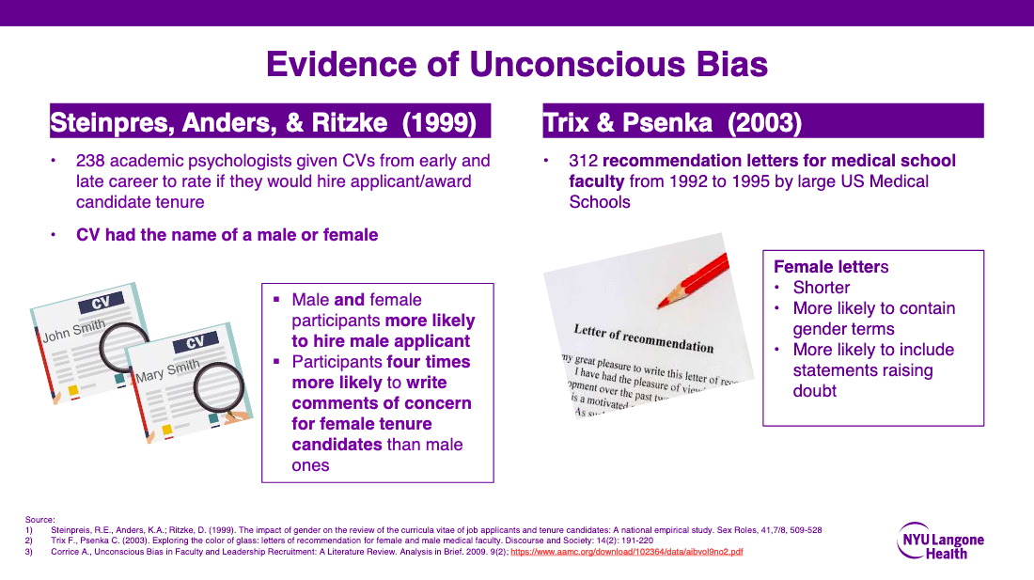
Source: UNCONSCIOUS BIAS & FACULTY
RECRUITMENT AND RETENTION, NYU Health

Slide 16
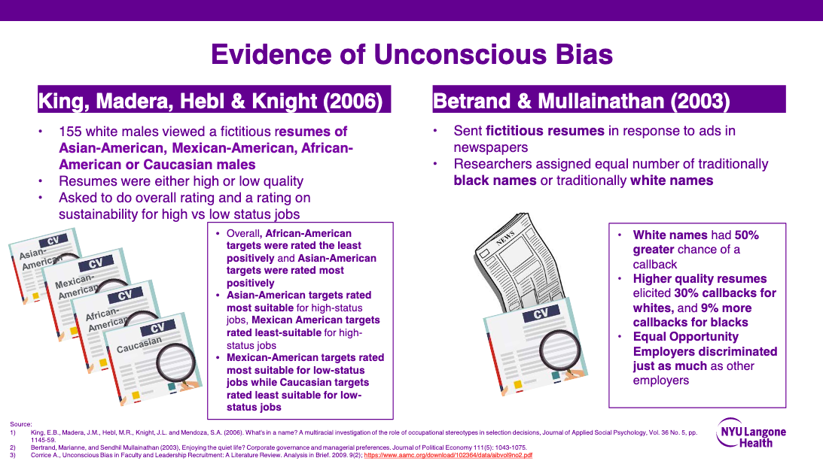
Source: UNCONSCIOUS BIAS & FACULTY
RECRUITMENT AND RETENTION, NYU Health

Slide 17
Strategies During Search
Misuse of “FIT” in the search process
Avoid the snap judgments that pass for fit (who I would like to go for coffee after work, “we have chemistry” etc.)
Avoid mistaking “rapport with the candidate” for a “skill”
Avoid identity-based barriers
Interviews should evaluate qualifications of the applicant that are relevant to a faculty position – questions about matters that are not job relevant (i.e. family status) are not allowed.

Slide 18
Avoid Questions that Might be Misunderstood as Discriminatory or Offensive
Federal Equal Employment Opportunity (EEO) laws and regulations prohibit discrimination against applicants on the basis of race, color, religion, gender/sex, national origin, age, handicapping condition, marital status, political affiliation, genetic information.
USF Policy: “Singling out or targeting an individual for different or adverse treatment with improper consideration of the individual’s race, color, marital status, sex, religion, national origin, disability, age, genetic information, sexual orientation, gender identity and expression, or veteran status” is prohibited.
Do you have a disability? Are you pregnant? What is your age? Are you a US Citizen?
Do you have children? What church do you attend?

Slide 19
Full Circle
DEI advocacy throughout the process
Revisiting short and long lists
Intentional Campus Visits
Relationship-building
      Maintain contact with interesting applicants
      Create a standing committee for future potential candidates
End of search DEI debriefing
Department DEI Plan: Holistic Equity Assessment and Goal-setting

Slide 20
Faculty Recruitment Checklist
Work with Chair to define position broadly
Ensure diverse search committee composition
Conduct implicit bias training and review (first committee meeting)
Ensure an inviting and broadly distributed advertisement
Create Advertising/Marketing PLAN to diversify
Actively RECRUIT candidates
Standardize and discuss evaluation criteria
Establish standard interview questions and review ILLEGAL ones
Create and re-evaluation short lists based on defined criteria and equity-mindedness

Slide 21
Data Resources
Faculty Diversity Resources
USF DARE Dashboard
USF Department Specific data
NSF: Survey of Earned Doctorates
NCSES Survey Data
ACE: Race and Ethnicity in Higher Ed
National Center for Faculty Development and Diversity
University of Michigan: ADVANCE grant
Brown University: Guide to Diversifying Faculty
Cornell University: Best Practices
University of Michigan Standard Evaluation Tool
Specialized Form for department/sub-discipline

Slide 22
Clara Buie, M.Ed.
Director, Diversity, Equity, and Inclusion buiec@usf.edu

