Slide 1


Expeditated Mid-Term Elections Candidate Elections
Next meeting: September 10, 2020 10:00 am- 11:00 am
Via Teams
This meeting is mandatory to maintain your candidacy.

Slide 2
Elections Rules Commission
Supervisor of Elections – Shemar Mckoy, shemarmckoy@usf.edu
SG Advisors – Jennifer Bielen, bielenj@usf.edu | Bart Stucker, bstucker@usf.edu | Robert Herron, robertherron@usf.edu
Responsibilities:
    Responsible for ensuring the education of candidates and tickets and holding them accountable to all relevant SG rules and policies.
    Clarification of any questions you may have regarding rules and procedures.
    Ensuring a fair election, operating official polling stations, resolving minor violation.
    The ERC is advised by Student Government Advising,(SG Advising)

Slide 3
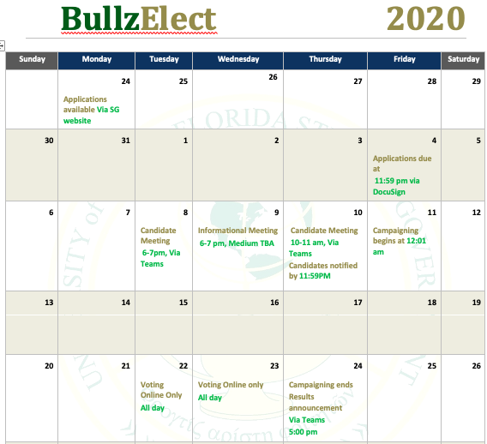

Slide 4
What is it like to be a Senator?
A senator’s role is to responsibly serve and represent ALL students at USF.
Complete the number of audits per semester as required by statutes. Write and approve all system-wide legislation.
Senators help decide how the Activity and Service Fee (A&S) revenue is distributed among University entities and organizations.
Communicate regularly with the USF community and their constituents.

Slide 5
What is it like to be a Senator?
Senators MUST attend Tuesday night senate meetings (typically 6pm-10pm).
This position will be allotted a maximum of 10-20 hours per week depending on prospective leadership role.
Some exceptions may be made for exams and class conflicts that require late arrival/early departure.
Perform all other duties as necessary to the position.

Slide 6
Open Senate Seats Per Campus
Tampa | 14
St Petersburg | 4
Sarasota-Manatee | 3

Slide 7
What is it like to be a Campus Council Representative?
Travel mostly consists of local campus events/meetings with the occasional trips to the other two campuses as needed.
This position will be allotted a maximum of 10 hours per week.
Oversee all local items such as: funding, approval of Rules of Procedure (ROP’s) and Standards of Procedure (SOP’s).
Perform all other duties as necessary to the position.

Slide 8
Open Campus Council Seats Per Campus
Tampa | 7
St Petersburg | 9
Sarasota-Manatee | 5

Slide 9
Campaigning (Chapter 706 in SG Statutes)
Campaign Staff
Any person who is helping a campaign ticket in any administrative capacity.
Updated Campaign Staff Lists must be submitted prior to campaigning and updated by 5PM every Friday until voting concludes.
Ensure that all Campaign Staff is familiar with campaign rules (Title VII).
Candidates and Campaign Tickets can be held liable for the actions of Campaign Staff.
Campaign Volunteers
Any person who is helping a campaign ticket in any non-administrative capacity

Slide 10
Campaigning (Chapter 706 in SG Statutes)
Contribution Statement
All of the money / resources being used or spent to campaign, whether donated from an outside sources or personal “out-of-pocket”.
Expense Statement
Record of how your contributions were allocated, what you spent money on. This statement shall include receipts attached.
A Campaign Ticket shall submit an amended expense form to the Election Rules Commission the Friday before voting begins and the Monday after voting ends, if changes have been made.

Slide 11
Campaign Materials
All print and electronic graphics / materials used by a campaign to further a candidate or campaign ticket.
Must follow guidelines under 706.2
Include candidate name on material
May not use USF or Student Government logos or trademarks
May not use University endorsements from or images of University administrators, USF departments, USF Spirit Squad, current NCAA Division I athletes, and/or any current non-student University Employee as an endorsement.

Slide 12
Campaign Materials Tampa-Campus
*If you are planning on using signs, they must be approved using the “Temporary Signage Request Form” on Bull sync. All Forms are processed by Center of Leadership and Civic Engagement (CLCE).
All signage on campus must be approved through CLCE. If approved, may post to up to three (3) locations.
Please Note: It is the candidate responsibility to get permission prior to posting any material.

Slide 13
Steps to request Signage Tampa-Campus:
Direct link to form:
Click https://usf.campuslabs.com/engage/submitter/form/start/387799
Login to BullSync: https://www.usf.edu/bullsync
Click ‘start’
To search for the form:
Login to BullSync: https://www.usf.edu/bullsync
Click the ‘forms’ tab
Search ‘signage’ in the search field
Select ‘SG Election Temporary Campus Signage Request Form’
Click ‘start’

Slide 14
Campaign Materials St. Pete-Campus
Postings on anything other than bulletin boards, inside or outside, are not permitted.
Fliers should be approved by whomever manages the bulletin boards in non-academic space.
Yard signs are permitted on campus, as long as they are professionally made. .
Please Note: It is the candidate responsibility to get permission prior to posting any material.

Slide 15
Campaign Materials Sarasota-Campus
Students must email the ERC Chair for signage approval. Dahlia Martinez, djmartinez@usf.edu
Students are permitted to hang signs anywhere in the Student Commons but only on bulletin boards throughout the rest of campus.
Yard signs must be "approved" by Facilities.
Please Note: It is the candidate responsibility to get permission prior to posting any material.

Slide 16
Polling Locations
Voting will take place from Tuesday, September 22nd through, September 23rd
ALL VOTING WILL TAKE PLACE ONLINE

Slide 17
Minor Violation – 706.5.3
First violation is a warning. Assessed by the ERC. 7 minor violations = disqualification
706.5.6. For each minor violation after the first violation and, a nominal of $25 will be levied against a Senate candidate, Campus Council ticket, or referendum campaign certified to take part in a USF Student Government election.
706.5.7.1. If fines are not paid within fifteen (15) business days, the candidate, or campaign ticket shall be disqualified from the current election.

Slide 18
Minor Violation – 706.5.3
Using A&S funded materials to further their campaign (with the exception of anything printed via the free printing locations listed on the USF Information Technology website).
Sliding campaign materials under doors of residence halls
Posting signs in unauthorized locations
Chalking in unauthorized locations
Campaigning in any Student Government Agency or Bureau

Slide 19
Minor Violation – 706.5.3
Campaigning while wearing any USF Department uniform, nametag, or polo given as a result of a position in that department
Early campaigning
Using University administrators, USF Spirit Squad, current NCAA athletes, Division 1 athletes, or any current non-student University employee as endorsement of a campaign
Placing campaign materials on vehicles parked on-campus
Any violation of the Election Code of Ethics
Condoning others to commit these acts

Slide 20
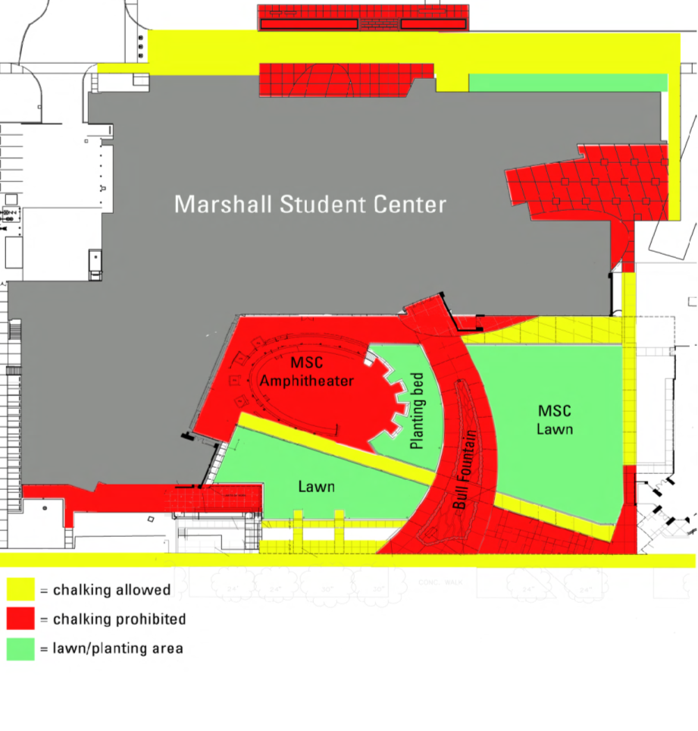
Tampa Campus
Chalking Guidelines
ONLY allowed to chalk where it will be washed away by rain
NO spray chalk please

Slide 21
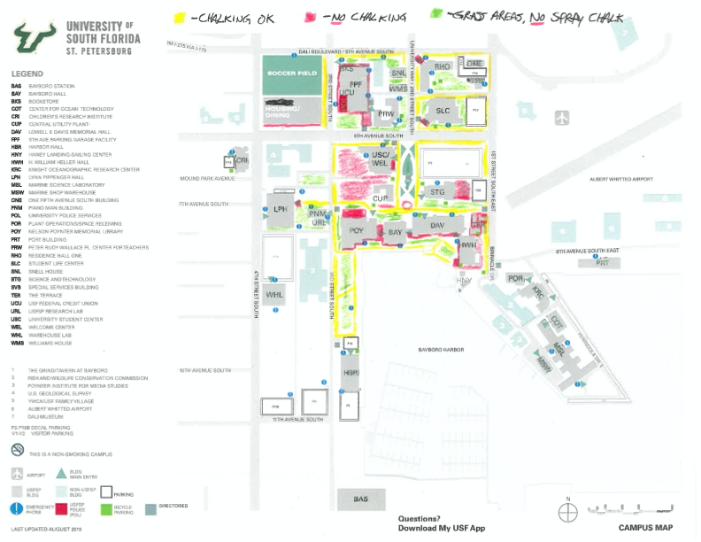
St Petersburg Campus
Chalking Guidelines
ONLY allowed to chalk where it will be washed away by rain
NO spray chalk please

Slide 22
Sarasota-Manatee Campus
Chalking Guidelines
ONLY allowed to chalk where it will be washed away by rain
NO spray chalk please

Slide 23
Major Violations – 706.5.9
Violations are assessed by the Supreme Court
No warning given
One major violation will result in disqualification
Any attempt, successful or unsuccessful, to:
Use force or threats in any way, including for money, favors, or votes
Use money or favors to persuade a person or group to act in a certain way, not including purchases of goods or sponsorships

Slide 24
Major Violations – 706.5.9
Spread false, damaging statements against any person or group
Tamper with voting software
Condoning the commission of any of these actions by others
Campaigning in any Formal department business only group chat during campaigning 706.5.9.2.7.1

Slide 25
Major Violations – 706.5.9
Any use of SG or USF resources to assist or harm a campaign, including:
Using social media pages that are otherwise primarily used for a position, department, or office
Using Listservs or other similar department/office email lists in any way
Using department/office tabling events
Seeking donors or volunteers while on the clock or in the workplace
Actively campaigning while on the clock or in the workplace
Condoning the commission of any of these actions by others

Slide 26
Major Violations – 706.5.9
Any of the following other violations:
Receiving more than the caps specified in SG Statutes 706.3
  $250 per donor (Senate)
Knowingly providing false information to the Supreme Court, the ERC, and/or to SG Advising
Withholding any financial records or any updates to them
Damaging, destroying, or thieving a campaign’s materials
Setting up or operating an unauthorized polling station
Condoning the commission of any major violations by others

Slide 27
Grievances – 706.6
Any complaint brought forth via the grievance form to the Election Rules Commission and can be submitted against a candidate certified to take part in a USF Student Government election.
If you believe that a violation has been committed, fill out an official campaign grievance form. This can be found on either the SG website or in the ERC office.
When filing a grievance you are responsible for providing all evidence against a campaign ticket.

Slide 28
Grievances – 706.6
If a grievance has been filed against you, you will have the opportunity to defend yourself during a grievance hearing.
  Each party will be allowed to make a 5-minute statement.
More information on the grievance process can be found in section 706.6 of Statutes.

Slide 29
Resources
The Elections Rules Commission
  Feel free to stop by during our virtual office hours or send us an email if you have any questions.
Student Government Statutes
  Available on Bull Sync and SG website
  Election procedures, rules, etc. can be found in Title 7

Slide 30
What you need to turn/turned in:
Declaration of Intent (before you leave)
Campaign staff list (if applicable)
Candidate expense sheet and contribution statement should be updated every Friday. The final statements are due on 09/18/2020.

Slide 31
What you need to turn/turned in:
Campaign bio and photo: Thursday, September 10th by 11:59pm
  Supervisor of Elections: Shemarmckoy@usf.edu
Please submit a photo and biography in a single PDF document. The photo must include only yourself and may not include any University or SG trademarks or logos.

Slide 32
Do’s and Don’t of Campaigning
Do not establish an unofficial polling station
Do not commit slander or libel, or damage another candidate’s materials
Do not use or solicit endorsement of university entities
Do not double vote
Always follow the Election Code of Ethics
Familiarize yourselves with Title 7 Statutes
Always contact/email the ERC if you have a question or concern

Slide 33
ERC Contact Information
Shemar Mckoy, Supervisor of Elections: Shemarmckoy@usf.edu
Tampa Campus: Marshall Student Center (MSC), Suite 4300
Atzin Santiago, Deputy Supervisor of Election: atzindtzoara@usf.edu
St. Pete Campus: Student Life Center (SLC) 1500
Savannah Carr, Deputy Supervisor of Elections: savannahc4@usf.edu.usf.edu
Sarasota/Manatee Campus: (SMC) A117
-Bart Stucker, Coordinator of Orientation & Wellness Programs: bstucker@usf.edu
Dahlia Martinez, Deputy Supervisor of Elections: djmartinez@usf.edu

Slide 34
Human Resource Requirements
An employee may not volunteer to perform the same types of duties that the individual is otherwise employed by USF to perform.
Volunteer service may not displace a paid position.
If a student has two paid student positions the students will have to choose between which paid appointment they would like to keep . A volunteer can’t work in a role that would otherwise be paid.
Please Note: Domestic students are limited to 40 hours per week and international students are limited to 20 hours per week.

Slide 35
Questions?

