Slide 1
University of South Florida
Title IX Investigator Training
7/29/2020

Slide 2
Overview
Definition
Role of Investigator
Bias/Prejudice
Overview of Investigative Interview
Managing Expectations
Advisors
Allegations
Elements
Collecting Facts
Preponderance of the evidence
Policy 0-004, 0-020
Notes:
Araiña (2min)

Slide 3
Sexual Harassment
Conduct on the basis of sex meeting one of the following conditions:
-An employee conditioning the provision of an aid, benefit, or service on an individual’s participation in unwelcome sexual conduct (Quid Pro Quo);
– Unwelcome conduct determined by a reasonable person to be so severe, pervasive, and objectively offensive that it effectively denies a person equal access to the recipient’s education program or activity;
– Acts of Sexual Violence: “Sexual assault”, “Dating violence”, “Domestic violence”
Notes:
JVZ (2min- will go more into this when discussing elements)

Slide 4
Role of Investigator
Neutral Fact Finder
Review complaint and allegations
Create investigation timeline
Conduct investigative interviews (parties, witnesses)
Evidence gathering
Document, Document, Document!
(record of investigation, timeline, and all communications)
Complete Final Investigative Report (FIR)
Review all evidence
Synthesize and analyze relevant evidence
Send final report to parties for review and written response at least 10 days prior to hearing
Attend hearing
Notes:
Araiña (3-5mins)

Slide 5
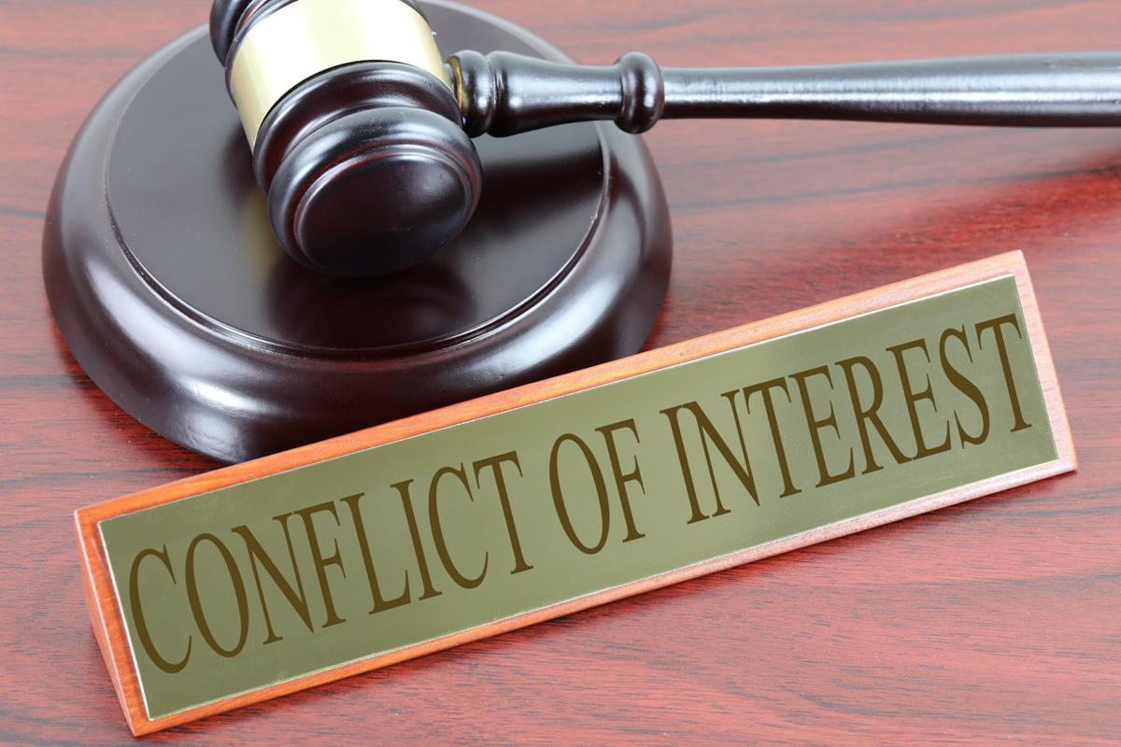
Conflict of Interest
Conflict of interest (positional vs situational)
Recuse yourself if there is a conflict of interest
Situational: Investigators know parties, pre-existing relationship (teacher/student)
Positional: Investigator role at institution creates bias (rare with USF structure)
Any other reason that would prohibit investigator from being neutral
Notes:
Araiña (3-5mins)

Slide 6
Bias and Prejudice
Implicit Bias
Sex stereotyping: The victim as well as the harasser may be a woman or a man. The victim does not have to be of the opposite sex. (eeoc)
Assumptions made about parties status and credibility
Do not assume Respondent is guilty based on status (accused)
Assumptions about parties affiliations
Greek Life, Athletics, Other Affiliations
Race, Ethnicity, Religion, Gender Identity, etc.
Check your assumptions!
REMEMBER: There is NO finding or assumption of responsibility made, until the conclusion of the entire process and the decision maker makes a determination.
Notes:
Araiña (5 mins)

Slide 7
Overview of Interview Meeting
Purpose
Obtain any relevant information interviewee has related to allegations
Setting the stage
Establish rapport
Ensure the interview location is a neutral, private space
Check your surroundings- put away any private/confidential notes, etc.
What is your space conveying?
Review Advisor Role
Review process
Answer any questions party may have before starting interview
Necessary accommodations
Review of Statement
Notes:
AM

Slide 8
Process Advisors
Respondent/Complainant allowed:
ONE Advisor permitted during interview (if party chooses)
Nonparticipating supportive role during investigations
Advisors cannot answer for party
Parties can request breaks and/or time to consult with advisors
Role will differ during hearings (explain to party)
Witnesses not allowed advisor (unless approved by TIXC in advance)
Interpreters (ADA signers or language)
If advisors are disruptive - investigators will remind them of their role one time. If advisors continue to disrupt interview investigators will ask the advisor to leave the interview and give the party the opportunity to reschedule
Notes:
AM

Slide 9
Allegations (NOI/A)
Read Notice of Investigation/Allegations
Investigators are only investigating allegations in NOI
The NOI= investigator swim lane
If other allegations come to light contact the TIXC before asking respondent about allegations.
New NOI must be issued for any additional allegations investigated
Review allegations and necessary elements

Slide 10
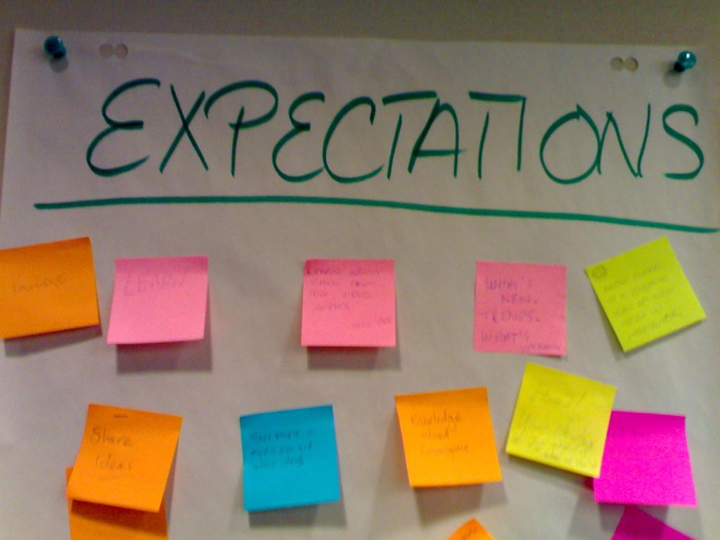
Managing Expectations
Role of advisor
Timeline
Process
Confidentiality/privacy
Notes:
AM

Slide 11
Investigative Interview
Questioning:
Be Prepared!
Review case file in advance
Prepare questions in advance and review with co-investigator
Make sure note taker has questions in advance
Strategize who will ask what- with co-investigator
Be flexible
Schedule enough time (for interviews
2.5-3 hours for Complainant/Respondent (depending on allegations, length of complaint)
Witnesses 1.5 hours (depending)
Notes:
AM

Slide 12
Elements
Sexual Harassment, as an umbrella category, includes the offenses of sexual harassment, sexual assault, domestic violence, dating violence, and stalking, and is further defined as conduct on the basis of sex that satisfies one or more of the following:
1. Quid Pro Quo Harassment: A USF employee, conditions the provision of an aid, benefit, or service of the recipient, on an individual’s participation in unwelcome sexual conduct; or
2. Sexual Harassment: Unwelcome conduct based on sex determined by a reasonable person to be so severe, pervasive, and objectively offensive that it effectively denies a person equal access to the school’s education program or activity; or
3. Sexual Assault: Rape, fondling, incest, statutory rape, Domestic Violence, Dating Violence, Stalking
Notes:
JVZ

Slide 13
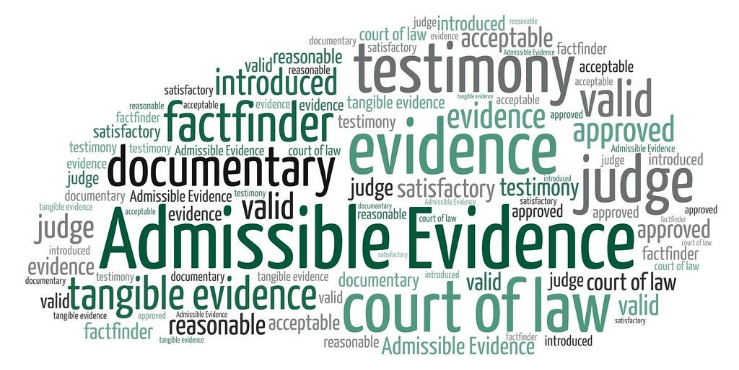
Evidence
Collecting Evidence- Investigator responsibility to collect evidence
Relevancy (related to allegations)
Determining what is relevant
Preponderance of the Evidence Standard:
-The standard against which information and evidence gathered during the investigation is assessed.
- The preponderance of evidence standard practically means
“more likely than not”
Notes:
JVZ

Slide 14
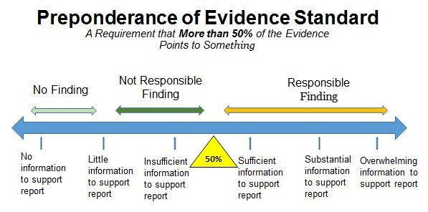
* investigators do not make findings
Notes:
JVZ

Slide 15
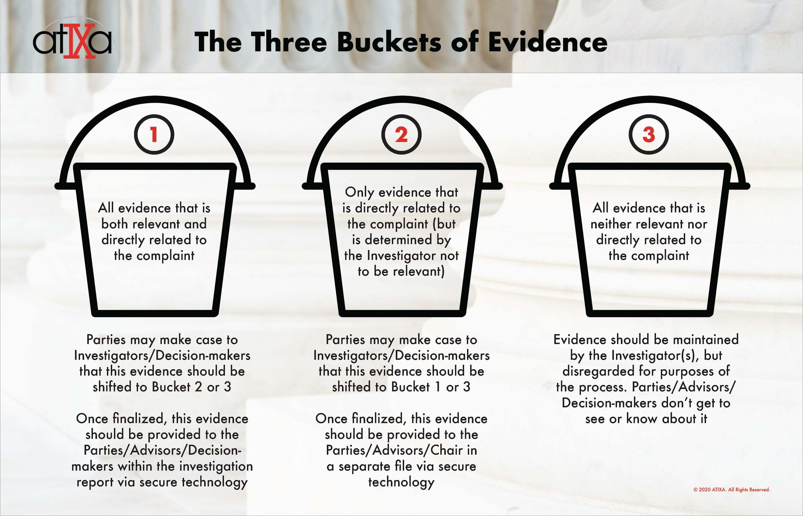
Notes:
JVZ

Slide 16
Report Writing
Use FIR Template
Stick to the FACTS (no opinions)
Avoid pronouns and names in report
Reduces potential reader bias
Promotes privacy (assists with future redactions (when applicable)
What to include:
Inculpatory evidence
Exculpatory evidence
Relevant information from witness statements
Analyzing Facts (allegations, facts collected, necessary elements)
Include all procedural steps taken

Slide 17
10 Day Commenting Period
After TIXC reviews draft of FIR and ensures all procedural elements met:
Share copy of FIR with Complainant and Respondent via Box
Parties have opportunity to provide comments on the FIR before it becomes final.
Investigators will review comments and record response to comments and/or make changes (if applicable).
If any changes made to FIR send out final FIR to party’s and to hearing administrative office (SCED/HR/AA).
At least 10 days before a hearing.
Notes:
JVZ/AM

Slide 18
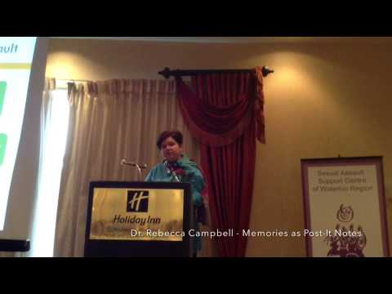
Effects of Trauma on Brain
Both parties may be experiencing trauma
Information may not be linear
Start with open ended questions
Notes:
AM

Slide 19
QUESTIONS?

Slide 20
Resources and References
Office for Civil Rights (OCR): https://www2.ed.gov/about/offices/list/ocr/newsroom.html#:~:text=%E2%80%9CTitle%20IX%20makes%20clear%20that,inside%20and%20outside%20the%20classroom.
Equal Employment Opportunity Commission (eeoc): https://www.eeoc.gov/fact-sheet/facts-about-sexual-harassment#:~:text=Unwelcome%20sexual%20advances%2C%20requests%20for,an%20individual's%20work%20performance%20or
Violence Against Women Act (VAWA): https://www.acenet.edu/Documents/VAWA-Summary.pdf
atIXa: https://atixa.org/

