Slide 1
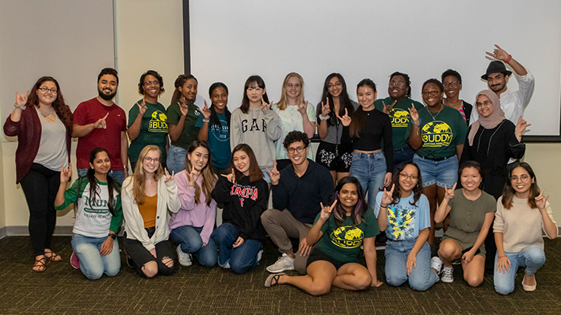
Welcome to USF!
Guidance for complying with the State of Florida Immunization Requirements
Strengthened by Diversity. We are USF.

Slide 2
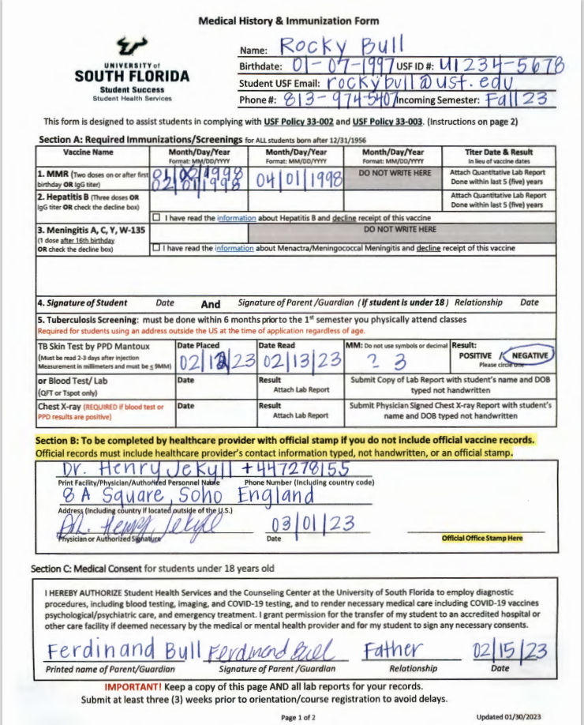
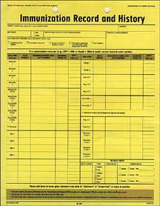
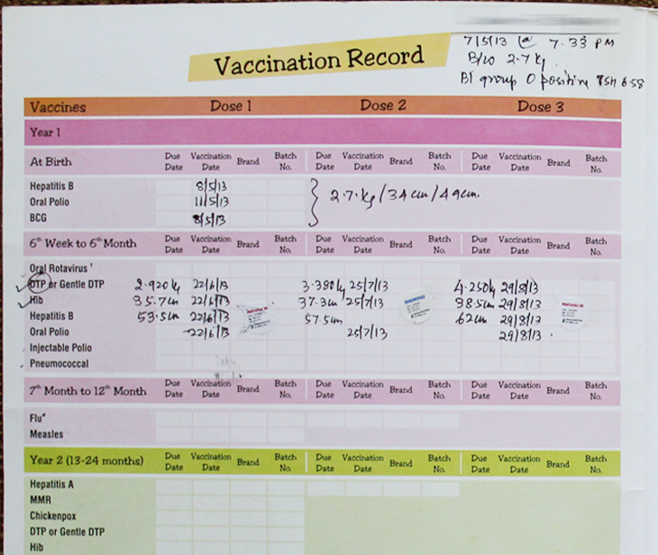

Step 1: Gather your vaccine records and review
Vaccine records complete?
Vaccine records not complete?
Make sure your personal records includes:
your full legal name, date of birth and health care provider’s contact information.
If your records are not complete, have your medical provider complete the USF Medical History and Immunization form

Slide 3

USF Medical History & Immunization form
No Corrections/Edits Allowed
USF Student Health Services will not accept/review documents altered/corrected in any way, including using correction fluid.
Tip: bring multiple blank copies to your medical provider in case the person completing the document makes a mistake.

Slide 4
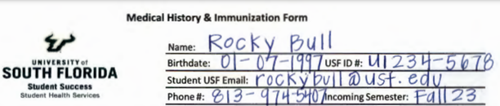
TOP PORTION OF FORM: Student May Complete

Slide 5
Item #1: MMR Vaccination
(Measles, Mumps, Rubella)
Your medical provider must document your vaccination dates or attach quantitative lab report
  USF will not accept any MMR received before your first birthday
  Second MMR should be received no earlier than 30 days after your first MMR

Slide 6
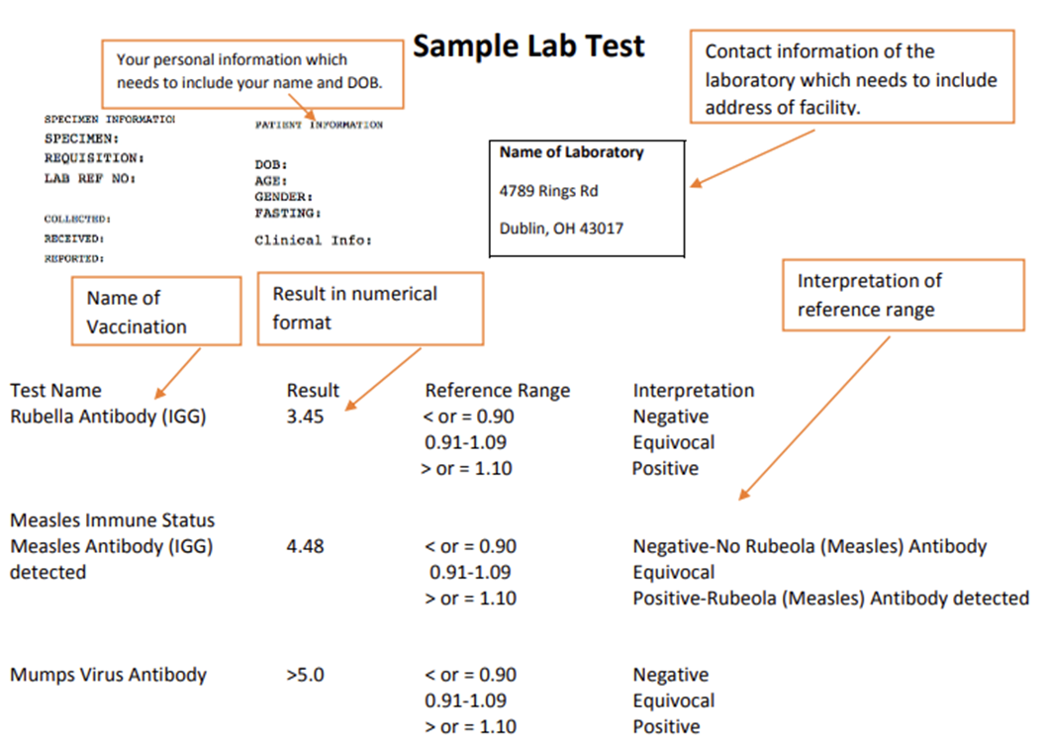
Blood Titer Test Lab Report for MMR
Blood Titer Tests must be within the last five years of a student’s program start date
Information on the Lab Report must include the student’s full name and date of birth as well as complete contact information for the laboratory
Information may not be written onto this document. It must either be typed or stamped

Slide 7
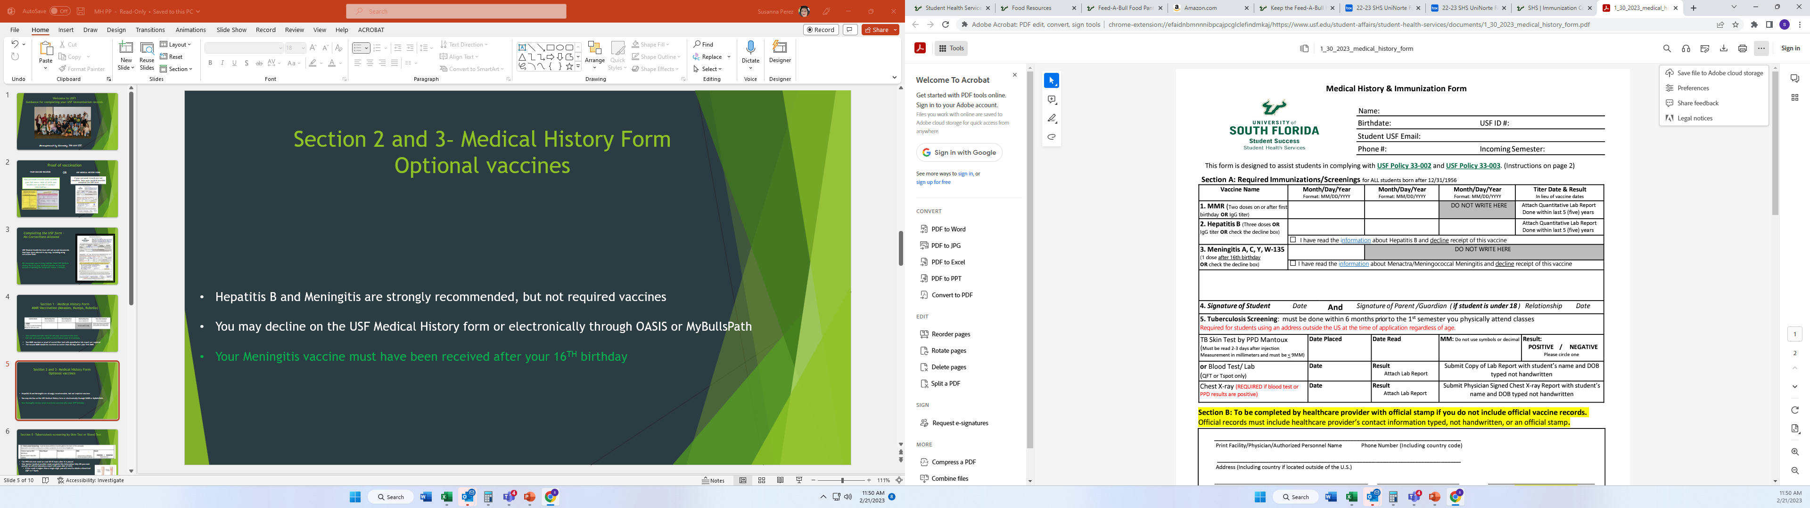
Items #2 & #3
Optional Vaccines
The State of Florida strongly recommends the Hepatitis B and Meningitis vaccinations
  Meningitis vaccine valid if received after your 16TH birthday
  You may decline/opt out of either vaccine on the form or electronically via OASIS or MyBullsPath
  Students will receive a hold on their USF accounts if they do not decline or show proof of these immunizations

Slide 8
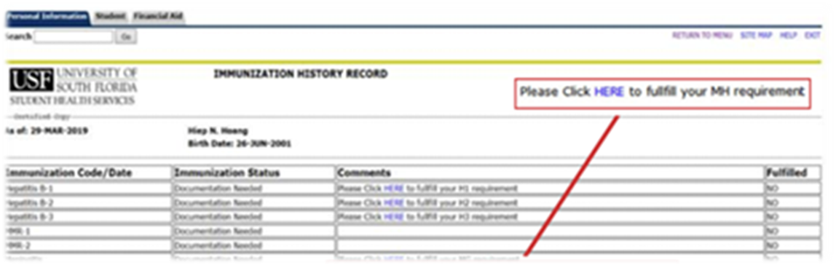
How to Decline Optional Vaccines Electronically
1. Log in to your MyUSF account by going to www.usf.edu
2. Log in to OASIS
3. Go to Personal Information
4. Go to View Immunization Records
5. For Hepatitis B and/or Meningitis, click on the hyperlink, HERE, and decline the vaccine(s)

Slide 9
Item #5 Tuberculosis screening
Must be completed within 6 months prior to 1st semester you physically attend USF
Summer (A & C) 2024: November 13, 2023 – May 13, 2024
Summer (B) 2024: December 24, 2023 – June 24, 2024
Fall 2024: February 26, 2024 – August 26, 2024

Slide 10
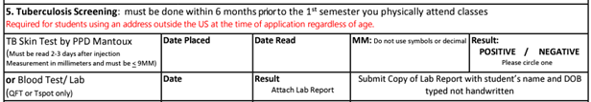
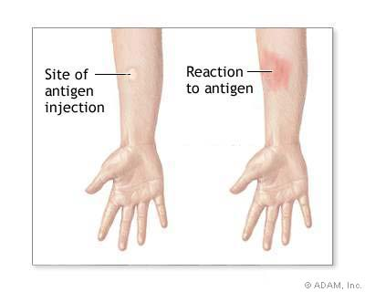
Item #5 Tuberculosis screening by Skin Test or Blood Test
TB Skin Test by PPD Mantoux must be read 48-72 hours after it is placed
Your medical provider must complete all sections fully or attach an official lab report with your full legal name and date of birth (month/day/year)
  Age is not a substitute for date of birth
USF will NOT accept the following in the ‘MM’ results box:
  Symbols such as “x,” (7 mm x 9 mm) or “<,” or “>” (>2mm or <2mm) will NOT be accepted
  Decimals such as 2.5 and .4 will NOT be accepted

Slide 11
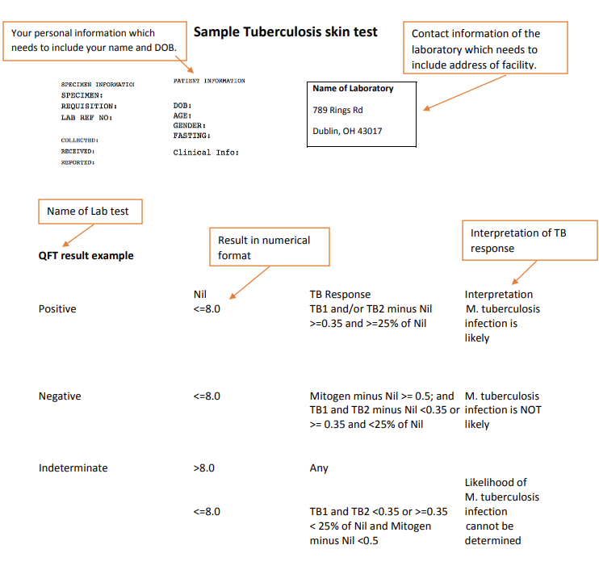
QuantiFERON (QFT) or T-Spot Blood Tests are Accepted
Information on the Lab Report must include the student’s full name and date of birth as well as complete contact information for the laboratory
TB lab reports must include the name of the lab test, a numeric result as well as an interpretation of the TB response
Information may not be written onto this document. It must either be typed or stamped

Slide 12
Item #5 (continued) Tuberculosis screening by Radiology Report
If you tested positive on the skin test or blood test (QFT or T Spot), you will need to provide the radiology report detailing the findings of your latest chest X-Ray (DO NOT SEND the IMAGES)
Radiology Reports will only be reviewed if accompanied with proof of a positive blood test.
1. Official radiology report must include a physician's signature and stamp
2. Contact information: Street address, city, country, telephone number + country
3. Students’ full name and date of birth
4. A narrative report including detailed summary of findings (please don't send chest x-ray images).

Slide 13
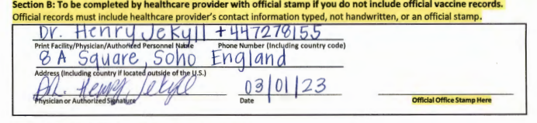
Section B: Medical Provider Verification
1.
2.
3.
6.
5.
4.
Make sure that your Medical Provider has fully completed the section:
Name of doctor’s office, hospital or medical provider
Phone number, including the country code
Street address, including the city and country
Signature from physician or authorized personnel
Date (Month, Day, Year)
Office Stamp (must be readable)

Slide 14
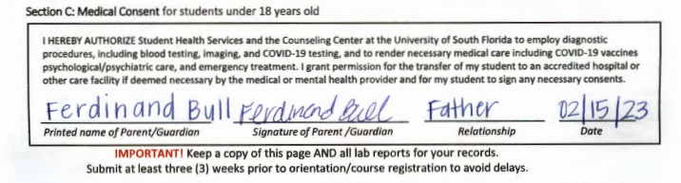
Section C – Medical Consent for Minors (Student younger than age 18)

Slide 15
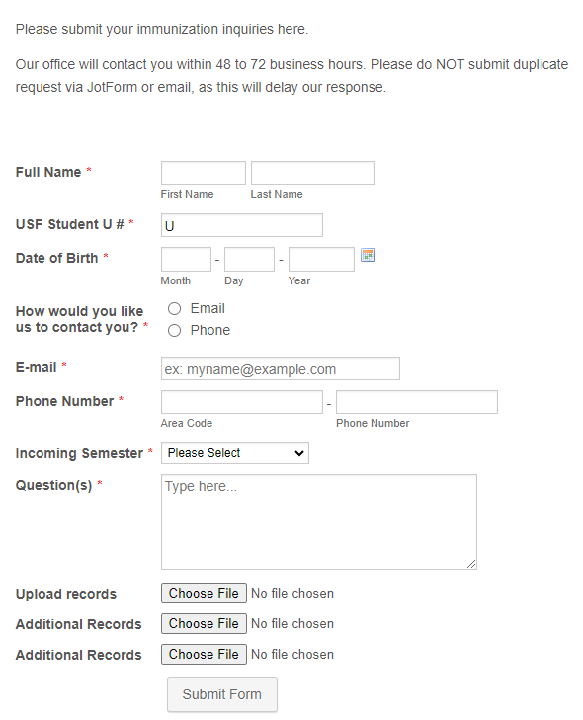
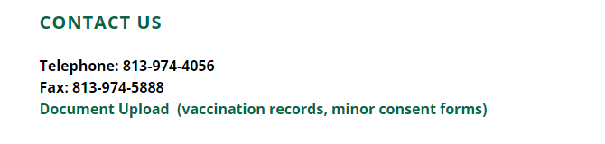
If you have questions, please visit
Webpage usf.edu/SHS and Select the “IMMUNIZATION” tab
For questions, please use this electronic jotform https://www.jotform.com/form/212995896332167

Slide 16
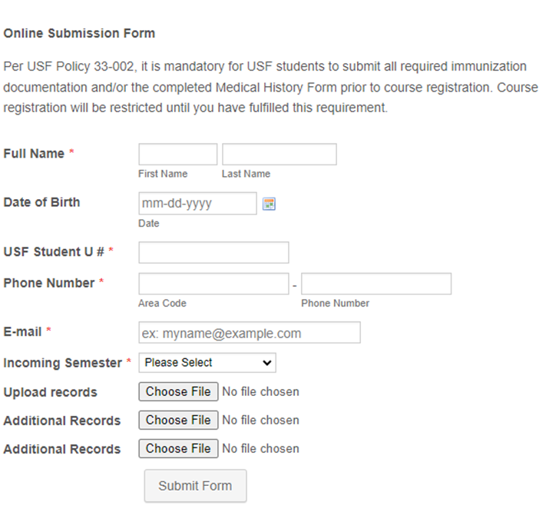
Ready to Submit Your Documents?
To submit vaccination documents please upload via this link https://form.jotform.com/211335806421144

Slide 17
Translated Documents Require the Following:
Stamp of translator
Signature of translator
Contact details of translator (street address, city, country, phone number + country code)

Slide 18

Immunization Compliance Appointment Request Form
Schedule an online appointment at the USF Clinic:
  https://form.jotform.com/211114735926150
After scheduling your appointment, you will be provided a temporary override, allowing you to register/pre-register for classes.
This override will expire the day after your appointment.
If you do not show up on time for your appointment, a hold will be placed on your account, and you will be cancelled from your classes

Slide 19
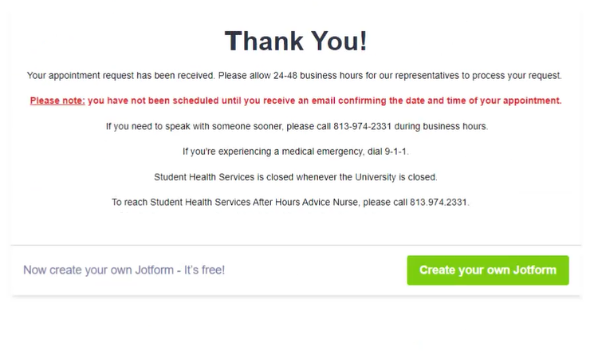
You will receive this confirmation when you successfully schedule your appointment

Slide 20



Thank you for your attention!

Slide 21

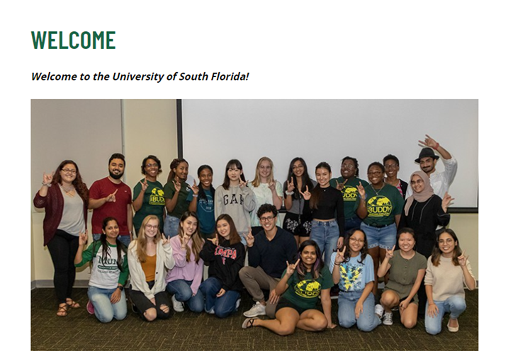
Systems used by USF students
Arrival Tips
Airport Transport, Housing, Insurance and Immunization information
Banking, Florida Driver’s License, Weather, Engagement, and Safety Information
https://www.usf.edu/world/for-students/international-students/international-onboarding/index.aspx

